Slide 1
Marketing
How the big brands do it.

Slide 2
The Plan
How big brands do marketing
How small brands should do marketing
Diagnosis
Strategy
Tactics

Slide 3
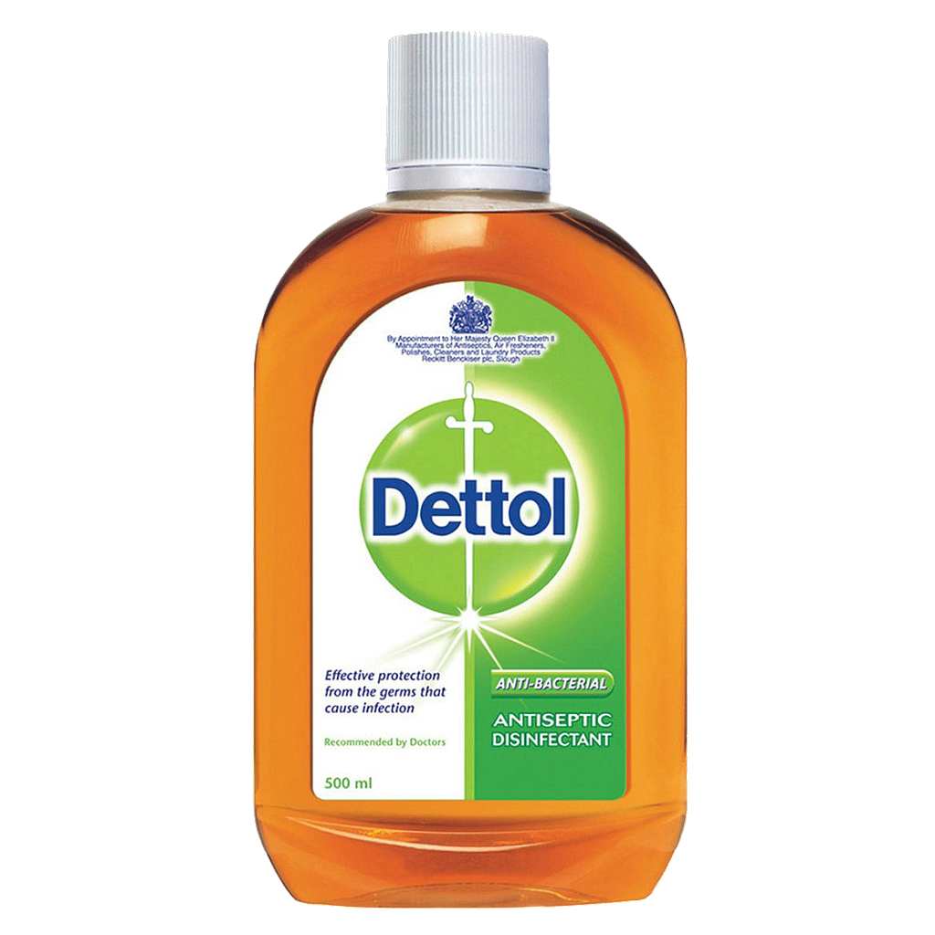
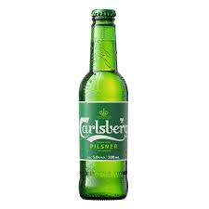
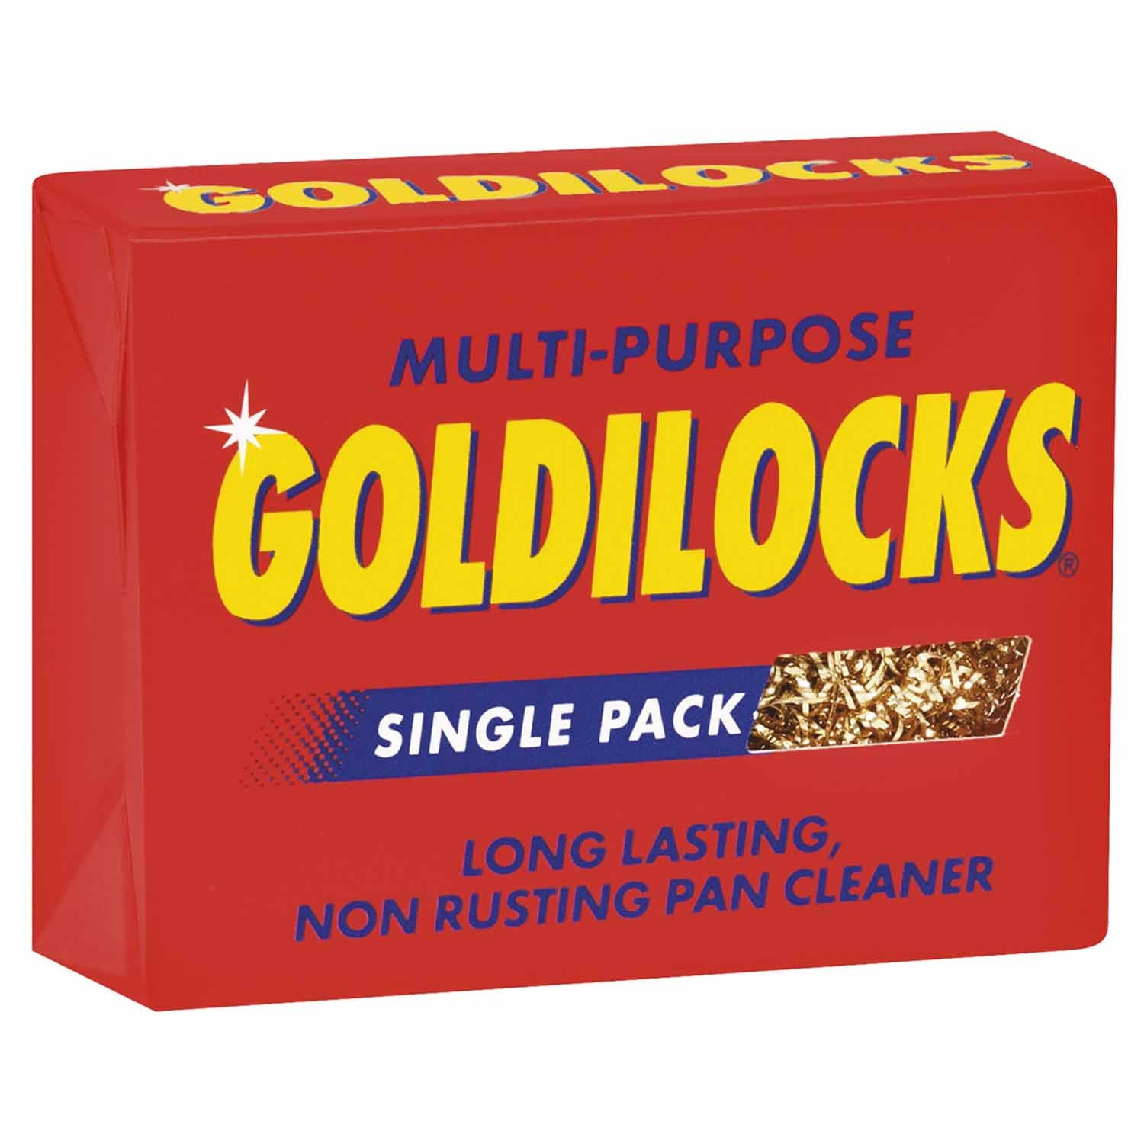
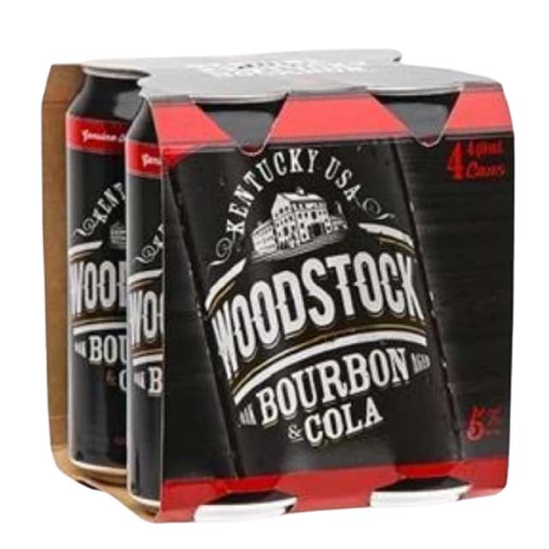
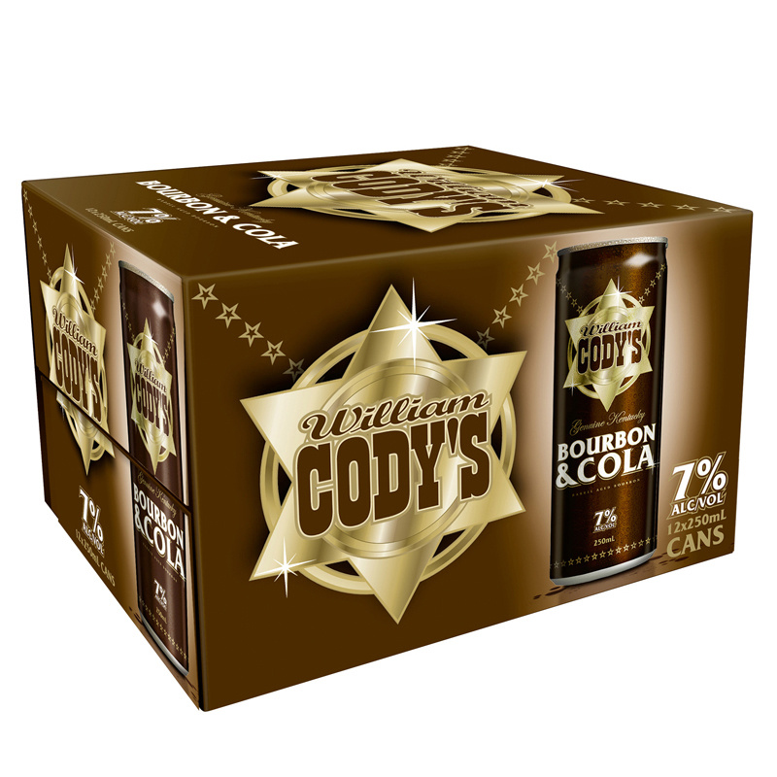
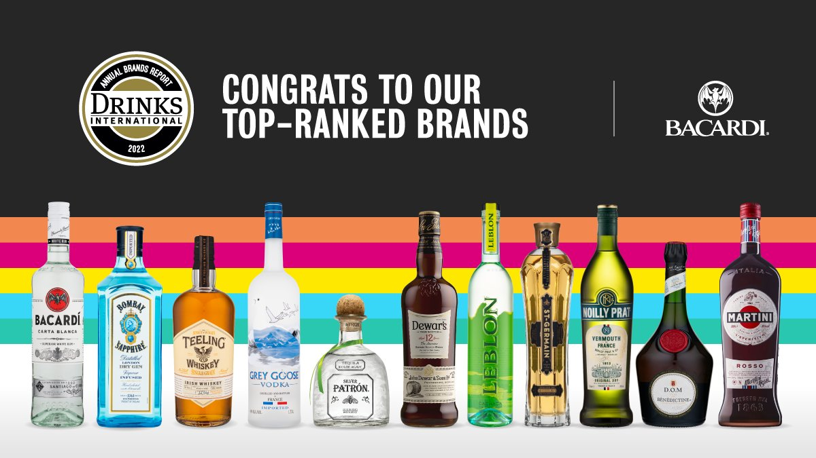
Kane

Slide 4
The Plan
How big brands do marketing
How small brands should do marketing
Diagnosis
Strategy
Tactics
Notes:
Too often small companies, new brands, starts ups…get straight into Tactics
It’s what we see as consumers…. but it’s not what we do as marketers
YOU MUST get the diagnosis right first, then move into strategy and only then tactics
Socks and then shoes
So I want to spend some time

Slide 5
Diagnosis

Slide 6
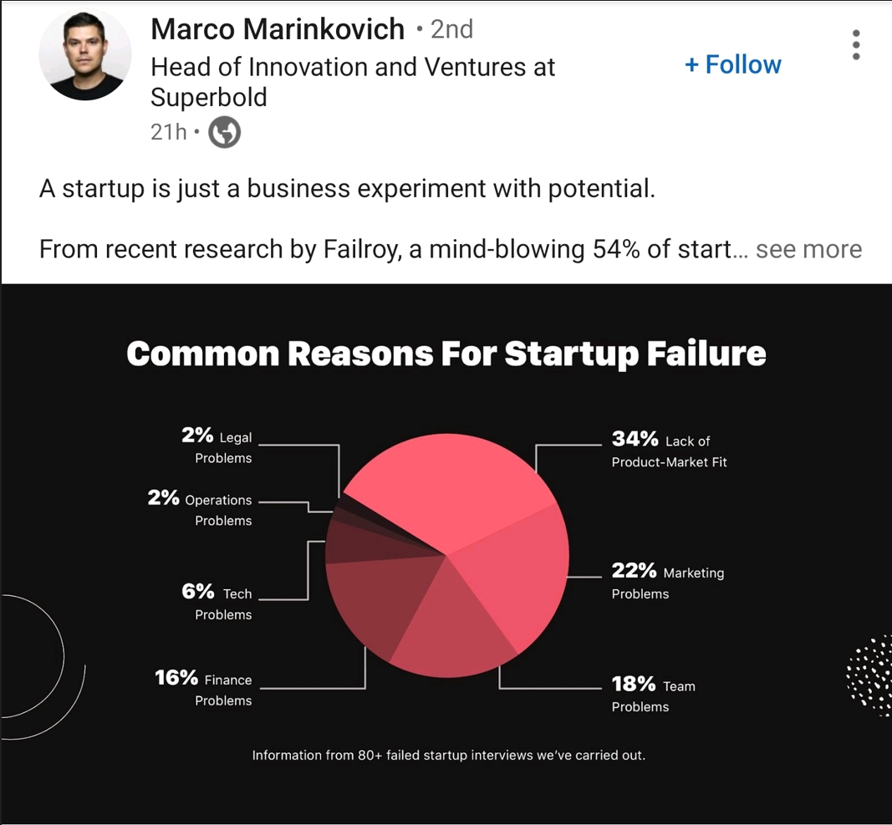
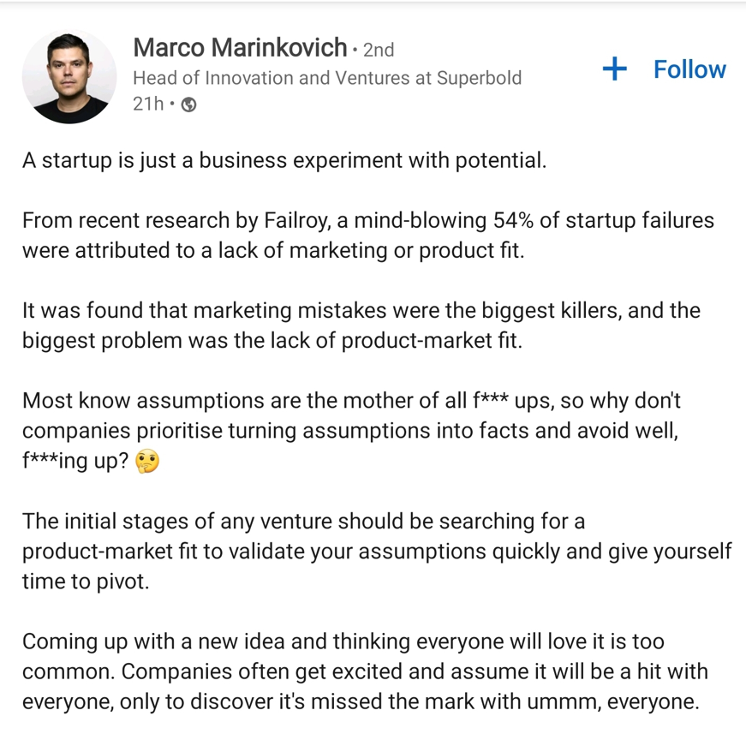

Slide 7
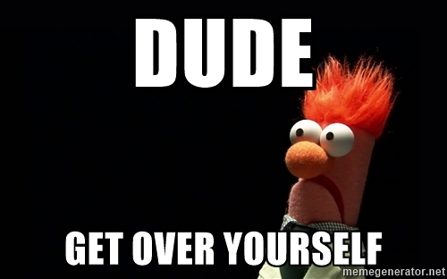

Slide 8
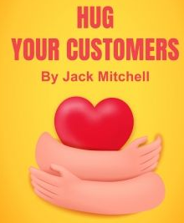
Put the customer at the heart

Slide 9
Put the customer at the heart
It’s not about:
You
Your passion
Your ingredients
Your origin story
Your ingredients
Your bottle
It is about:
How it tastes
How it makes them feel
How it makes them look
How they use it
Why they buy it
When they consume it

Slide 10
Put the customer at the heart
BENEFITS
FEATURES
It’s not about:
You
Your passion
Your ingredients
Your origin story
Your ingredients
Your bottle
It is about:
How it tastes
How it makes them feel
How it makes them look
How they use it
Why they buy it

Slide 11
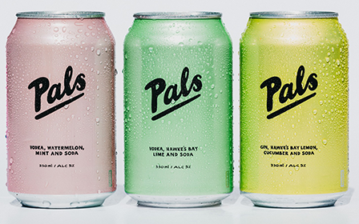
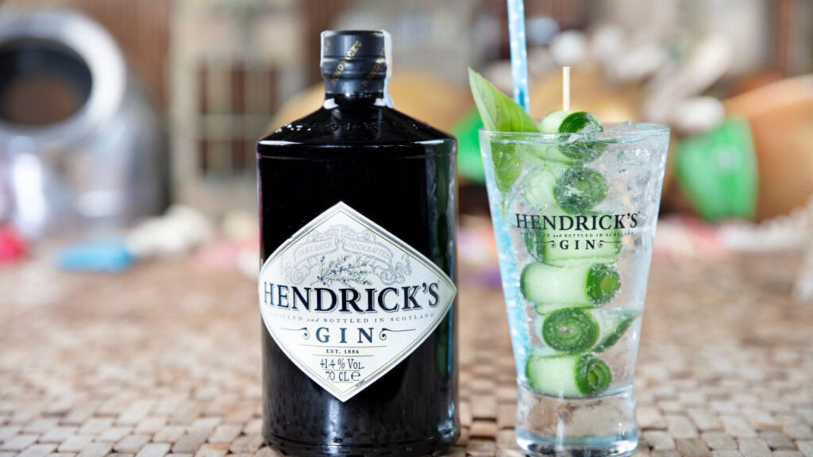
BENEFITS

Slide 12
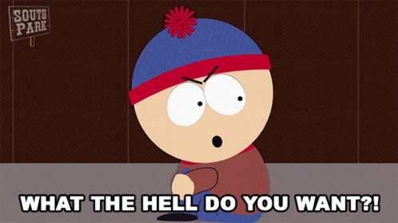
BENEFITS

Slide 13
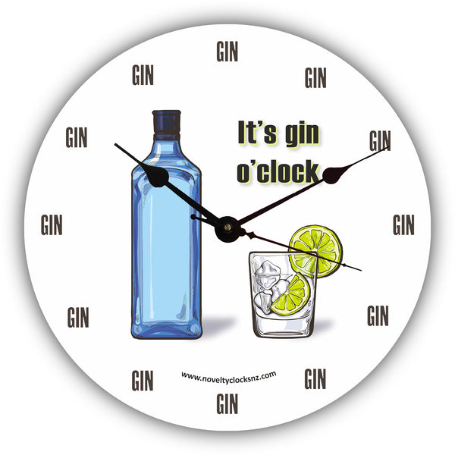
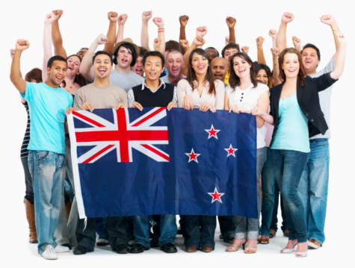
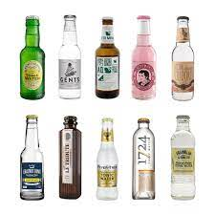
Put the customer at the heart
Know them to grow them
Who they are
When they drink
What else they drink
How they consume

Slide 14
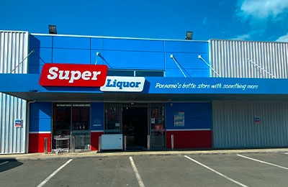
Put the customer at the heart
Know them to grow them
Where they drink
How often they buy
How they heard about you
Where they bought from

Slide 15
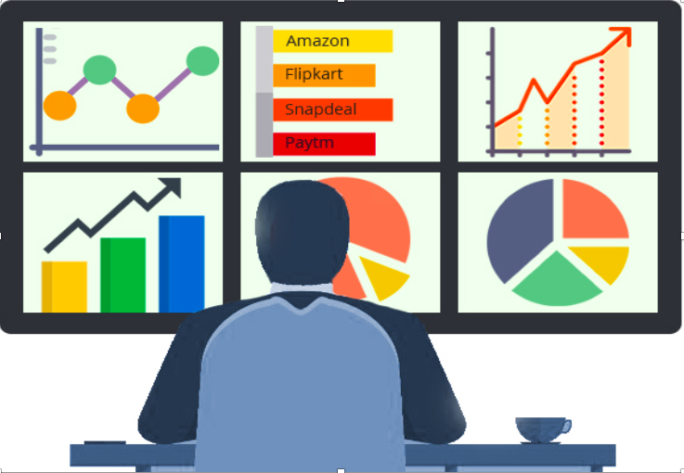
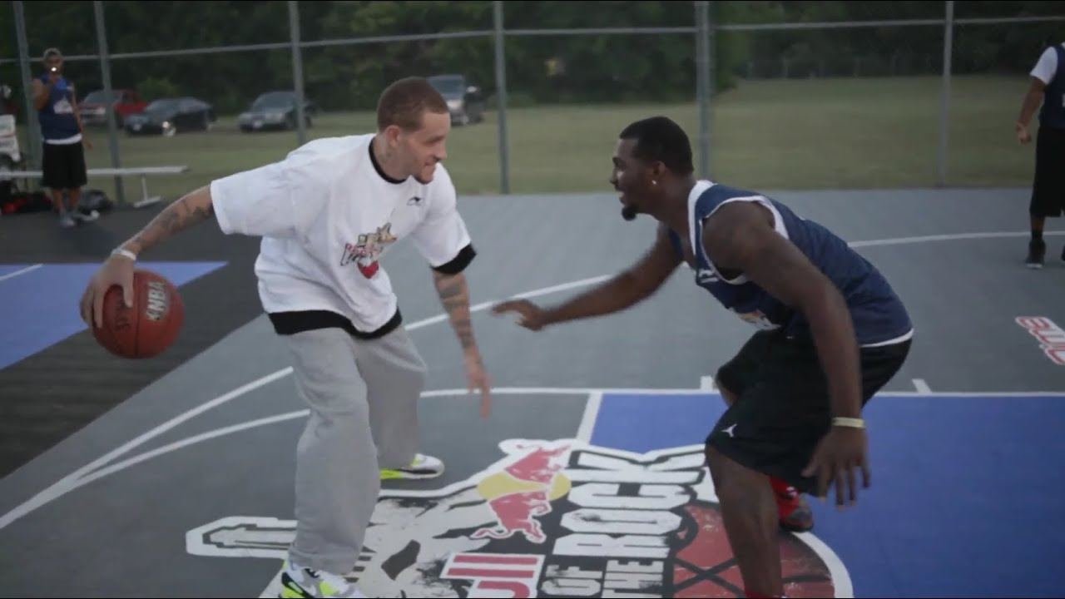
You can do it!
Know them to grow them
Survey Monkey
One on ones
Small groups
Sales data

Slide 16
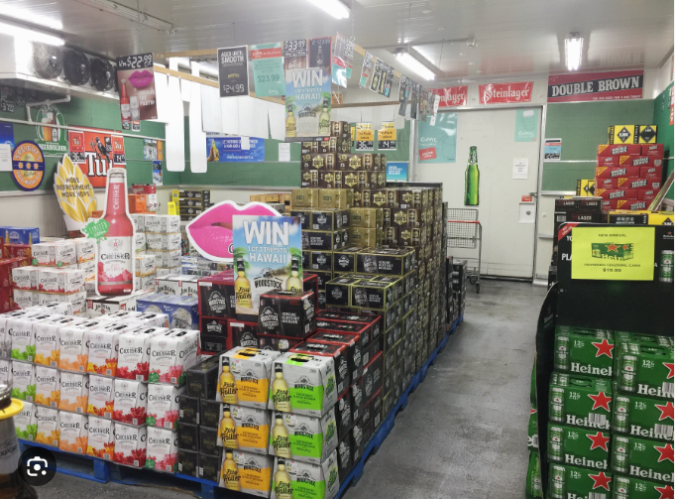
Notes:
Get out in to stores

Slide 17
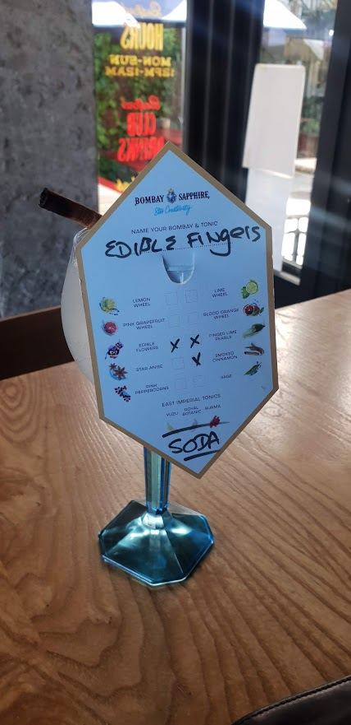
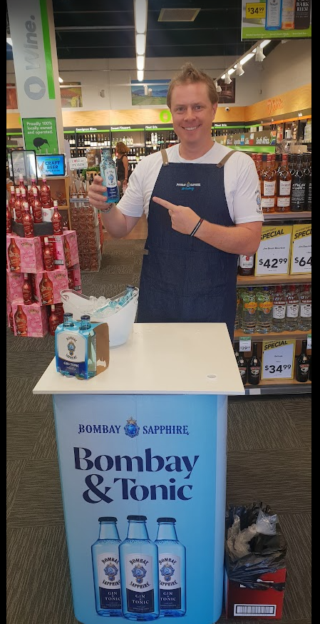
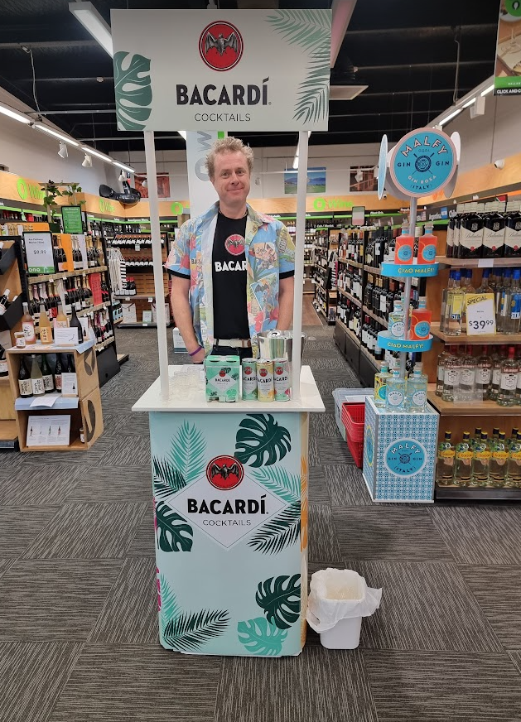
Notes:
Hang out where your customers make decisions

Slide 18
What are you looking for
Who are the main groups of potential buyers
What are their unmet needs
How can you delight them

Slide 19
Strategy

Slide 20
Strategy
Objectives
Target audience
Positioning
Consistent look and feel

Slide 21
Positioning
What is your target’s unmet need and how can you delight them?
What word/phrase can you own in people’s mind?

Slide 22
Positioning Statement
To [target audience], our brand is the [category] that provides [benefit] because [features/ reason to believe]

Slide 23
Positioning Statement
To families, Volvo is the car that provides peace of mind because safety is our priority

Slide 24
Positioning Statement
To active humans, Powerade is the lifestyle drink that provides maximum hydration because our unique formula and 4 different electrolytes

Slide 25
Positioning Statement
To NZ Distillers, DSA is the association that provides advocacy, support and advice because we have a team of fellow distillers with experience and skills

Slide 26
What your customers want
What you can deliver
YOUR POSITION
A space that is not too crowded

Slide 27
Positioning Statement
Once you land on your position, FOCUS FOCUS FOCUS

Slide 28
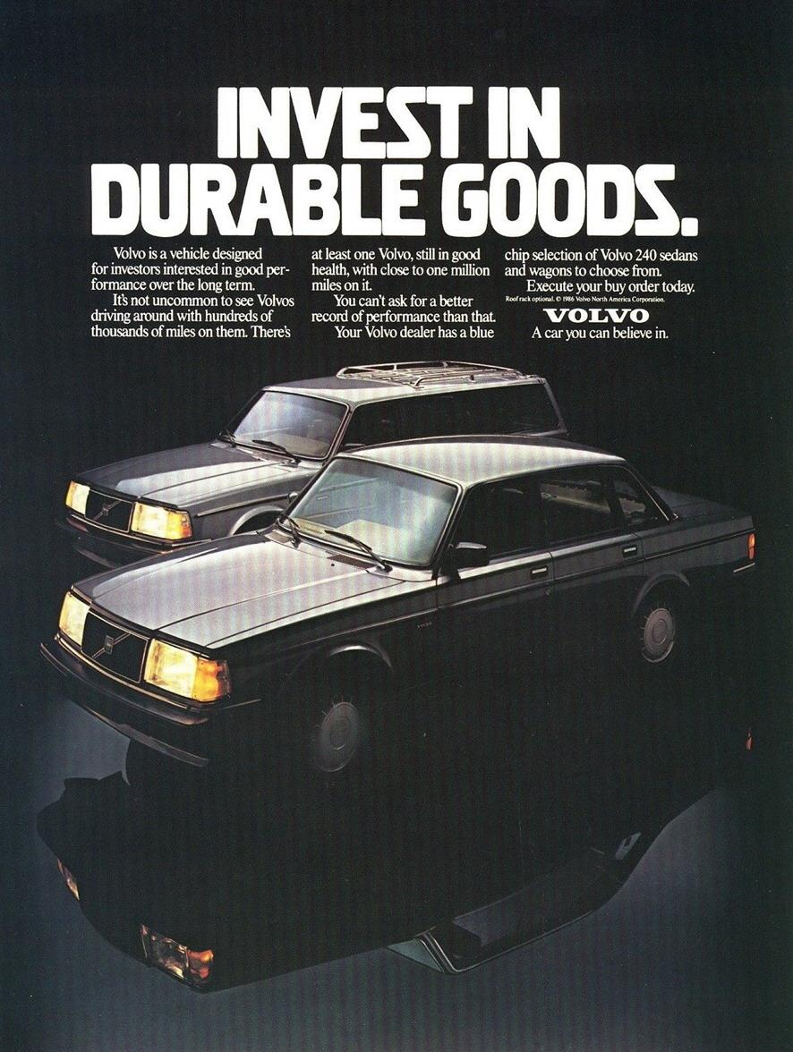

Slide 29
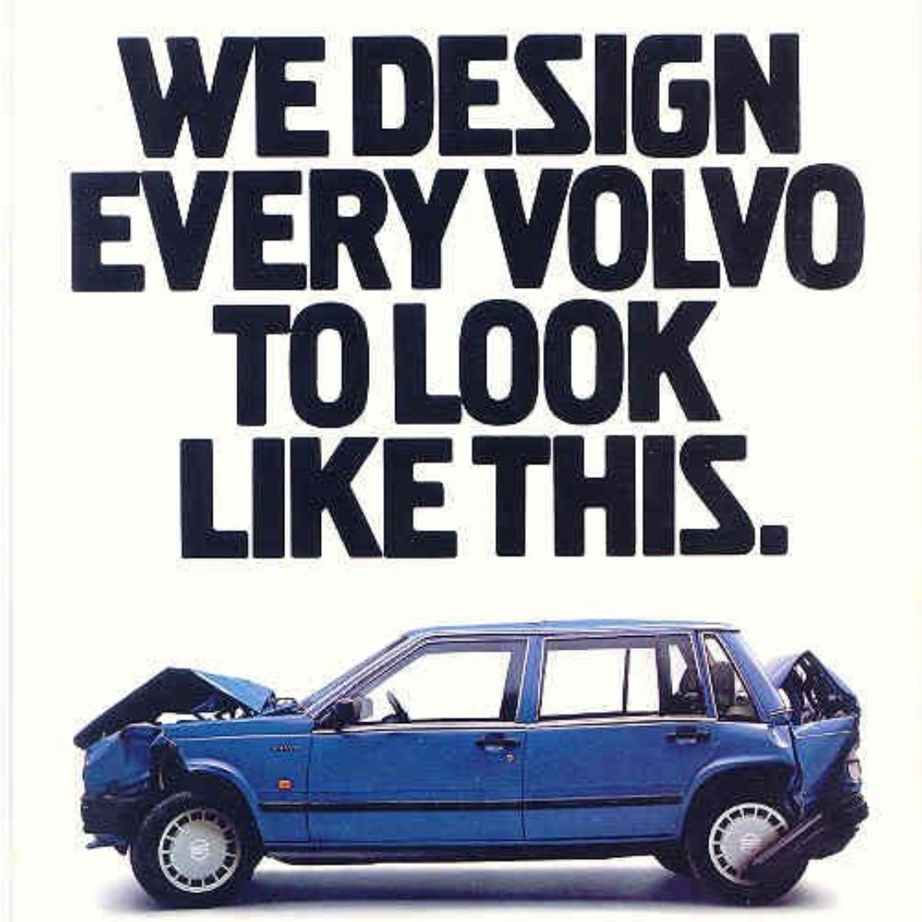

Slide 30
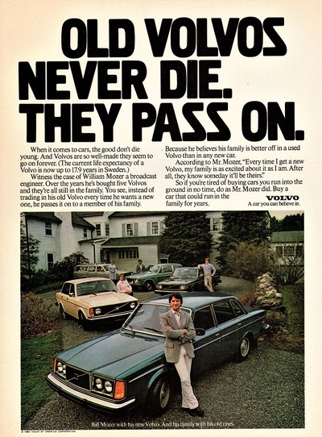

Slide 31
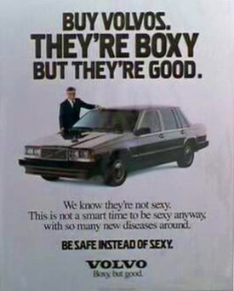

Slide 33
Strategy
Objectives
Target audience
Positioning
Consistent look and feel
Notes:
Be brave, be willing to take a stand, annoy people outside your target audience

Slide 34
Tight position, wide reach
People that buy all booze
People that only buy spirits
People that only buy gin
People that only buy your gin
Notes:
Most of your buyers will be light buyers

Slide 35
Tactics

Slide 36
Tactics
Price
Product
Place
Promotion
Notes:
Based on your questions

Slide 37
Promotion
Social media / print / targeting
Which media channels strike chords with which customers? Who is influenced by what?
Have a position, stick with it, maximise reach – mental availability.
Whatever gets you the most reach
Then make sure you are there when the buyers are buying – physical availability
Distribution
In store tastings
Display stands
Neck tags
Price promotion

Slide 38
Promotion
add-ons - upsizes, bonuses Do these help? – yes, anything that makes you stand out in store
outers /do they matter in the deluxe segment – yes for displays, free chance to get your logo in sight
Word of mouth – Be loved, find fans, reward fans
What would be your approach to marketing if you had no money in the marketing budget?
FOCUS.
In-store Tastings
Free stock to someone on insta with
Grow your own social profile
Get some budget

Slide 39
Place
What to do with Distributors?
How to get into Bars?

Slide 40
Distributors/Bars/Retailers
Alignment
Your job
Their job
What is your strategy, and can they deliver on that?
What is their strategy, and can you help them with that?
Have a VERY clear position, occasion, drink
Be the best brand they deal with
Best margin
Best support
Best relationship
Best plans
Best innovation pipeline
Best training
Marketing
Sales
Distribution
HELP THEM HELP YOU

Slide 41
Nearly there…

Slide 42
The Plan
How big brands do marketing
How small brands should do marketing
Diagnosis
Strategy
Tactics
Notes:
Spend time of diagnosis and strategy
Say no
Strategy is about naking some choices

Slide 43
Thank you

