Slide 1
National Programme 3 (NP3) and Auditing Valerie Adams
1

Slide 2
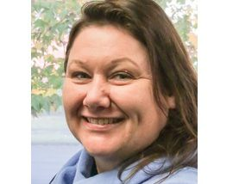
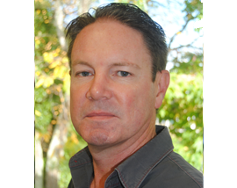
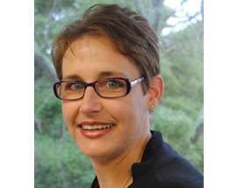
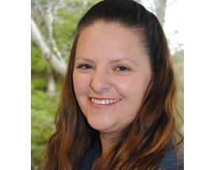
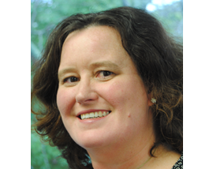
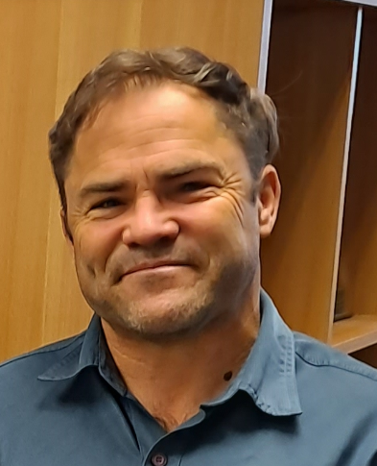
All Systems Go and All Systems Go Auditing Leading IT Solutions and Food Safety Services Provide Consulting, Auditing and Verification Services IT Hardware and Software Suppliers Team members based in Auckland, Hamilton, Napier, Wanganui and Christchurch
2
Notes:
The ASG Food Safety team work with clients to ensure that their processes and associated documentation meet New Zealand Regulatory requirements, Customer requirements, or Global Standards, that are required for their sector and market.
The ASG Auditing team have been verifying against the Food Act 2014 from its inception and has provided National Programme 3 verification services for many Distillers in New Zealand.

Slide 3
What is a National Programme 3 (NP3)
Developed to meet the Food Act 2014 and Food Regulations 2015 requirements.
Distillers fall under the NP3 category as they are categorised as a medium-risk businesses.
The NP3 Guidance outlines the food safety rules, so you don’t need to read the fine print. ☺
3
Notes:
The Food Act 2014 helps make sure that food and beverages sold throughout NZ are safe.
It has a sliding scale where businesses that are higher risk, from a food safety point of view, will operate under more stringent food safety requirements and checks than lower-risk food businesses.
Distillers fall under the National Programme 3 category
National P
The Food Act 2014 helps make sure that food and beverages sold throughout NZ are safe. The Food Regulations 2015 sets out the guidance to achieve the Act requirements.
programme 3 sets the food safety rules for medium-risk businesses.

Slide 4
5 Steps to Register
1: Check that your business fits with NP3
2: Before you register, contact a Verifier
To register you must have a letter from a verifier agreeing to conduct the verification
3: Register with your local Council or MPI
Contact verifier and arrange a visit. Your verification will occur approximately 4-6 weeks after registration
4: Make safe food/beverage
You can start making your product commercially, keeping records.
You do not need to wait for the verification.
5: Get checked/ verified
4
Notes:
STEP 1: CHECK THAT YOUR BUSINESS FITS WITH NP3
STEP 2: MAKE SAFE FOOD/Beverage
Follow good food safety practices and keep some written records of what you do.
STEP 3: BEFORE YOU REGISTER, CONTACT A VERIFIER
Arrange for a verifier to check your business. Skills and capacity.
STEP 4: REGISTER WITH MPI OR YOUR LOCAL COUNCIL
You must register with your local council or MPI, and renew your registration every 2 years.
STEP 5: GET CHECKED
Once you have registered, a verifier or auditor must visit your business and check you are making safe food.

Slide 5
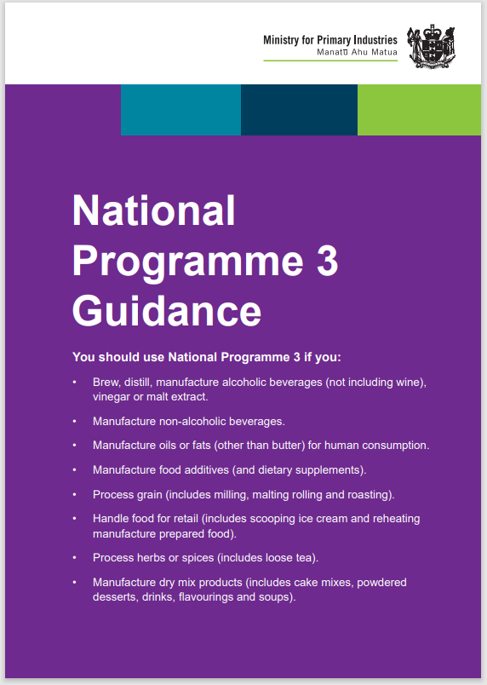
What do I need for a NP3
Obtain the NP3 Guidance document
Review requirements
Follow applicable sections
5
Notes:
Note these are the minimum requirements. It doesn’t stop you from writing a full Food Control Plan if you want to or writing SOP’s (standard operating procedures for cleaning or distilling or………..
What’s in the NP3 Guidance
Note these are the minimum requirements. It doesn’t stop you from writing a full Food Control Plan if you want to or writing SOP’s (standard operating procedures for cleaning or distilling).
The GREEN pages outline information about setting up your business and staff training.
The BLUE pages outline information about cleaning and sanitising, maintaining equipment and facilities, and personal hygiene.
The ORANGE pages outline information about control steps commonly used in NP 3 businesses. These procedures have already been proven to reduce or eliminate hazards so food is safe and suitable. You only need to use the orange pages which apply to your business.
The RED pages outline what to do when something goes wrong

Slide 6
How to use the NP3 Guidance
The guidance is dividend into colour coded cards which contains topics to be covered
GREEN
Setting up your business
Staff training.
BLUE
Cleaning and sanitising,
Maintaining equipment and facilities
Personal hygiene.
ORANGE
Control steps commonly used in NP 3 businesses.
These procedures have already been proven to reduce or eliminate hazards, so food is safe and suitable.
You only need to use the orange pages which apply to your business.
RED
What to do when something goes wrong
6
Notes:
Note these are the minimum requirements. It doesn’t stop you from writing a full Food Control Plan if you want to or writing SOP’s (standard operating procedures for cleaning or distilling or………..
What’s in the NP3 Guidance
Note these are the minimum requirements. It doesn’t stop you from writing a full Food Control Plan if you want to or writing SOP’s (standard operating procedures for cleaning or distilling).
The GREEN pages outline information about setting up your business and staff training.
The BLUE pages outline information about cleaning and sanitising, maintaining equipment and facilities, and personal hygiene.
The ORANGE pages outline information about control steps commonly used in NP 3 businesses. These procedures have already been proven to reduce or eliminate hazards so food is safe and suitable. You only need to use the orange pages which apply to your business.
The RED pages outline what to do when something goes wrong
Know has general information about why this topic is important to food safety and gives ideas for how you can comply with food law. Do outlines what you must do to comply with the food safety laws. Show outlines what your verifier will ask you to demonstrate or the records they will expect to see.

Slide 7
What Records to Keep
Process records Fermentation
Distillation
Bottling
Packing
Sales
Who has the product
Complaints
7
Notes:
Note these are the minimum requirements. It doesn’t stop you from writing a full Food Control Plan if you want to or writing SOP’s (standard operating procedures for cleaning or distilling or………..
Records are not mandatory for all topics however, without records it will be harder to prove your food is safe and suitable which could lead to:
◦ recalling food,
◦ stopping sale of food,
◦ having to make certain improvements to your processes or practices,
◦ fines or prosecution.
All of the above can cost your business in time, money or reputation.

Slide 8
The Verification
Is announced – no surprise visits unless there are problems
You have the opportunity to describe your process and how you make sure the products that you sell are safe and suitable.
Verifiers check for compliance, not problems.
Records (electronic or hard copies) will be checked to confirm compliance.
8
Notes:
Verifiers are:
Not mean and nasty
Able to guide without telling you what to do. (Coach or mentor without being prescriptive)
Help business become more robust

Slide 9
Food Safety vs Food Suitability
Food Safety
preventing illness or harm from
Biological
Chemical
Physical
Allergen
Food Suitability
meets customer expectations
doesn’t contain anything unexpected or offensive
Taking responsibility for Food Suitability means:
◦ only using foods or ingredients that are fit for purpose,
◦ labelling food correctly,
◦ making sure any claims about your food are true.
9
Notes:
Taking responsibility for Food Safety means understanding the possible hazards that could make your food unsafe and taking steps to:
◦ keep bugs out,
◦ reduce bugs to safe levels,
◦ eliminate or remove bugs.
Food must not have undeclared allergens::
Either forgotten and not put on the label or cross contamination on site.
You must keep dirt out of your product whether it falls into your product when open to your environment, transferred from dirty hands, clothing etc, or your raw materials are not “clean”
Could add making sure bottles are clean - I look for how they manage broken glass (i.e. broken bottles), could have breakage when empties are in transit or even in filler (harder to manage, but easy for hand-filling, and perhaps less likely to break).
Ingredients are not harmful e.g. pesticides or other contamination in your raw materials you are distilling what you say you are distilling - not an unknown weed or dodgy mushroom
Hazards fall into 3 categories
Biological (bugs):
Certain bugs can make people sick. Food can be unsafe if it has high enough levels of these bugs.
Chemical:
Many chemicals can make people sick if in or on food.
Physical (foreign):
Glass, metal or other sharp objects can sometimes get into food and cause harm.

Slide 10
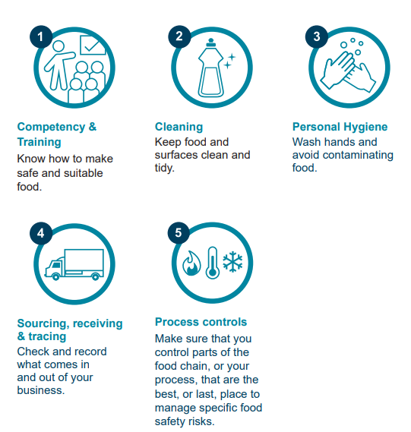
What must be checked?
Mandatory
Registration and scope of operations
Improvements or corrective actions
Complaints and recalls
Non-compliance
Managing unsafe/unsuitable food
10
Notes:
Picture is generic and additional checks
Mandatory - Registration and Scope of Operations
Is your scope correct?
NP3
Business details
Legal name of owner and business
Trading name of business
Address of business
Scope of operations
Brewers, distillers, manufacturers of vinegar, alcoholic beverages, or malt extract
Product Type - Spirits and Liqueurs
Trading Operations – Retail, Wholesale, Internet
Processes of Interest – Fermentation
Mandatory - Improvements or Corrective Actions
Changing things up
Create new products
Improve old products – less cost, faster,
Produce consistent flavours
from natural products
change with season
Supplier change
Trouble shooting
Mandatory - Complaints and Recalls
Test the system annually – ie mock recall
If a customer complains about your food – then you need to investigate and document findings
Finding out what is wrong will test your traceability
Who you have sold product to and product details if possible
Were common substantiated complaints identified?
Were food safety / suitability issues appropriately identified and responded to? Were records kept?
There are 2 kinds of recall:
◦ trade level – where food that has been distributed to stores is being recalled,
◦ consumer level – where there is public notification of the recall.
• There are 2 main reasons you might need to recall food:
◦ something has gone wrong in your business,
◦ something has gone wrong in a supplier’s business and you have already used the ingredient, input, equipment, packaging or food they are recalling.
• The records you must keep can help in your procedure for recalling food. Traceability is extremely important in a
recall situation.
• A recall is needed if you have doubts your food is safe and suitable and you have already sold or distributed some or all of it.
If you decide to recall, you must:
◦ notify MPI as soon as possible and at least within 24 hours,
◦ call 0800 00 83 33 and ask for the Food Compliance team (if during work hours)
or ask for the on-call MPI Food Safety Officer (if calling after hours)
Mandatory - Non-compliance
What non-compliance resulted from recent external audits or investigations?
Were these addressed in the timeframes agreed? Did the operator failure to address no- compliances result in additional visits to the site since the last audit, or sanctions applied by a Food Safety Officer?
What steps have been taken to identify cause, improve and correct the issue?
Were corrective actions were taken were these appropriate?
Was a suitably skilled person used to carry out the action?
Were records kept?
Mandatory - Managing unsafe/unsuitable food
When things go wrong (and they will sometimes), you need to take immediate action to keep food safe and suitable.
What do you need to do?
• Set-up procedures that allow you to react quickly when something goes wrong.
• As soon as a problem affecting food safety and/or suitability is identified:
identify all food that is, or could be unsafe or unsuitable
prevent it from being sold or, determine if a recall is necessary
notify your verifier that there is (or has been) a problem as soon as possible
fix the problem
take action (or make changes) to prevent the problem from happening again
keep clear, accurate records of all the actions you took once the problem was identified
Top 5 - Training, Supervision and Competency
Why
MPI requirement – need written record
Use the NP3 guidance to train yourself and your staff
Simply Safe & Suitable records – useful format
See NP3 guidance for reference
Top 5 - Personal Hygiene and Behaviour
Hand washing and facilities
Not going to work sick
Check facilities – hand wash basin, running water, single use towel
Staff need to be trained in hand washing
Sickness
What do sick
Need record
48 hour exclusion rule
Staff need to be trained what to do when sick and this training is recorded
Specific Checks
Training, Supervision and Competency
Personal hygiene and behaviour
Hand washing and facilities
Not going to work sick
Process controls
Distillation process
Preventing cross contamination
Dirt
Allergens
Foreign matter like glass out of your product
Cleaning and sanitising

Slide 11
MPI Data Verification Checks Common Issues
Non-Compliant
Food Labelling & Advertising
Documentation & Record-Keeping
Process Controls for Physical Hazards
Water Supply
Improvements & Corrective Actions
Non-conforming
Training, Supervision & Competency Suppliers & Purchasing
Food Labelling & Advertising
Traceability
Registration/Scope of Operations
11
Notes:
Non-Compliant
Food Labelling & Advertising- 5- 0.28%
Documentation & Record-Keeping- 4 - 0.22%
Process Controls for Physical Hazards (other)- 3 - 0.17%
Water Supply- 3 -0.17%
Improvements & Corrective Actions – 2 - 0.11%
Non-conforming
Training, Supervision & Competency- 169- 9.34%
Suppliers & Purchasing -156 - 8.62%
Food Labelling & Advertising – 148 - 8.18%
Traceability – 126 - 6.96%
Registration/Scope of Operations -118 - 6.52%

Slide 12
Suppliers and Purchasing/ Importing Raw Materials
Suppliers and purchasing
Food Act registered (unless exempt)
Overseas suppliers must have equivalent/suitable food safety certification
Importing
You must be a registered importer.
Even if you are only importing a small amount of ingredients, i.e. receiving ingredients from overseas through the mail.
12

Slide 13
Knowing what’s in your Food
Check ingredients or additives are
Compliant with the FSANZ code - details which additives, preservatives and processing aids can be, or must be, used with specific foods.
approved before they are used.(Can check with the code or ask consultant, verifier or registration authority for more information)
Permitted to be used in NZ
Approved for countries you intend to export to.
If you are a contract manufacturer you are responsible
for ensuring your/their ingredients are safe and suitable
it is not okay to mix mystery ingredients together
Keep details of recipes and ingredients
13
Notes:
A guide to Alcoholic Drinks – what’s in them and how to label them (mpi.govt.nz)
Spirit is made from fermenting a food source (e.g. sugar cane, potato, cereal) which
is distilled to make potable alcohol. Tequila must contain at least 35% Alc/Vol. All
other spirits must contain at least 37% Alc/Vol.
You can add any of the following when making a spirit:
• water,
• sugars,
• honey,
• spices (e.g. juniper berry).
Spices are made from the aromatic seeds, roots, berries or other fruits from a
variety of plants. They can be used to flavour spirits. Spices are not food additive
flavourings.
Whisky, brandy, rum, gin, vodka and tequila are considered to be spirits. Your spirit
must have the taste, aroma and traits associated with the spirit you’re making.
Spirits can’t be sold in a NZ supermarket/grocery shop.
Brandy is a spirit made from distilled wine, or fermented grapes or grape product.
You can add the following ingredients when making brandy:
• water,
• sugars,
• honey,
• spices,
• grape juice,
• grape juice concentrates,
• wine,
• prune juice.
Spices are made from the aromatic seed, roots, berries or other fruits from a
variety of plants. They can be used to flavour brandy. Spices are not food additives
flavouring.
Brandy can't be sold in a NZ supermarket/grocery shop.
Liqueur is a spirit that contains more than 15% Alc/Vol and is flavoured by or mixed
with other foods (e.g. cream).
Liqueur can’t be sold in a NZ supermarket/grocery shopKeep separate
Store separately
Thoroughly clean all equipment in between or use separate equipment
Process allergen-free foods before allergen containing foods
Know what your allergens are on site – ingredients or additives
Keep separate
Store separately
Thoroughly clean all equipment in between or use separate equipment
Process allergen-free foods before allergen containing foods
Labelling – Customers need to know what is in your food – to allow them to make informed choices.
Labels will be checked by verifiers
“If you are making foods on behalf of other businesses (e.g. a contract manufacturer) you are responsible for ensuring your ingredients are safe and suitable (it is not okay to mix mystery ingredients together)”
Keep details of recipes and ingredients so you know what allergens these contain.

Slide 14
Process Controls
Prevention of Cross Contamination
Dirt, foreign matter (e.g. glass, twigs, string, items not intended to be in the product)
Residual chemicals from cleaning and sanitising
A calibrated pH meter or strips can be used
Food safe coolants may be used with proof there are no leaks in the system
Prevention of Poor Processing Practices
Resulting in Methanol (exceeding regulatory limits)
Whiskey, rum, gin and vodka:0.4g methanol/L of ethanol
Other spirits, fruit/vegetable wine & mead: 8g methanol/L of ethanol
Water filters should be changed/maintained as required
14

Slide 15
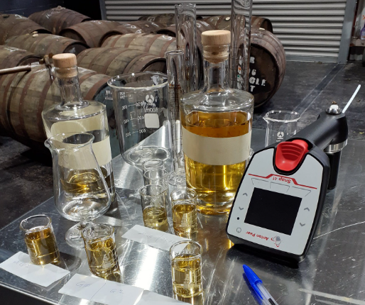
Calibration
Be guided by customs for alcohol measurement requirements and accuracy during production and customs reporting.
Certified Hydrometers
Anton Paar – Snap 41
Thermometers - may be required for correction of hydrometer readings.
pH meters - need to be calibrated regularly
Spirits that have more than 1.15% Alc/Vol must have an alcohol statement which is accurate to within 0.5% alcohol
15
Notes:
Cerifified Hydrometers and Anton Paar – Snap 14 are the 2 methods of alcohol measurement which we have encountered in our work as verifiers, which we have found acceptable.

Slide 16
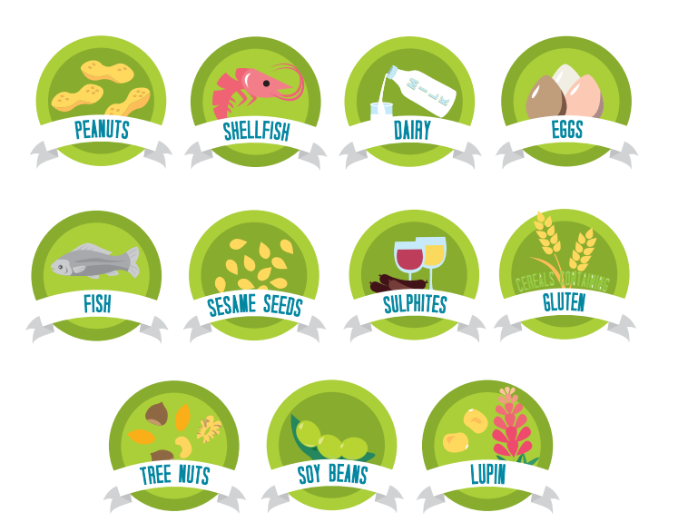
Food Allergens
16
Notes:
Food allergens can result in life threatening reactions which can occur within minutes of eating or drinking the food.
Egg
Peanuts
Milk
Soy
Sesame
Lupin
Gluten (barley, oats, rye, wheat)
Fish
Crustacea
Molluscs
Almond, pecan, brazil nut, pine nut, cashew, pistachio, hazelnut, walnut, macadamia.
Sulphites (>10ppm)

Slide 17
Ingredients exempt from allergen labelling.
Some ingredients do not have to be allergen labelled. This is because they have been judged as safe as they have been produced in such a way as to make them safe for people with allergies.
Glucose syrups made from wheat starch (gluten maximum limit of 20mg/kg)
Distilled alcohol from wheat or whey
Gluten/wheat in beer or spirits (after fermentation (and/or distillation)
Isinglass from fish used to produce beer or wine
17
Notes:
they may want to get a PIF from supplier to be sure

Slide 18
Labelling
Labels vary from product to product and will be checked by your Verifier.
It is your responsibility to:
make sure your drink contains the allowed ingredients and inputs
ensure your label has all the right information to meet the rules in the
Food Standards Code,
Food Act,
Fair Trading Act,
Sale and Supply of Alcohol Act,
Weights and Measures Act,
Geographical Indications (Wine and Spirits) Registration Act.
18
Notes:
Sometimes businesses copy labels from other products which is where they can go wrong.
Labelling – Customers need to know what is in your food – to allow them to make informed choices.
Low alcohol labelling
• The words low alcohol must not be used if a drink contains more than 1.15% Alc/Vol.
• The words non-intoxicating or words meaning the same thing must not be used if a drink contains more than 0.5% Alc/Vol
Geographical indications (GI)
Protection can be granted to the names of a territory, region or location that spirits or wines are associated with. These are known as GI.
Before using a GI you need to check to see if it is registered in NZ. If it is registered, there are rules you will need to meet before you use that name.
GI can't be used in relation to spirits unless the spirit has been made in the stated country, region or location, and where a characteristic is attributed to the origin.
Additionally for spirits, where a characteristic is attributed to the origin, this must be accurate on the label (e.g. Scotch Whisky must be made in Scotland).

Slide 19
All Alcoholic Drink Labels Need
From 1 August 2023, a 'pregnancy warning label' must be included on packaged alcoholic drinks with more than 1.15% alc/vol that are for retail sale, except when the alcoholic drink is packaged in the presence of the purchaser.
Accurate name or description
Amount of alcohol
Pregnancy warning label
Net contents
Number of standard drinks
Business name and physical address
Lot/batch ID
May need if applicable
Allergen and advisory statements
Best Before date
Storage instructions
Nutrition information panel
(if you make a nutrition content claim)
19
Notes:
Low alcohol labelling
• The words low alcohol must not be used if a drink contains more than 1.15% Alc/Vol.
• The words non-intoxicating or words meaning the same thing must not be used if a drink contains more than 0.5% Alc/Vol
Geographical indications (GI)
Protection can be granted to the names of a territory, region or location that spirits or wines are associated with. These are known as GI.
Before using a GI you need to check to see if it is registered in NZ. If it is registered, there are rules you will need to meet before you use that name.
GI can't be used in relation to spirits unless the spirit has been made in the stated country, region or location, and where a characteristic is attributed to the origin.
Additionally for spirits, where a characteristic is attributed to the origin, this must be accurate on the label (e.g. Scotch Whisky must be made in Scotland).

Slide 20
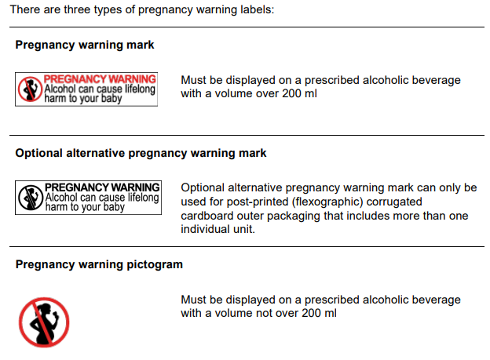
Pregnancy Warning Labels
Applies from 2 February 2024.
20
Notes:
The outer package of an individual unit with a volume not over 200 ml must show the pregnancy warning pictogram, while the outer package of an individual unit with a volume over 200ml must show the pregnancy warning mark. The pregnancy warning mark or where applicable, the optional alternative pregnancy warning mark, must be shown on an outer package with more than one individual unit, no matter what volume is contained in each individual unit.
For example:
• A single bottle of spirits with a volume of not more than 200 ml contained in an outer box must have a pregnancy warning pictogram on the outer packaging.
• Two 100ml bottles of liqueur contained in a box must have a pregnancy warning pictogram shown on each 100 ml bottle of liqueur. A pregnancy warning mark must be shown on the outer packaging (box).
• A 1L bottle of spirits and a 100ml bottle of liqueur contained in a box must show a pregnancy warning mark on the 1 L bottle, and a pregnancy warning pictogram on the 100ml bottle. A pregnancy warning mark must also be shown on the outer packaging (box).
Pregnancy warning labels on corrugated cardboard packaging used for multiple individual units of alcoholic drinks are permitted to be in a single colour on a contrasting background when a post-print process is used. This requirement applies from 2 February 2024.

Slide 21
Complaints and Recalls
Complaints should be documented and investigated.
They can trigger a Recall
The records you keep can help in your recall process
Traceability is extremely important in a recall
What raw materials used
What batches made
Where it has been sold
Being prepared reduces stress and costs of any recall
An annual mock recall is mandatory for all food businesses from
1 July 2023
21
Notes:
A consumer-level recall: This involves removing affected product from the supply chain and communicating to consumers.
A trade-level recall: This involves removing affected product from the supply chain.
No further action: Resolve the problem without the need for a recall.
Common complaints:
Foreign objects in food
An allergic reaction to foods
Food sold past its use-by date
Incorrect labelling
An unregistered food business
Unhygienic or incorrect food handling, storage, transport, or preparation
Food poisoning
Fair Trading Act breaches
Advertisment content or placement
Weight and/or measurement of products
Non-Compliant
Food Labelling & Advertising- 5- 0.28%
Documentation & Record-Keeping- 4 - 0.22%
Process Controls for Physical Hazards (other)- 3 - 0.17%
Water Supply- 3 -0.17%
Improvements & Corrective Actions – 2 - 0.11%
Non-conforming
Training, Supervision & Competency- 169- 9.34%
Suppliers & Purchasing -156 - 8.62%
Food Labelling & Advertising – 148 - 8.18%
Traceability – 126 - 6.96%
Registration/Scope of Operations -118 - 6.52%

Slide 22
Costs to be Considered
Registration
Set by local Council
Renew every 2 years
Verification
Set by Verifier
There are three main parts to the verification.
preparation
on-site assessment
reporting.
Frequency depends on how well you are managing food safety.
It could be as little as once every 2 years.
22
Notes:
Like a car… rego and warrant
Auckland $174
Napier $252 (New) $110 (Renew)
Masterton $300 (New)
$125 (Renew)
Christchurch $408 (New)
$349 (Renew)
What can affect the length of a verification?
food safety risk,
size of your business,
types of processes,
preparation

Slide 23
Useful Links
National programme 3 Guidance 2018 (mpi.govt.nz)
Steps for National Programme 3 | NZ Government (mpi.govt.nz)
A guide to Alcoholic Drinks – what’s in them and how to label them (mpi.govt.nz)
The notebook for businesses making and selling food (mpi.govt.nz)
Food importing requirements | NZ Government (mpi.govt.nz)
23
Notes:
PBV Frequency. If do well then, no need for extra checks.

Slide 24
Question Time
24

