Slide 1
Distillation for flavour
Richard Archer

Slide 2
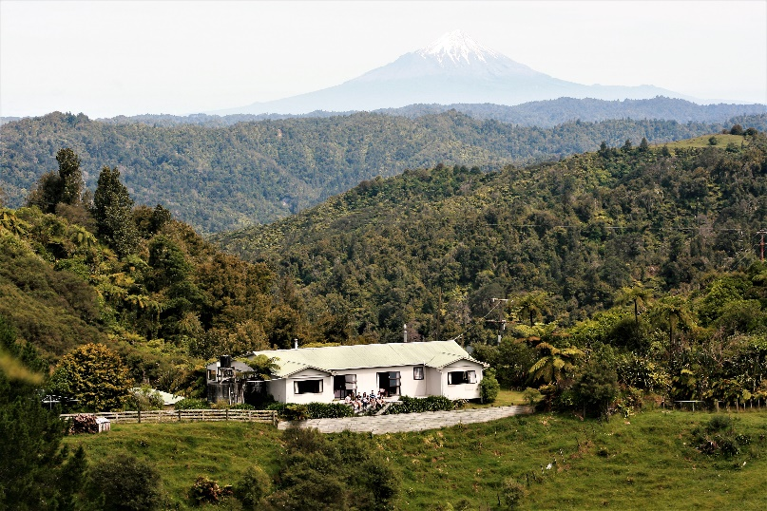
Thank you for inviting me
Logan Campbell Professor Food Technology – Massey University
Before that 20 years in Dairy Industry
Before that, 5 years fermentation and deer by-products industries

Slide 3
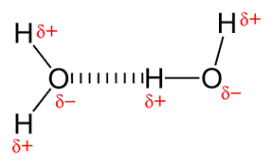
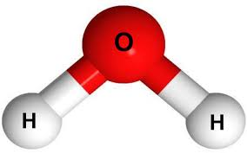
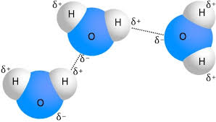
Water - it sticks TO ITSELF

Slide 4
Water - and wriggles

Slide 5
changes with temperature
Higher temperature:
More wriggling
Tears some H-bonds apart
At room temp, liquid water in gangs of three
At higher temps in gangs or two or as loners
At lower temps in bigger and bigger clumps

Slide 6
changes with temperature
Tearing apart takes energy
Specific heat capacity
To heat 1 kg of water by 1°C takes 4.18 kJ
Or 0.0012 kWh
Or 0.03 cents

Slide 7
changes with temperature
Tearing apart takes energy
To heat 1 kg of water by 1°C takes 4.18 kJ
To heat 1 kg of copper by 1°C takes only 0.38 kJ

Slide 8
changes with temperature
Tearing apart takes energy
To heat 1 kg of water by 1°C takes 4.18 kJ
To heat 1 kg of copper by 1°C takes only 0.38 kJ
To heat 1 kg of ethanol by 1°C takes 2.46 kJ

Slide 9
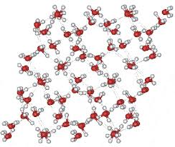
changes with temperature
Below zero water is solid ice
Above 100 °C water is gas (for 1 atmosphere pressure)

Slide 10
changes with temperature
For 1 kg water to melt from ice to water at 0°C:
Takes 334 kJ of energy
Enough to heat that 1kg of water from 0°C to 80°C
For 1 kg water to evaporate at 100°C:
Takes 2260 kJ of energy
Enough to heat 1kg of water from 0°C to 542°C !!

Slide 11
changes with temperature
For 1 kg water to melt from ice to water at 0°C:
Takes 334 kJ of energy
Enough to heat that 1kg from 0°C to 80°C
Or 0.09 kWh or ~2.3 cents
For 1 kg water to evaporate at 100°C:
Takes 2260 kJ of energy
Enough to heat 1kg from 0°C to 542°C
Or 0.63 kWh or ~ 16 cents

Slide 12
changes with temperature
For 1 kg water to evaporate at 100°C:
Takes 2260 kJ of energy
Or 0.63 kWh or ~ 16 cents
For 1 kg ethanol to evaporate at 78 °C:
Takes 850 kJ of energy
Or ~6 cents

Slide 13
Vapour pressure
Liquid water always gives off some water vapour
At 0°C zero degrees vapour pressure is 0.6 kPa
At 80°C it is 46 kPa
At 100 °C is 101 kPa = one atmosphere

Slide 14
Vapour pressure
101 kPa
3 kPa
19 kPa
43 kPa
Water
Water
Water
Water
25°C
50°C
78.4°C
100°C
Liquid water always gives off some water vapour

Slide 15
Vapour pressure
101 kPa
3 kPa
19 kPa
43 kPa
Water
Water
Water
Water
101 kPa
8 kPa
46 kPa
Ethanol
Ethanol
Ethanol
Ethanol
25°C
50°C
78.4°C
100°C

Slide 16
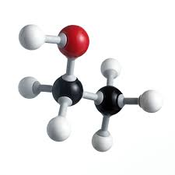
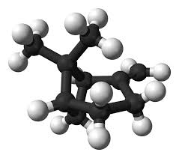
Water Ethanol beta-pinene
Ethanol quite likes water – hydrophilic – fully miscible
Βeta-pinene hates water – hydrophobic – immiscible
Beta-pines likes ethanol - soluble

Slide 17
alpha-pinene
Melts at -63 °C so likes to be liquid normally
Βoils at 157 °C so hard to get it into vapour

Slide 18
alpha-pinene
Melts at -63 °C so likes to be liquid normally
Βoils at 157 °C so hard to get it into vapour
Unless you put it into water-ethanol which it doesn’t like

Slide 19
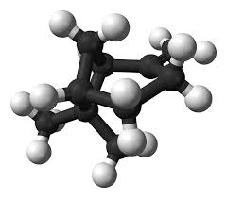
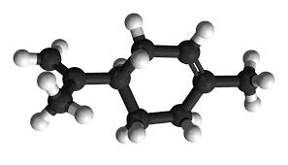
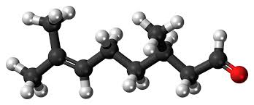
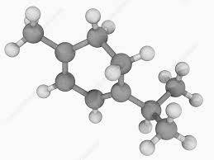
Major gin cogeners - hydrophobic
Beta-pinene boils ~166 °C
Limonene boils ~176 °C
Citronellal boils ~204 °C
Terpinene boils at ~174 °C
And melts at 60 °C – usually solid

Slide 20
VOLATILITY of Cogeners in Aq-ETOH
Absolute volatility of X =
When the mix is boiling
[mole fraction = fraction of # of molecules]
$$\frac{mole fraction of X in vapour}{mole fraction of X in liquid}$$
vapour
liquid

Slide 21
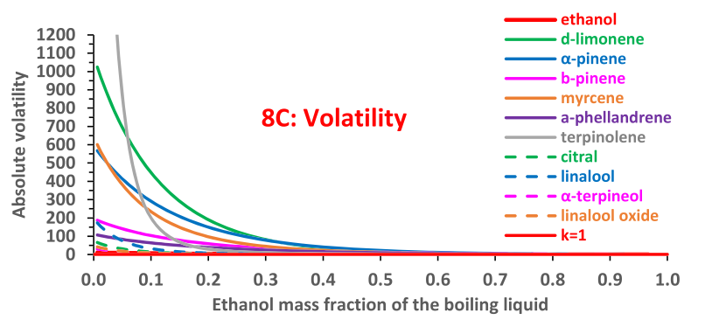
VOLATILITY of gin Cogeners in Aq-ETOH
Esteban-Decloux et al J. Inst. Brew. 2022 128:171-187

Slide 22
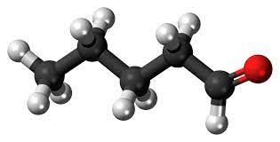
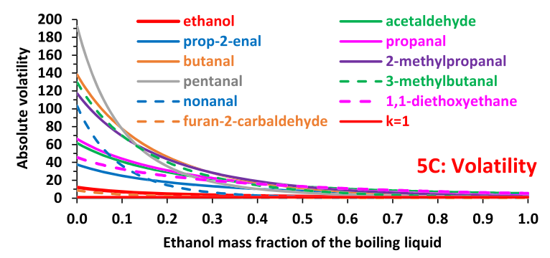
VOLATILITY of ALDEHYDES in Aq-ETOH
Esteban-Decloux et al J. Inst. Brew. 2022 128:171-187
Notes:
Pentanal – quite hydrophilic – happier to stay in boiling water than others

Slide 23
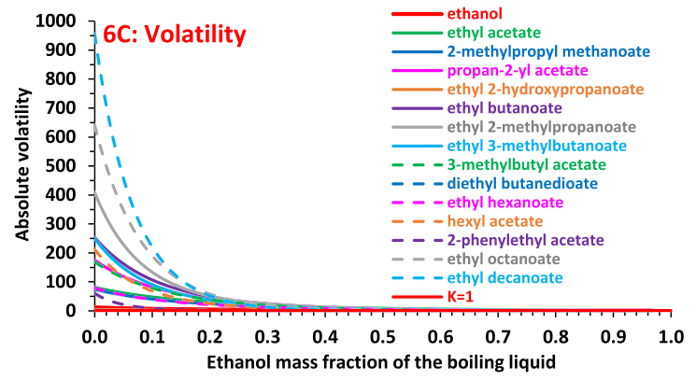
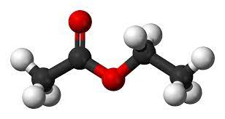
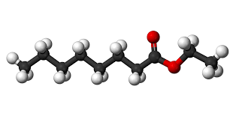
VOLATILITY of ESTERS in Aq-ETOH
Esteban-Decloux et al J. Inst. Brew. 2022 128:171-187

Slide 24
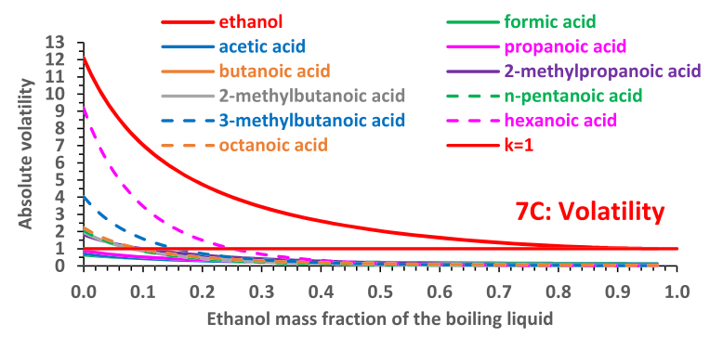
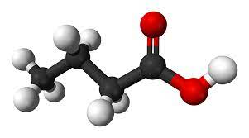
VOLATILITY of VF Acids in Aq-ETOH
Esteban-Decloux et al J. Inst. Brew. 2022 128:171-187

Slide 25
Gin
Ester
Acids
Aldehydes
Esteban-Decloux et al J. Inst. Brew. 2022 128:171-187

Slide 26
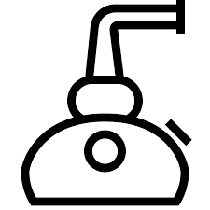
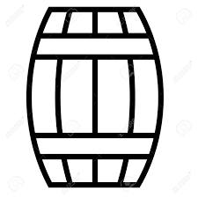
Whisky Batch Distillation
Wash – foreshots – includes methanol – chuck
Spirit – heads – smaller aldehydes etc
Next – middle cut – esters, good flavours product
Next – late middle cut – smoke phenolics product
Finally – tails – hydrophobic, high boiling acids, aldehydes

Slide 27
WHAT happens to the Rubbish?
Acids that get recycled to the next batch?
Aldehydes that get recycled?
What happens when they are redistilled in another batch? Same?

Slide 28
WHAT happens to the Rubbish?
Acids that get recycled to the next batch?
Aldehydes that get recycled?
What happens when they are redistilled in another batch? Same?
Do they “break down” and disappear?
They must shape-shift to make the middle cut next time round….

Slide 29
WHAT happens to the Rubbish?
Aldehydes can oxidise to organic acids….
Organic acids can react with ethanol to form esters….
?
Organic acids
Ethanol
Esters

Slide 30
the Rubbish turns to gold?
Early in a batch still run ethanol in the vapours in high (water low)
Further up the lyne arm ethanol in vapours higher
Inside of beaten copper vessels get flaky as they age
Just the conditions for esterification??
Up here!
Organic acids
Ethanol
Esters

Slide 31
Energy needs of distillation
Water needs 2260 kJ for 1 kg
Ethanol needs 850 kJ for 1 kg
Energy demand climbs during a run:
Constant heat → declining evaporation rate

Slide 32
~14 c/kg
Energy needs of distillation
~10 c/kg
Water needs 2260 kJ for 1 kg
Ethanol needs 850 kJ for 1 kg
Energy demand climbs during a run:
Constant heat → declining evaporation rate

Slide 33
Energy needs of distillation
Still contents get wetter over run
Boiling point climbs
Constant heat → declining evaporation rate
Temp driving force declines
Unless you lift hot oil temp to compensate

Slide 34
WHAT is reflux?
Think of three distillations runs in a row to get more and more pure
8%
40%
75%
92%

Slide 35
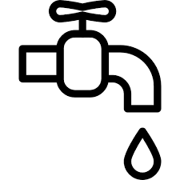
WHAT is reflux?
But you need three lots of heating and cooling
8%
40%
75%
92%

Slide 36
WHAT is reflux?
Unless:
Use the heat over and over
Bubbling through liquid
Heat stronger spirit in next still
→multiple distillations in one device
92%
8%

Slide 37
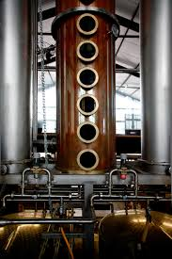
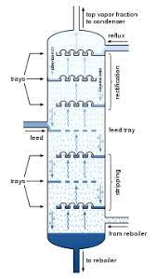
Distillation column
92%
8%

Slide 38
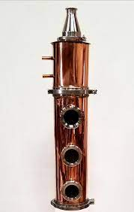
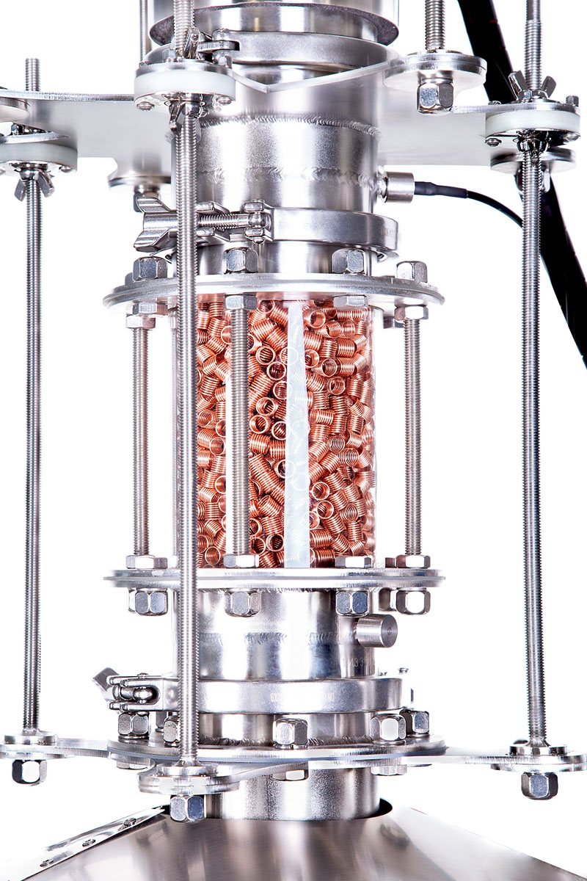
Distillation column

Slide 39
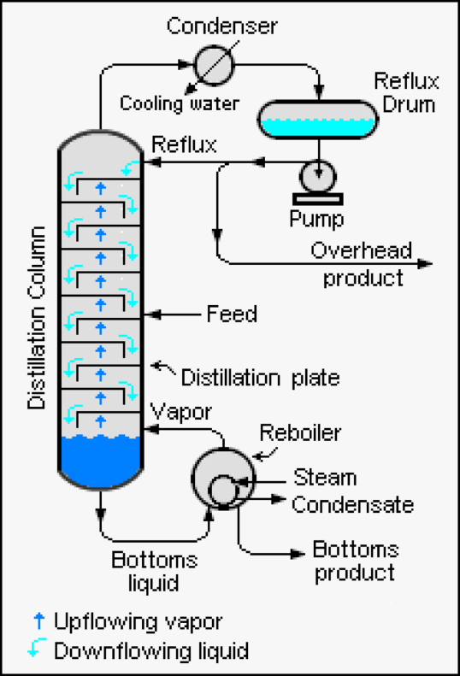
Distillation column needs reflux
Dephlegmator to condense only some of the vapours
Condenser + partial reflux
or
Need partial condensation of vapour
To make liquid spirit
To drain backward
To condense upcoming vapours
To act as multiple stages of still
Selective condensation of high boiling stuff

Slide 40
When do you need a column?
If hard to get up to high alcohol
To knock down unwanted flavour components
To make clean neutral spirit of later use
For gin making
For blending

Slide 41
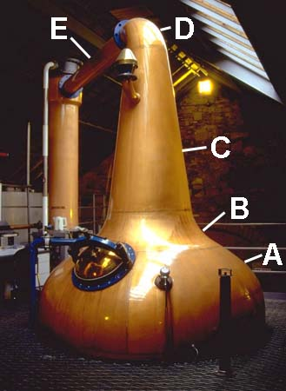
A pot still has some reflux built in
Long/extended neck
Ball or lamp glass neck
Rising lyne arm

Slide 42
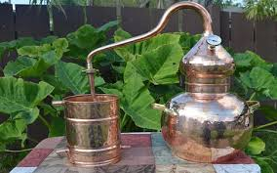
A pot still and scale
Smaller still → more surface/volume
More reflux
More copper
Different

Slide 43
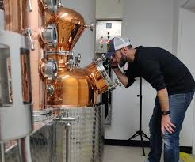
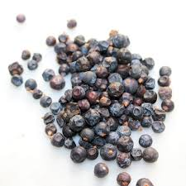
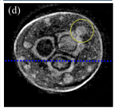
Gin - maceration
Soak some of the juniper in EtOH/water cold overnight
Solvent penetrates the juniper
by diffusion
by capillary action
Air bubbles likely to remain in pores and crevices

Slide 44
Gin - maceration
Some osmosis across cell walls
Not much dissolving of target compounds – yet
Very low solubility of target compounds in aqueous ethanol

Slide 45
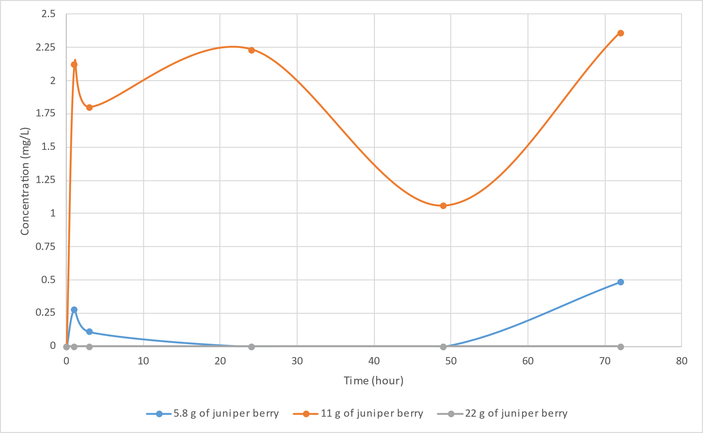
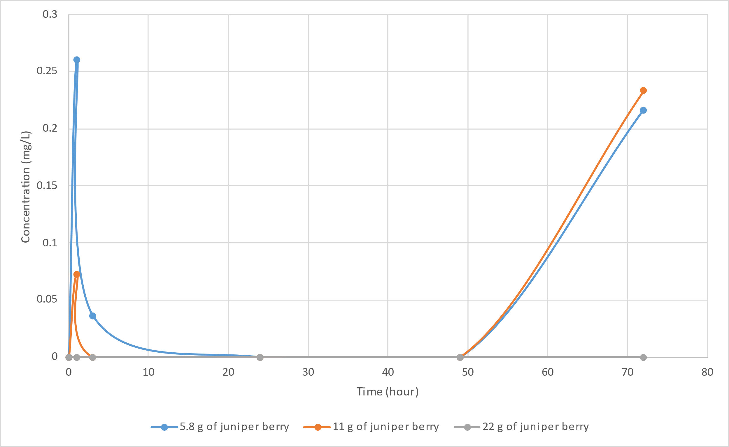
Gin - maceration
For some compounds botanical ratios makes a difference
limonene
350 mL 60% ABV
γ-terpinene
350 mL 60% ABV
11g juniper berry
11g juniper berry
5.8 g juniper berry
5.8 g juniper berry
From Beau Welch’s Master’s project
Notes:
Higher ratios not always the best. Law of diminishing returns. Need to find an economic optimum berry:solvent ratio.

Slide 46
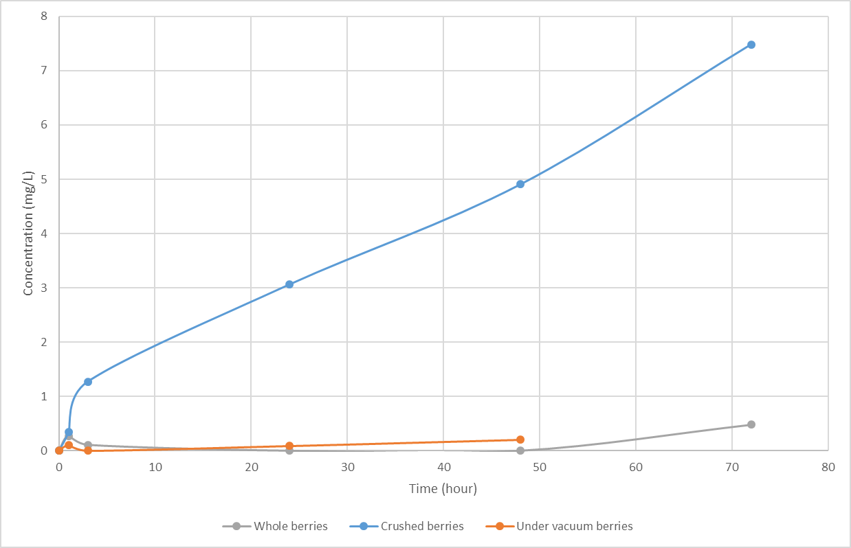
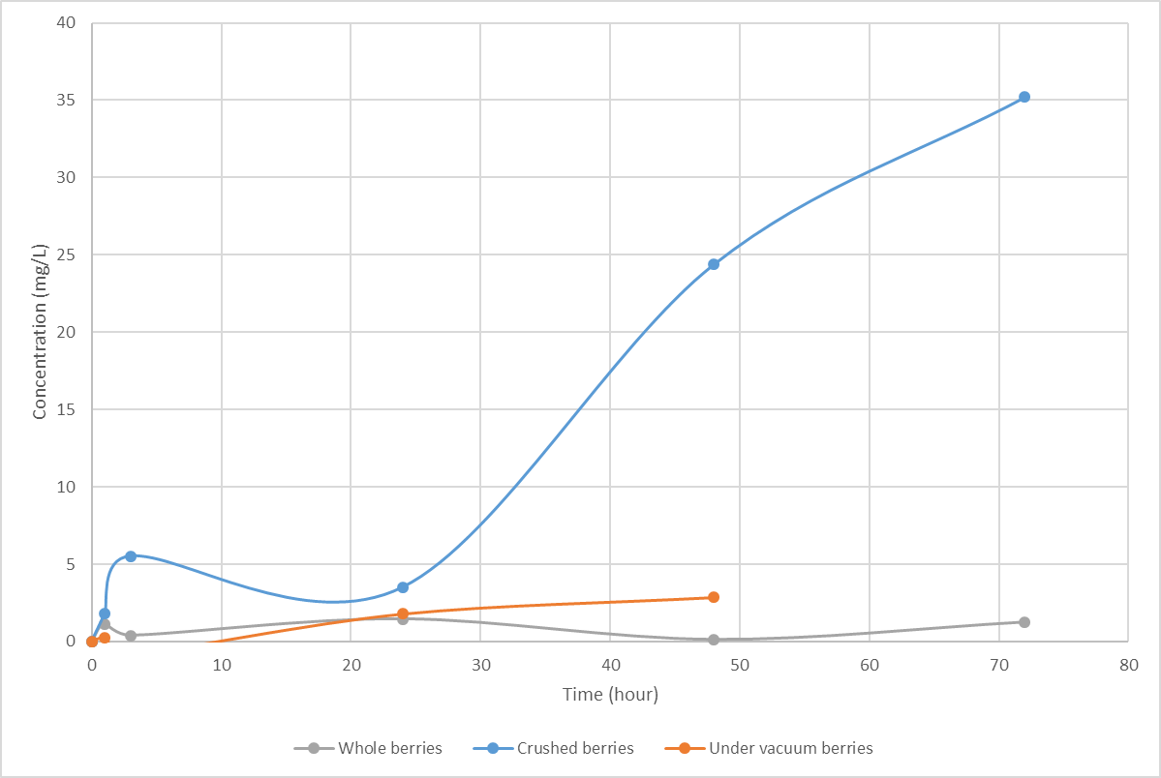
Gin - maceration
Crushing berries before maceration helps extraction
limonene
β-myrcene
crushed berries
crushed berries
whole berries
whole berries
vacuum
vacuum
From Beau Welch’s Master’s project

Slide 47
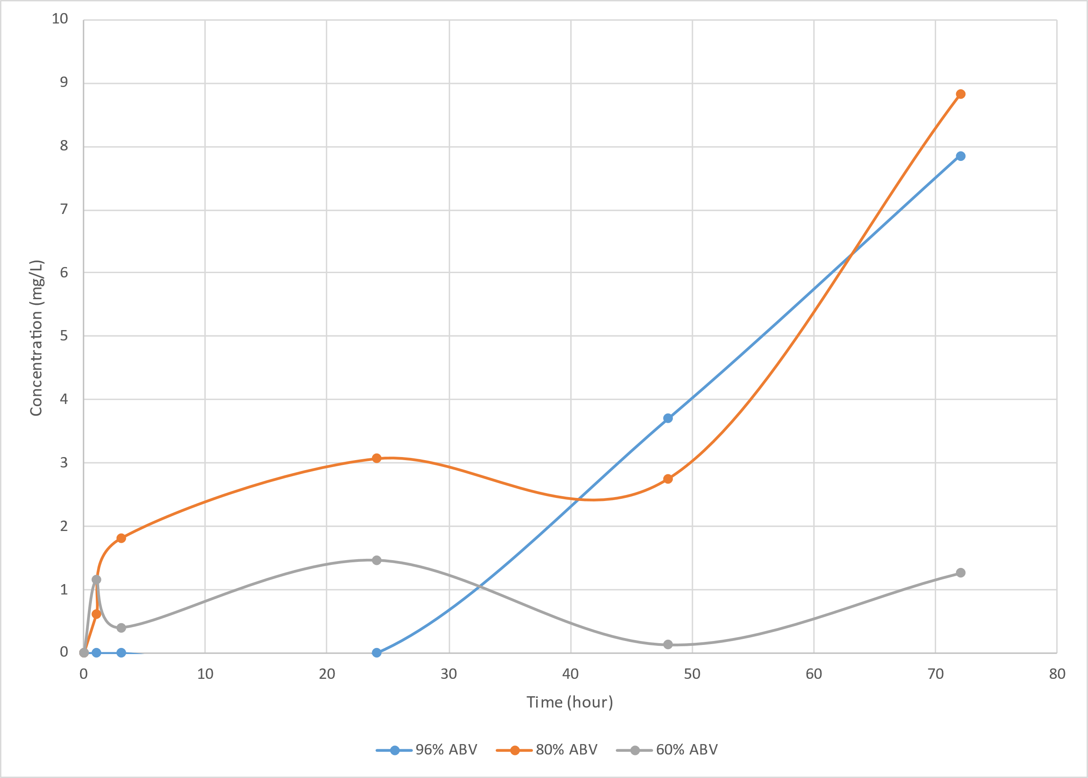
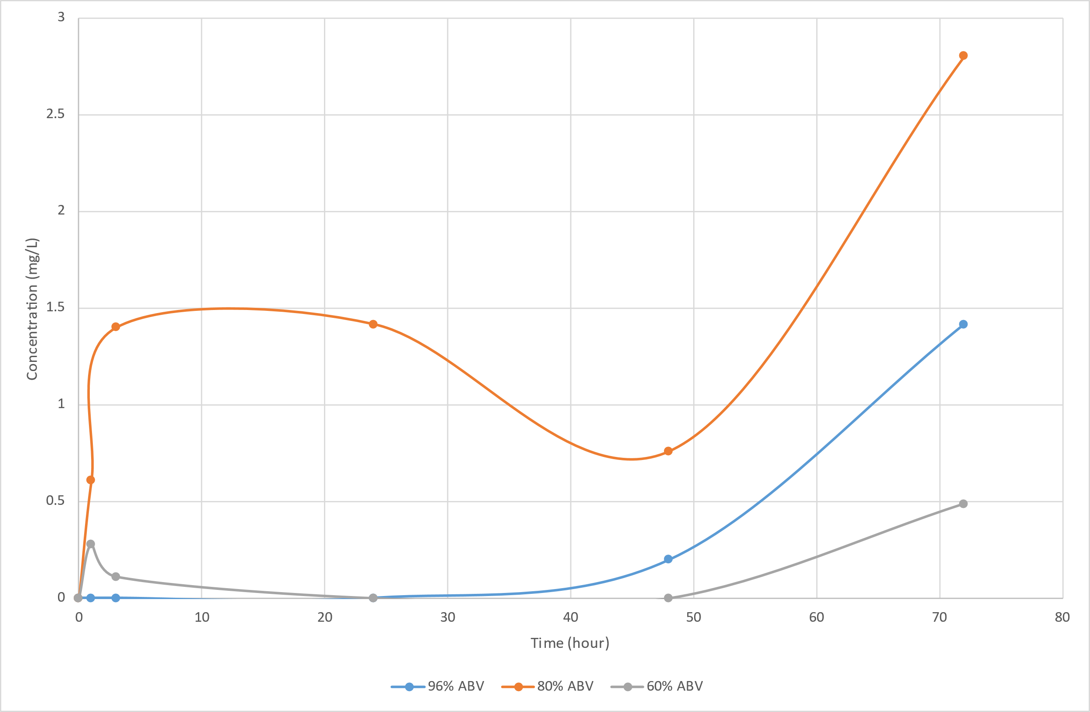
Gin - maceration
ABV affects extraction – higher appears slower
limonene
β-myrcene
80% ABV
80% ABV
96% ABV
96% ABV
60% ABV
60% ABV

Slide 48
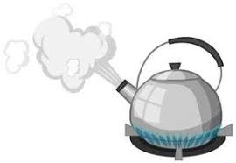
Gin - hydrodistillation
Boiling this mixture the next morning
Solubility climbs with temperature
But volatility very high
Diffusion through solvent inside juniper
Agitated by vigour of boil
As soon as pinene (eg) reaches bubble wall it leaps into vapour
Juniper likely to act as bubble nucleation sites
Careful if it goes off the boil and you restart…..may bump!

Slide 49
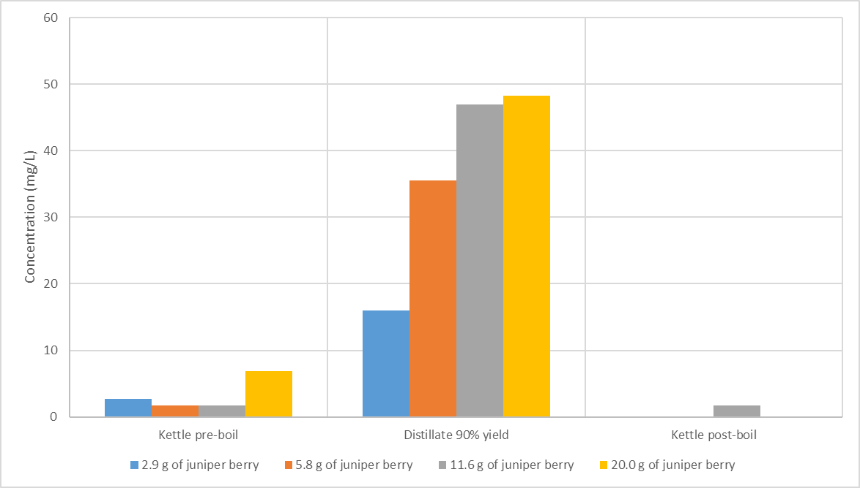
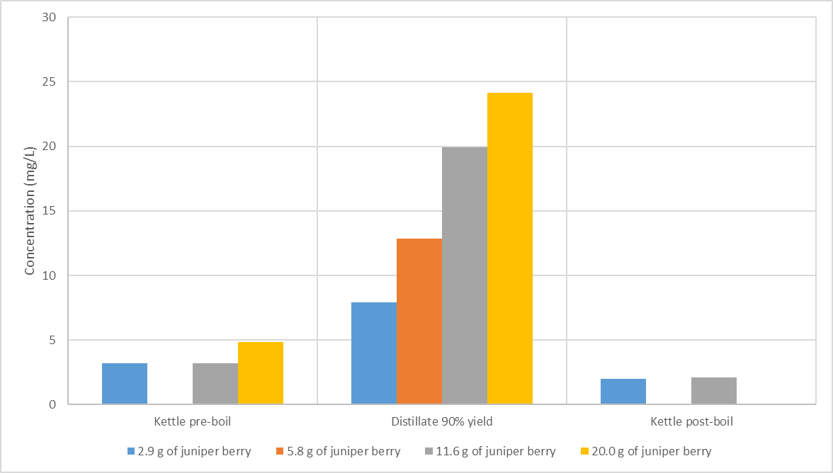
Gin - hydrodistillation
90% of macerate extract reports to condensate when boiled
α-pinene
β-myrcene
limonene
macerate
distillate
raffinate
20 g in 350 mL
11.6 g
5.8 g
2.9 g
From Beau Welch’s Master’s project

Slide 50
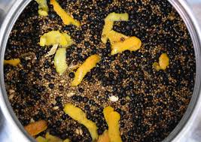
Gin – Botanicals basket
Many processes happening simultaneously
Vapour condensing heat botanicals to condensate boiling point
Wetting of botanicals with solvent
Dissolution, migration, evaporation of cogeners (good & bad)
Percolation through the bed and return to still – some leaching
Evaporation of cogener out of the EtOH/Water solution

Slide 51
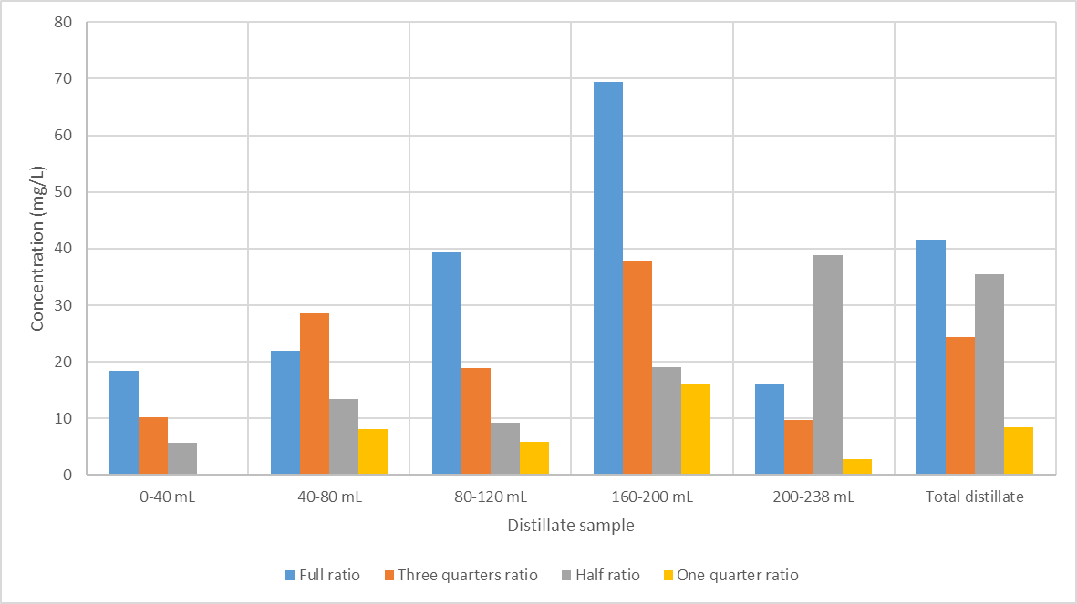
Gin – condensate percolation
α-pinene
Fraction 4
Fractions 1- 5 mixed
Full ratio of botanical:solvent
Fraction 3
Fraction 5
Fraction 2
Fraction 1
3/4 ratio
1/2 ratio
1/4 ratio
From Beau Welch’s Master’s project

Slide 52
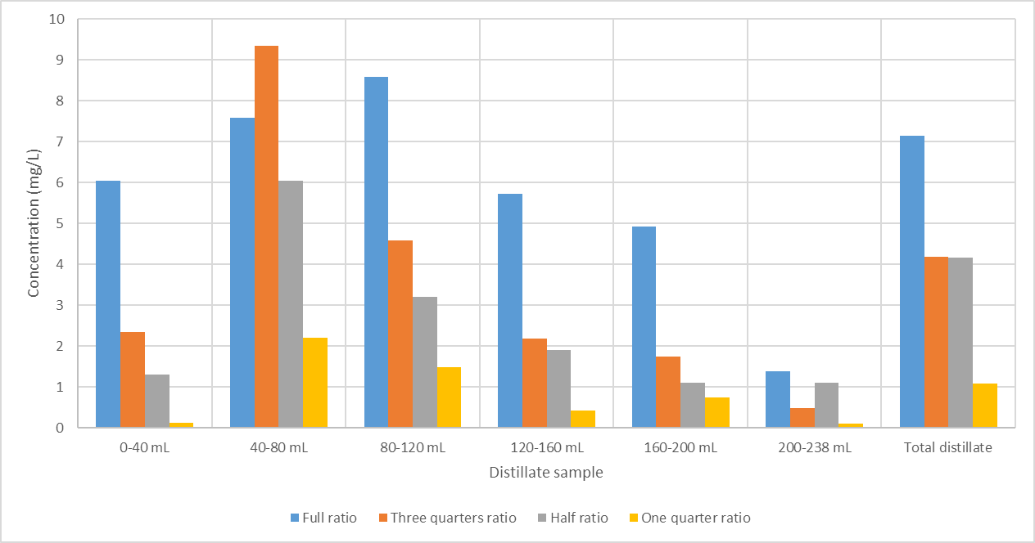
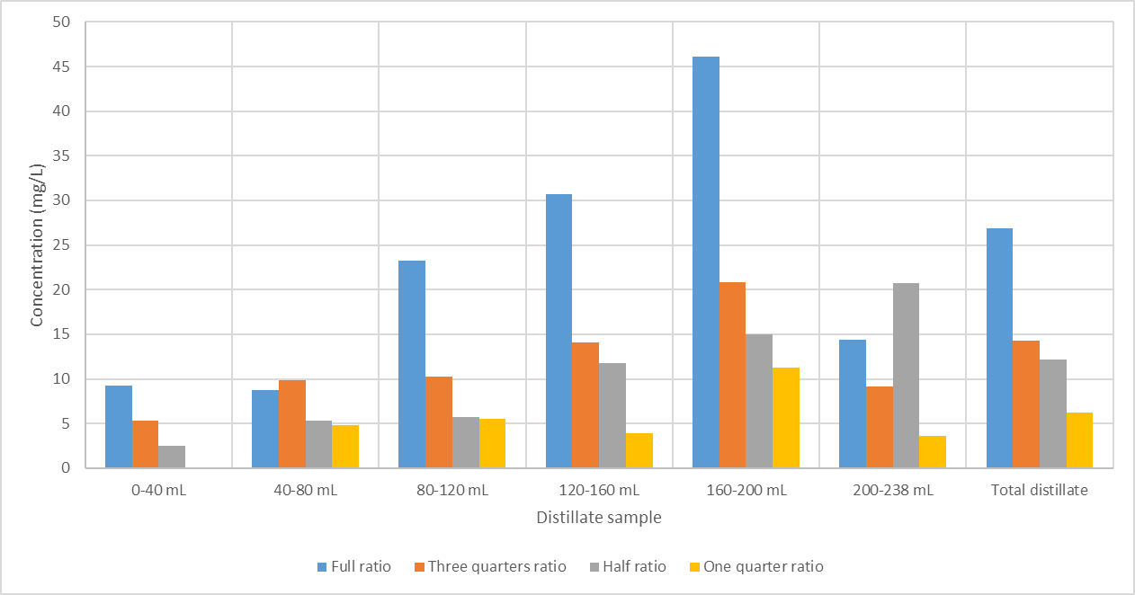
Gin – condensate percolation
Mobile later
γ-terpinene
Mobile early
β-myrcene
Fractions 1- 6 mixed
Fractions 1- 6 mixed
From Beau Welch’s Master’s project

Slide 53
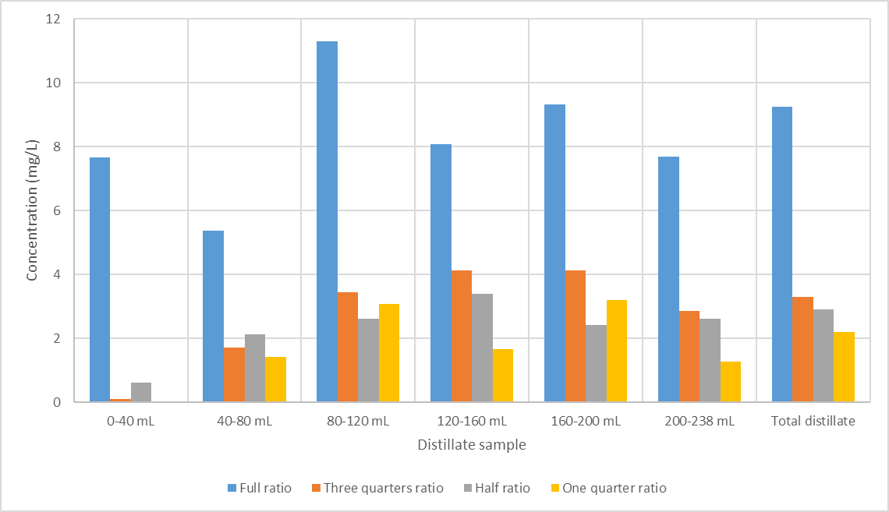
Gin – condensate percolation
citronellal
From Beau Welch’s Master’s project

Slide 54
Gin – Botanicals basket
Start with high EtOH in the vapour
Good for cogener solubility
Bad for cogener volatility
As run proceeds vapours get wetter and hotter
Gin

Slide 55
Gin – Botanicals basket
Temperature climbs as boiling/condensing point of vapours climbs
Solvent in basket gets hotter
Cogener solubility climbs a bit
Hydrophobic cogeners’ volatility climbs more
Gin

Slide 56
Gin – Botanicals basket
Energy (latent heat) in the condensing vapour rises
May get some thermal breakdown of botanicals → vegetal notes
Gin

Slide 57
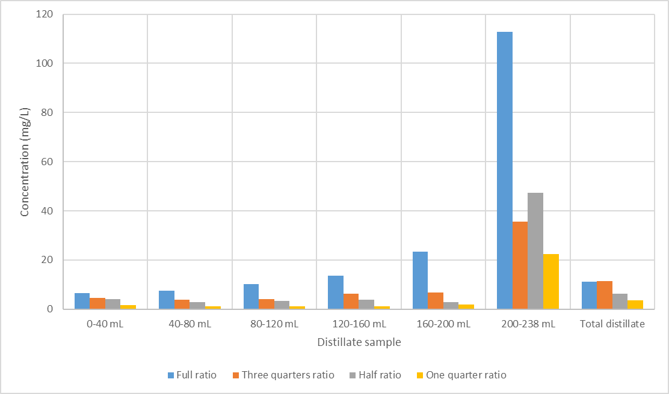
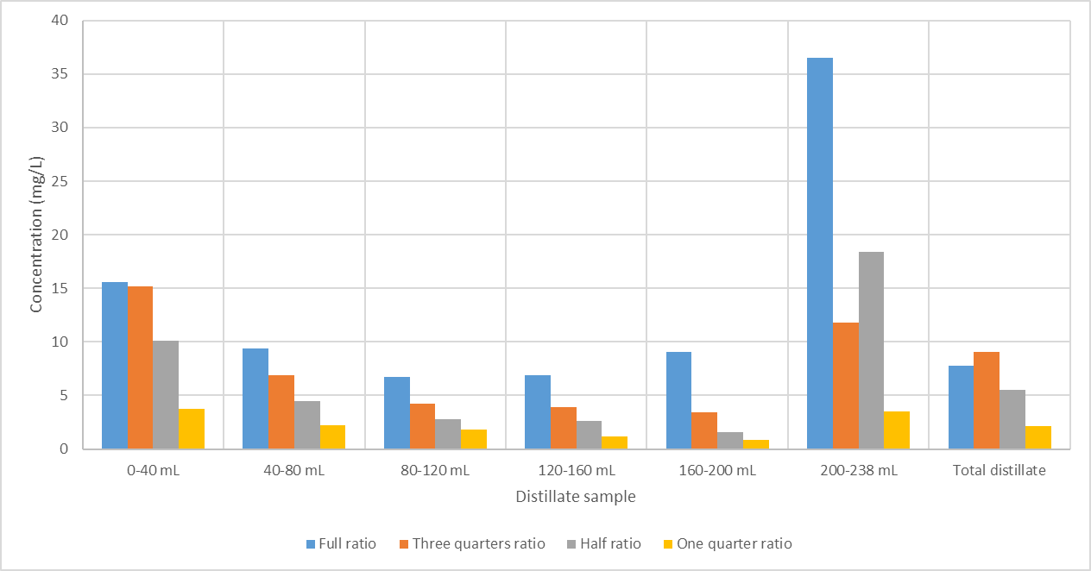
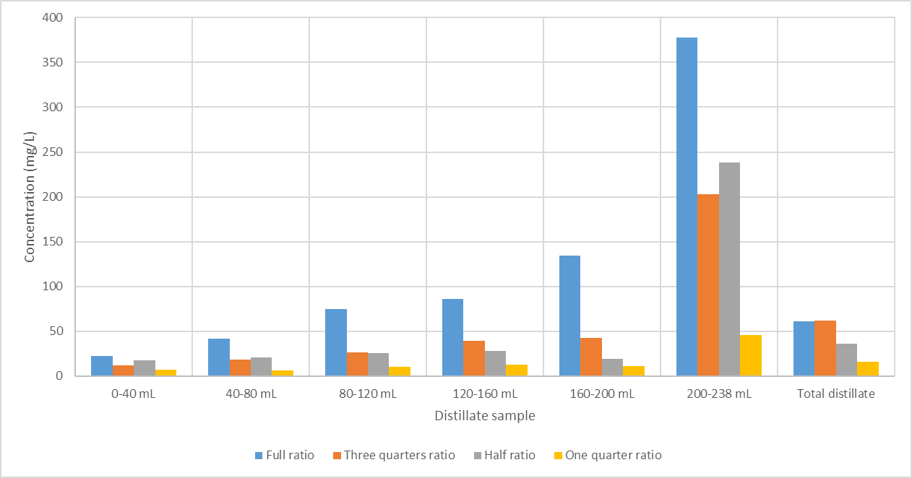
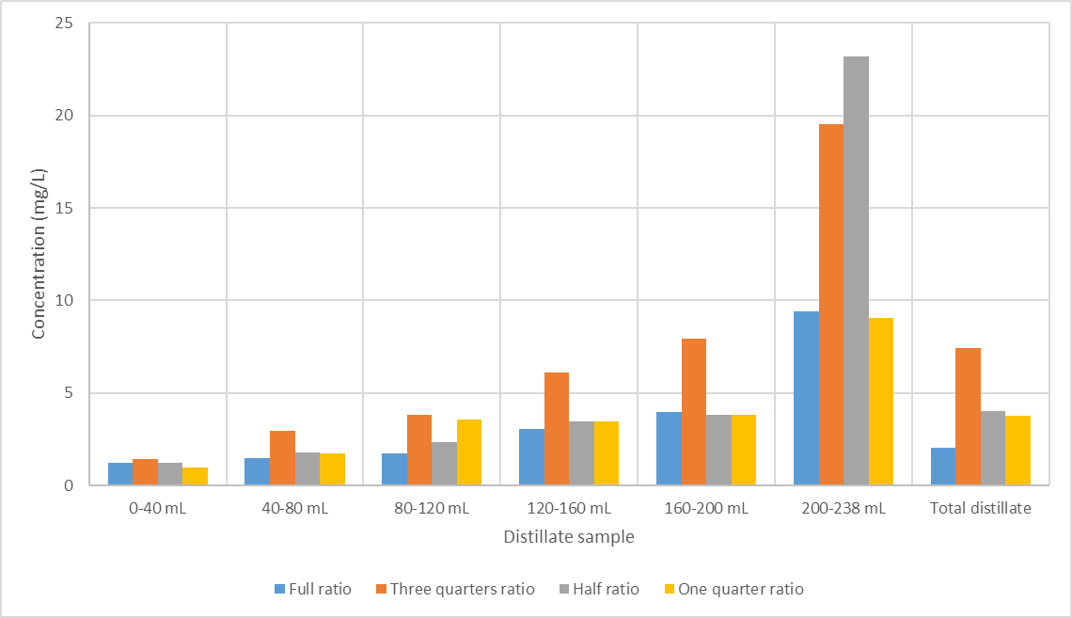
Gin – Vapour distillation
limonene
γ-terpinene
Highest ratio not best
citronellal
β-myrcene
Highest ratio not best
From Beau Welch’s Master’s project

Slide 58
summary
Basic physics of flavour distillation is well known
But spirit distillation is very complex
Lots of interactions between solvents, cogeners & botanicals
Science helps most in analysis of product

Slide 59
summary
It is still an art-form
Partly because the product is art

Slide 60
THANK you

