Slide 1
‘Tasting Notes’ Insights and practical tips for effective product tasting
Professor Joanne Hort
Fonterra Riddet Chair in Consumer Sensory Science
Food Experience and Sensory testing Lab
Massey University

Slide 2
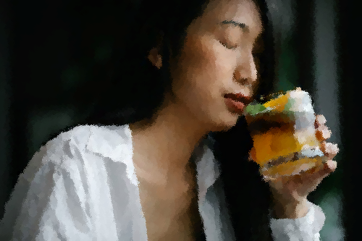
Overview
Sensory perception
Tips for successful product evaluation
Taster behaviour
When, where, how
Improving your tasting ability
Individual variation in perception
Q&A

Slide 3
Sensory perception
‘A complex biological material and an even more complex human sensation-perception-cognition mechanism.’ (Martens, 1999)
stimulus
perception

Slide 4
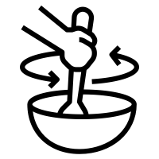
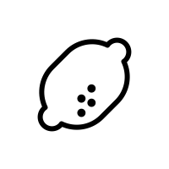
The brain decides: Perception is multimodal

Slide 5
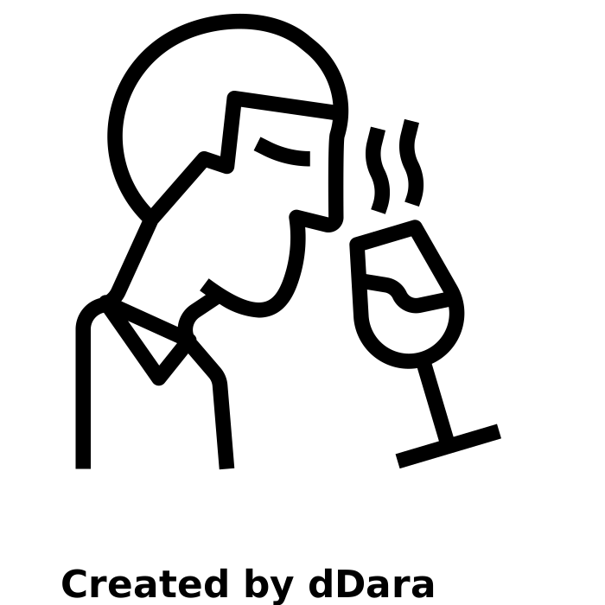
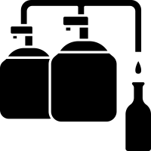
The brain decides: Adaptation and & habituation
Adaptation
Habituation

Slide 6
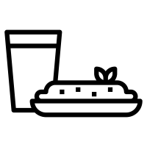
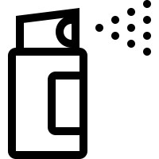
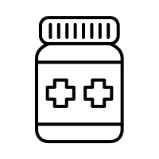
What can you personally do?
Timing!
Smell neutral!
Health awareness
Stay hydrated!
Avoid lingering foods
Behaviours
Not eating drinking etc, avoid certain food and drink brushing teeth – say why
No smoking vaping …
Body odour - own and that of teh toiletires you are wearing remember even if you ca n long smell it it may have subcnscious impact and will affect you tasting friends!
Medication - affect central vervous system - be aware of reduced or changes abilty
COVID
11am (or your equivalent)
The room

Slide 7
Right time, Right Place!
11am. When are you your most sensitive?
Odour free
Clean/hygienic
Neutral cleaning products
Ventilated
Quiet
Bland
Well lit

Slide 8
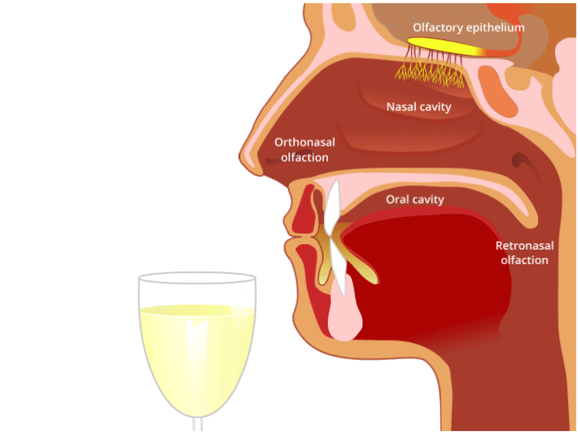
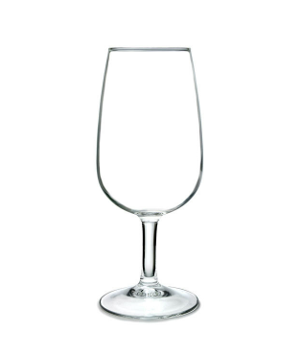
Evaluating the liquid
Clean, odour free, glassware
Be consistent
Then
Palate cleanser - water neutral, room temp not cold as can effect sensitivity of palalte Cracker absorb liquid removeing some residual tastes and flavours but then a swillwtih wtar ato gert rid of cracker - must bebland, no salt wtarecrackers often good option – sub thresholdtatses flavours, trigeminal
Carbonated too acidic and other add lingering lfalvours etc wihch canimpact if trying to compare psubtle different liquids
Apple slices can be good is cleasnewith water as wel

Slide 9
Evaluating the liquid
Lid glass
Hold to light
Clean, odour free, glassware
Be consistent
No need to swirl
Waft glass under nose
Inhale slowly
Be consistent
Take a sip
‘Chew’
Coat all oral surfaces
Add water/don’t add water
Spit/Don’t spit

Slide 10
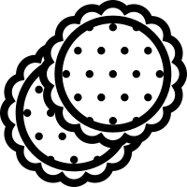
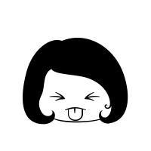
In the spirit of fairness…
Palate Cleanse:
20°
Be consistent
A | B | C
A | C | B
B | C | A
B | A | C
C | A | B
C | B | A
Consistent protocols: palate cleansing, temperature, amount consumed, water added, time to swallow…
416
Taste blind
Balance/randomise sample order
Team work

Slide 11
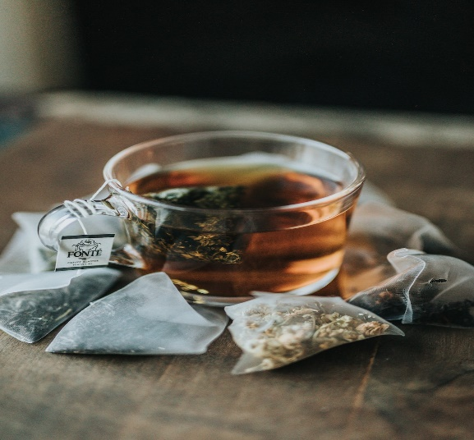
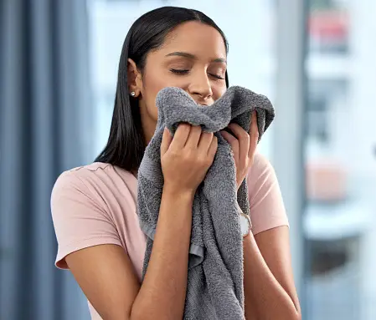
Honing the instrument…
Sniff, taste, feel
everything!
Awaken your senses

Slide 12
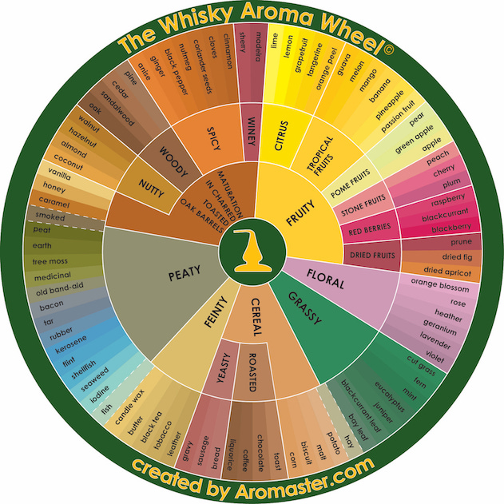
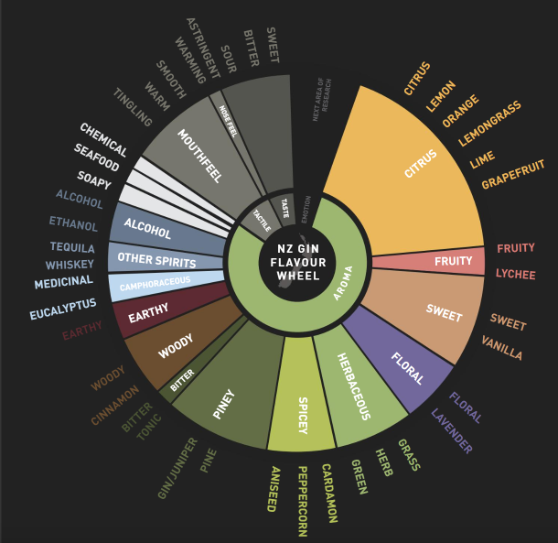
Tip of the tongue….
NZ Gin Consumer Flavour Wheel
Feast & BeGin Distilling (2019)

Slide 13
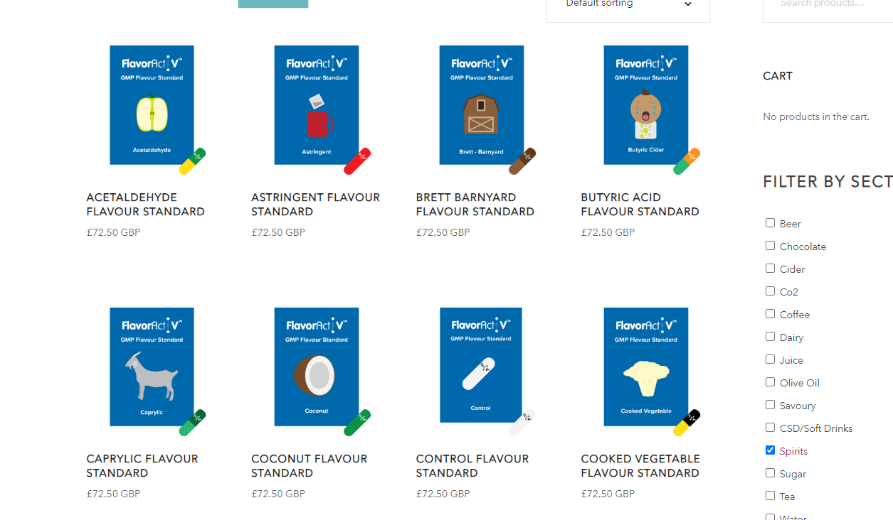
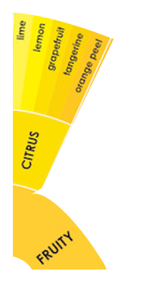
Committing to memory
Ingredients
Essential oils, compounds
Reference samples

Slide 14
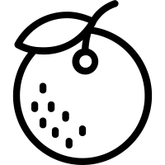
Committing to memory
Florida orange
Ingredients
Essential oils, compounds
Reference samples
Spiked liquid
Different concentrations
Spiked spirits
Spirits
Sniff /taste
Focus on the sensation
Say the descriptor (10-20s)
Imagine an image/icon

Slide 15
Individual variation in perception
Genetic
Specific Ageusias (lack of taste)
Specific Anosmias (lack of smell)
Temporary loss – cold, covid, medication …
Individual Thresholds - Physiology
Taster status

Slide 16
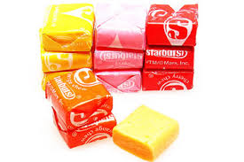
What’s your taster status?
Prop Taster Status
Filter paper – impregnated with
Propylthiouracil
PROP is an anti thyroid agent used in the treatment of Grave’s Disease. You will only consume a very tiny amount of what would be in one tablet given to patients so it is harmless, - it is up to you if you wish to continue to participate.

Slide 17
What’s your taster status?
Place the filter paper on the tip of your tongue
Let is become wet with saliva and move your tongue a bit and then remove the paper.
Rate the intensity of bitterness
(feel free to eat the sweet)
Almost tasteless
Bitter
Very Bitter and very unpleasant

Slide 18
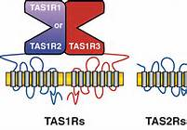
Individuals re be classified according to their response:
Barely detectable – Non taster
Detectable but moderate – Tasters
Above moderate – Supertasters
Taster status to Prop is genetically determined via the Tas2r38 gene, but….
Supertasters also have more papillae (contain taste buds and other sensory receptors) on the tongue.
All tastes, and many flavour and mouthfeel attributes are more intense/more discriminable.

Slide 19
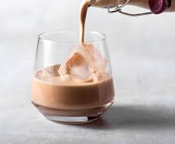
Individual variation in perception
Prop taster status: taste (and hence some flavours) and mouthfeel.
Sweet liker status: sweet likers and dislikers
Thermal taster status: thermal tasters perceive a taste from thermal stimulation of tongue
Fatty acid status: sensitivity to fatty acids

Slide 20
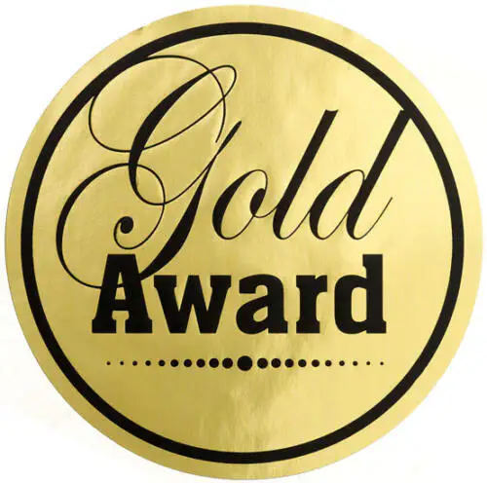
The last drop…..
Sensory perception is complex and individual
Adopt good behaviours
Train and maintain the instrument (that’s you)
Consider when, where and how to do your tasting
Be consistent, follow good tasting protocols

Slide 21
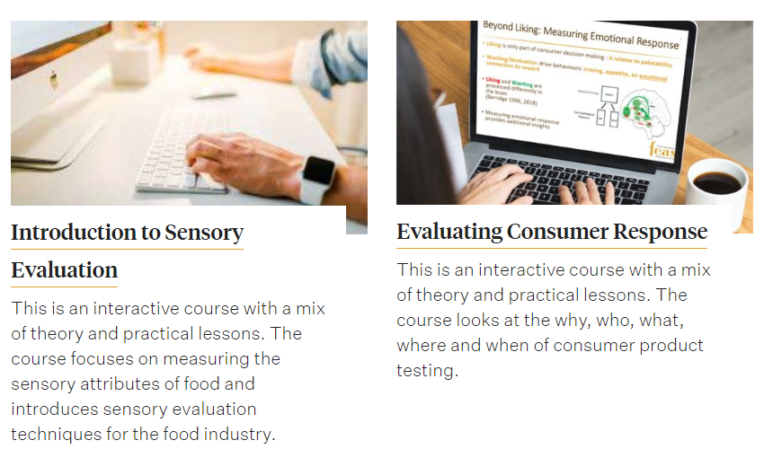
Online training courses

Slide 22
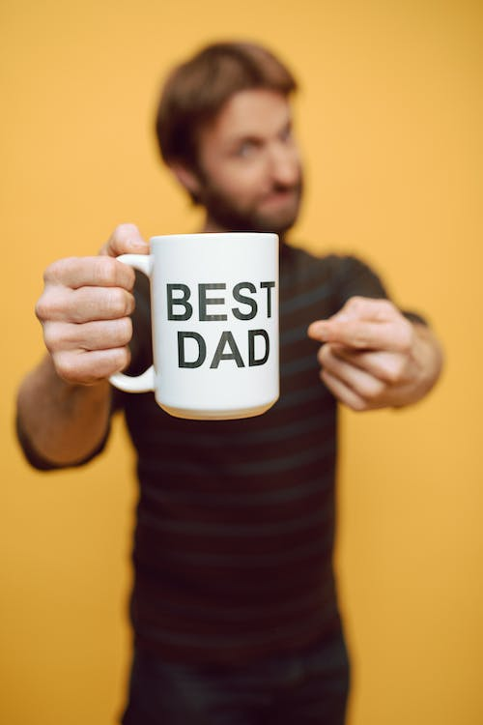
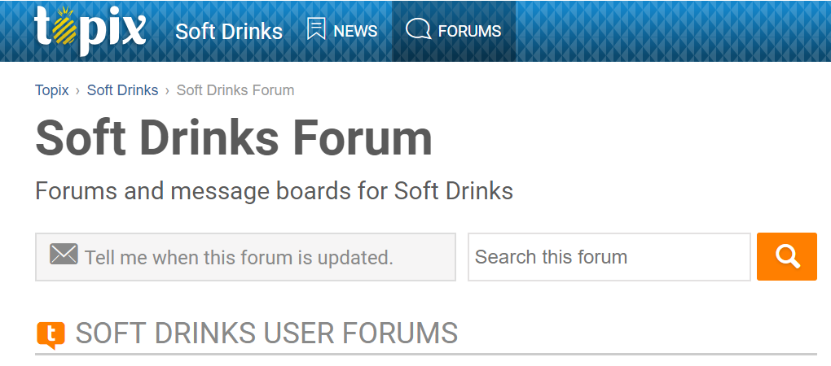
Understand your consumers…
Local or online community
Websites, forums etc
DISTILLER
EVER

