Slide 1
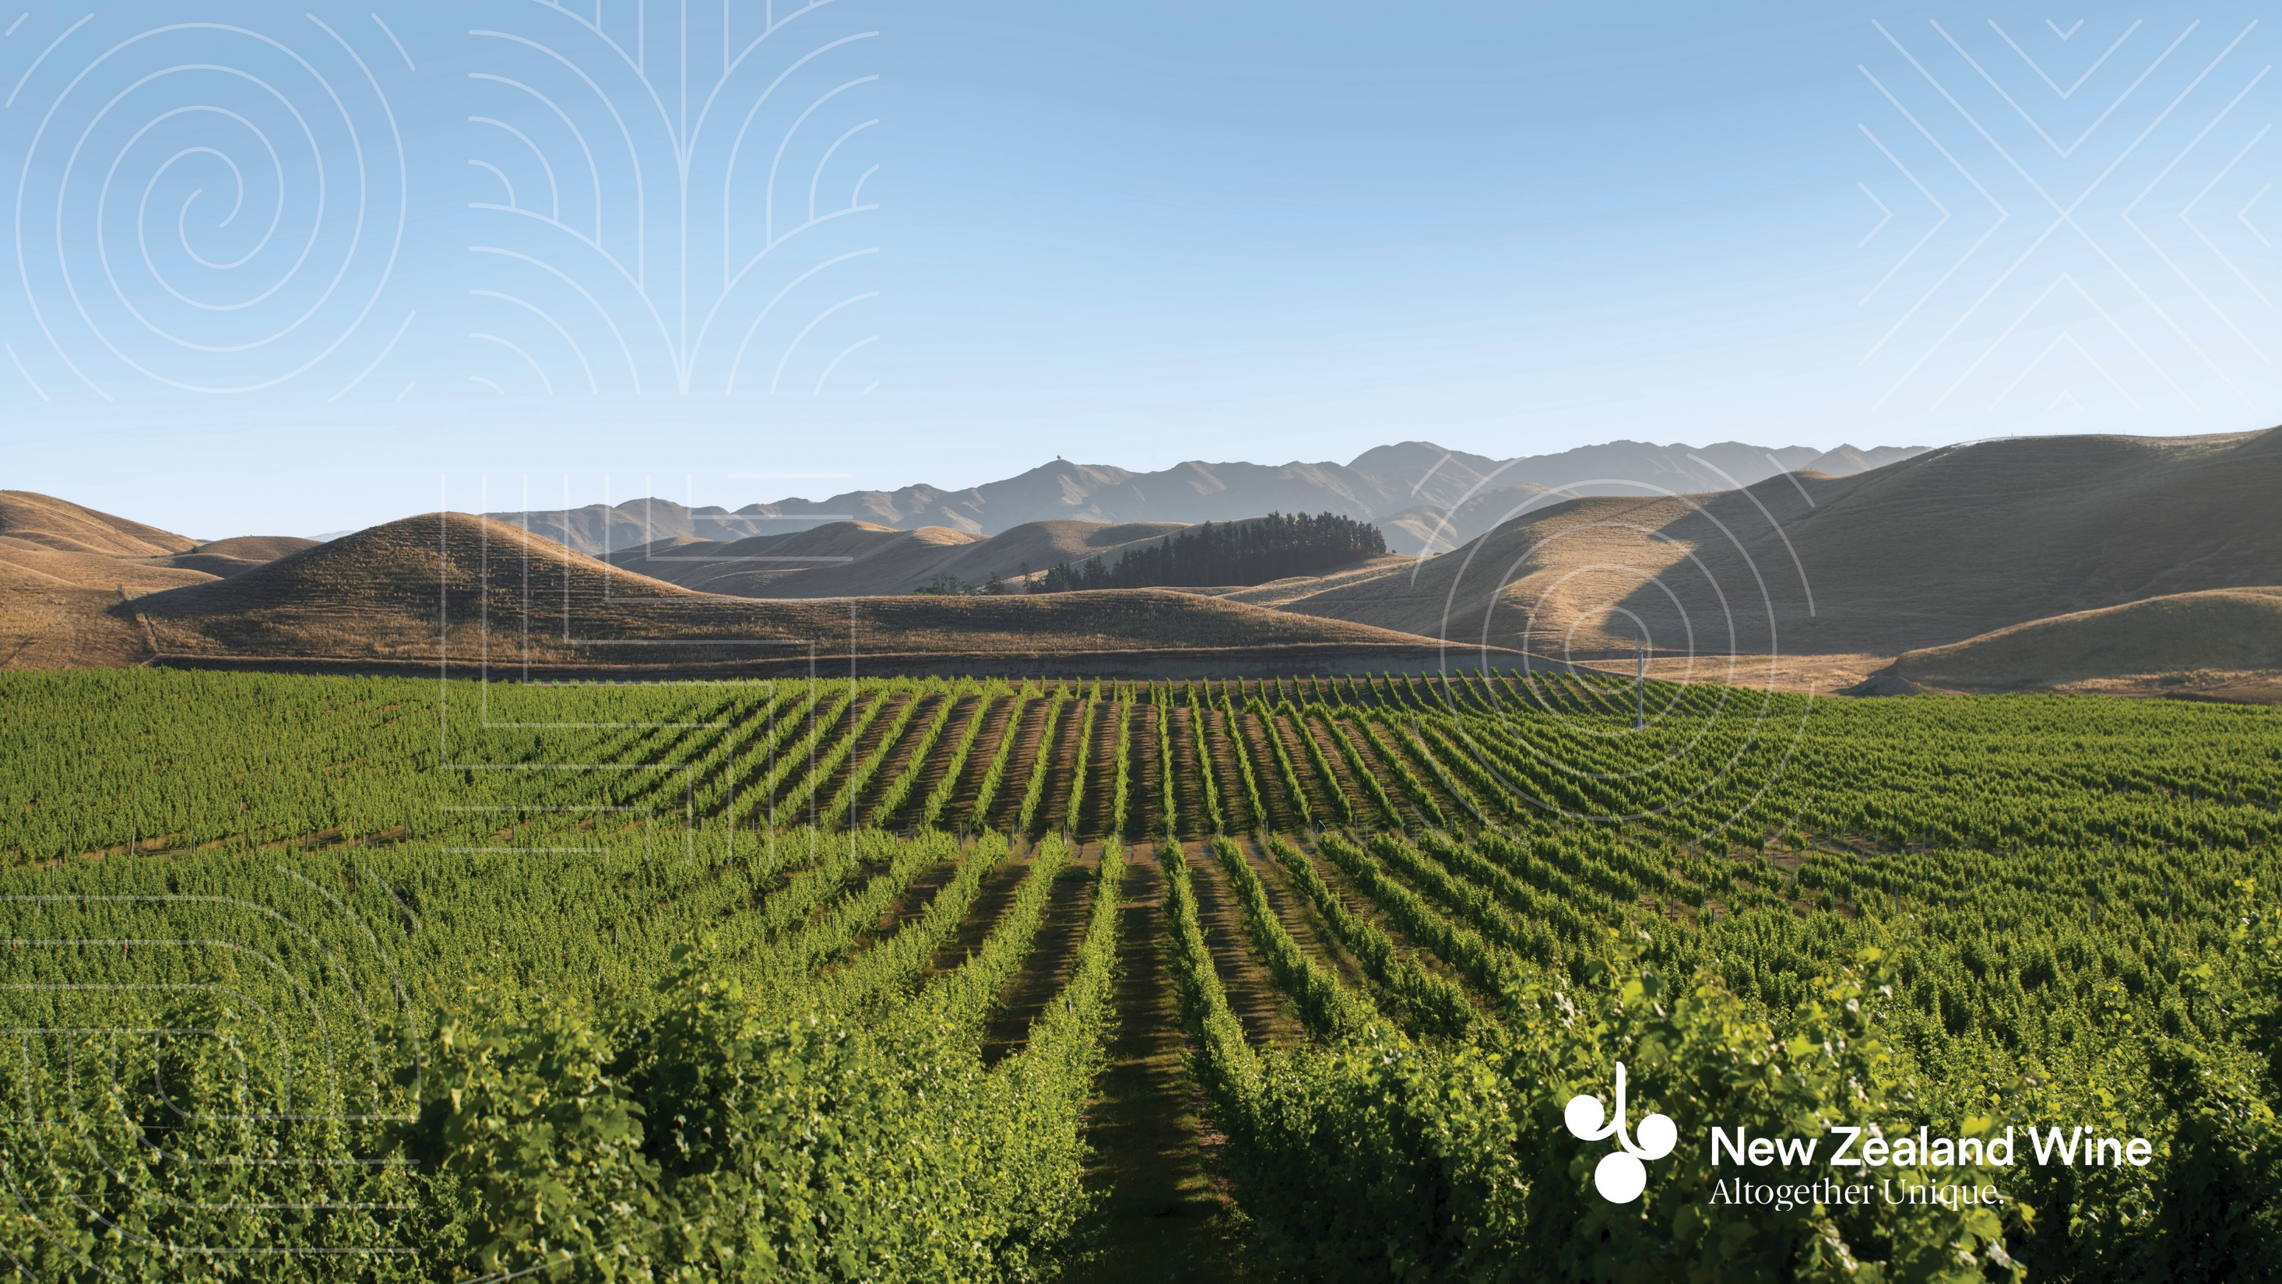
The New Zealand wine industry:
Demonstrating our commitment to the future
Dr Edwin Massey (GM Sustainability, NZW)

Slide 2
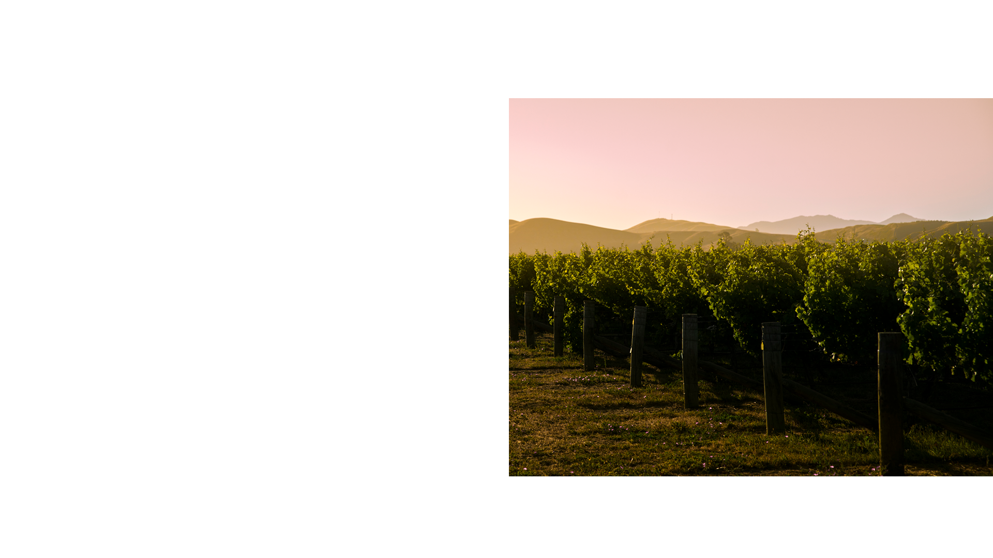
New Zealand Winegrowers
NZW is the national organisation for the country's grape and wine sector.
Vision
Around the world, New Zealand is renowned for our exceptional wines
Mission
To create enduring value for our members
Purpose
To protect and enhance the reputation of
New Zealand wine
Support sustainable, diversified value growth of New Zealand wine

Slide 3
Export Value $ million

Slide 4
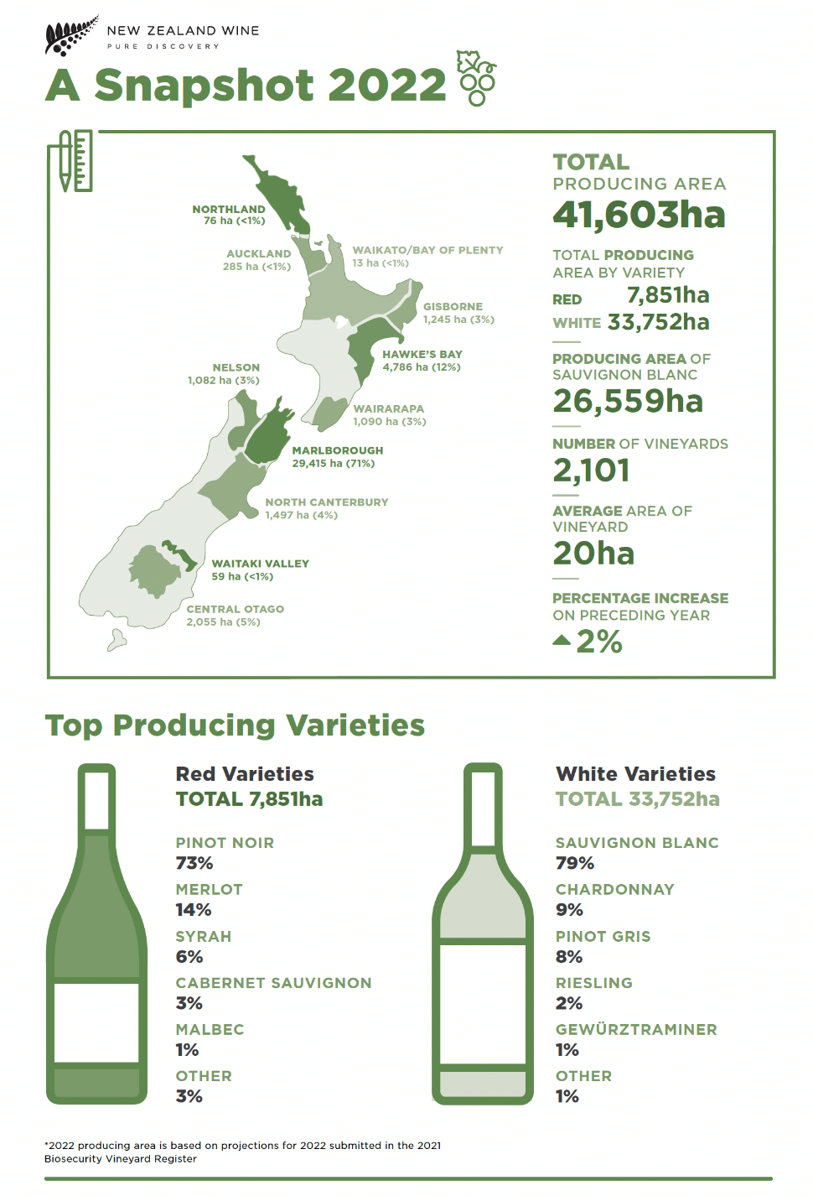
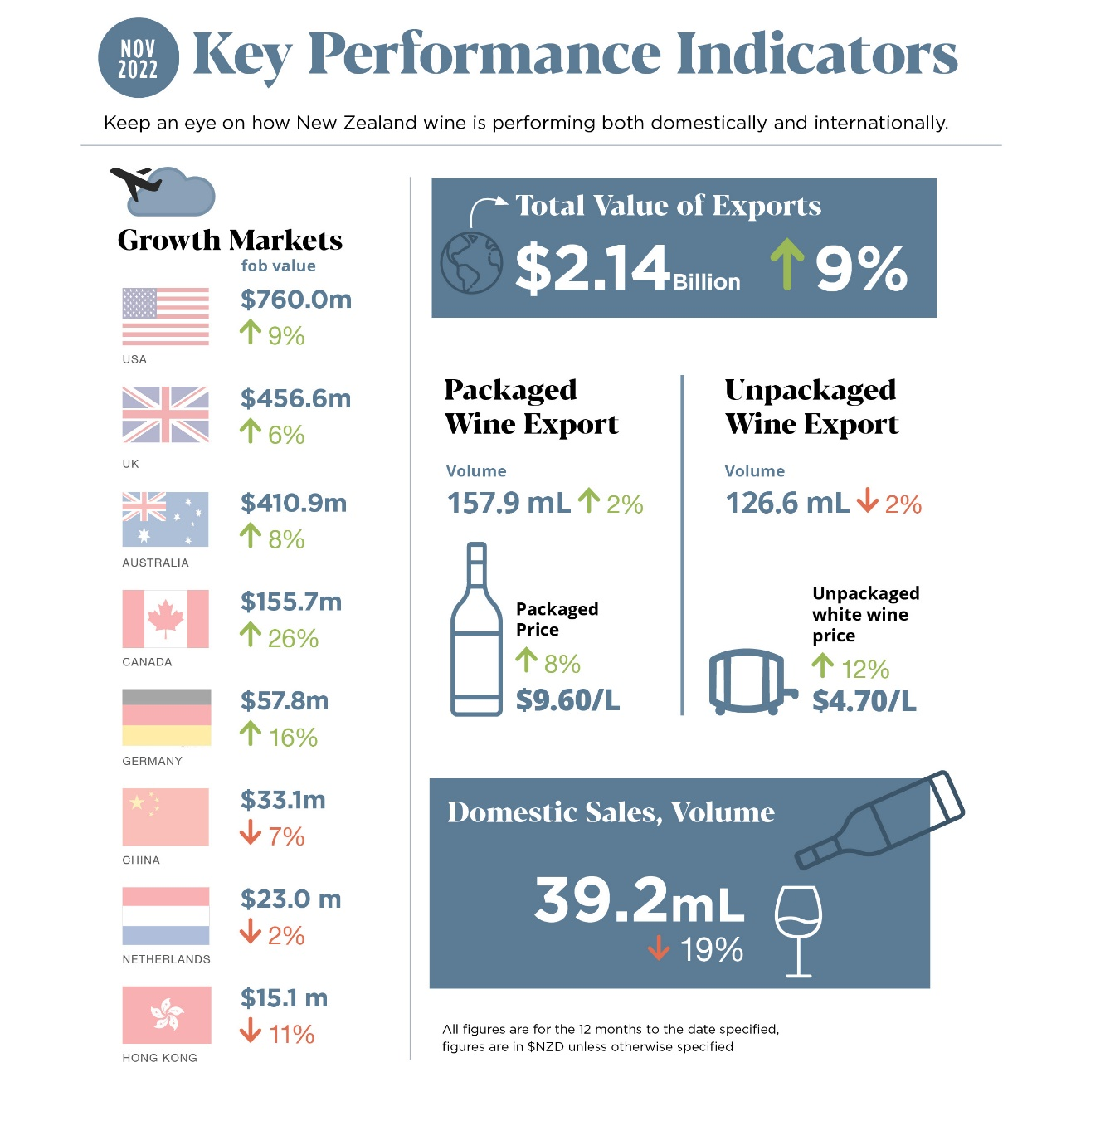
Notes:
Overview of the NZ wine industry – where our wine comes from (vineyard register infographic) vs where our wine goes (most recent KPI infographic)

Slide 5
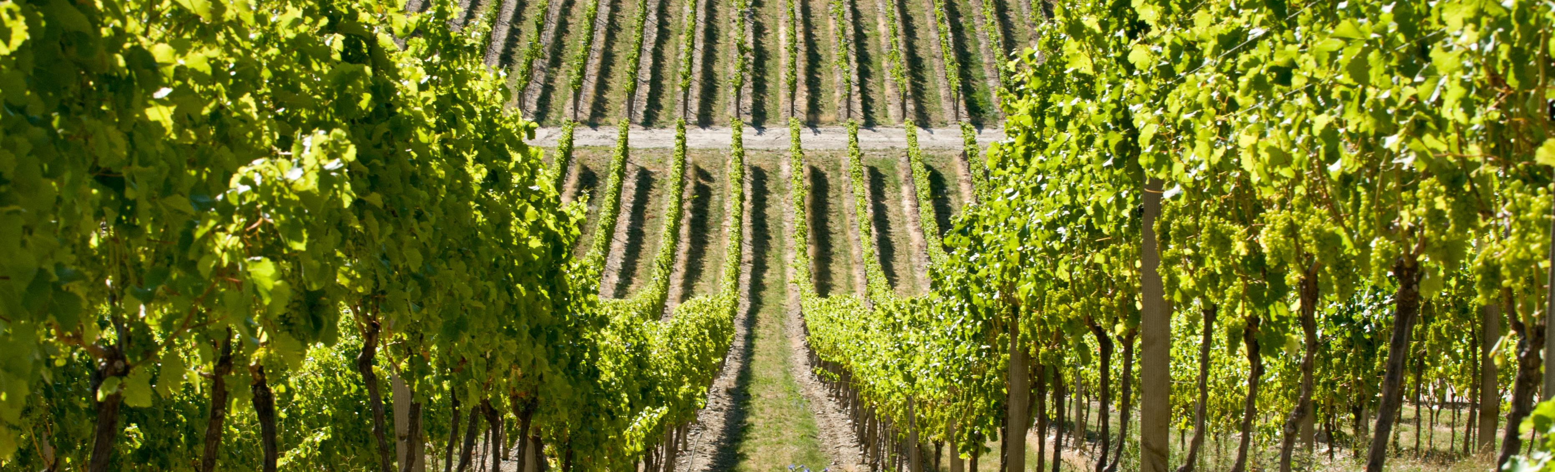
Premium sustainable wine
Shift from value added production to production that aligns
with consumers' values
Altogether unique
Reputation is everything

Slide 6
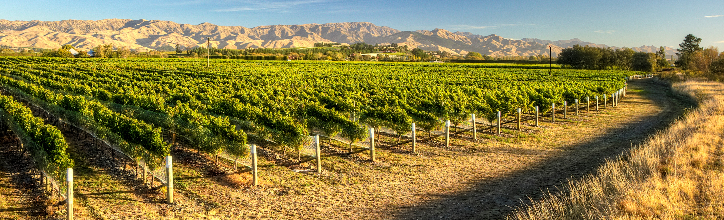
Our Sustainability Journey is vital for continued growth
Consumers expect it
Governments demand it
Hip pockets require it
It’s the right thing to do

Slide 7
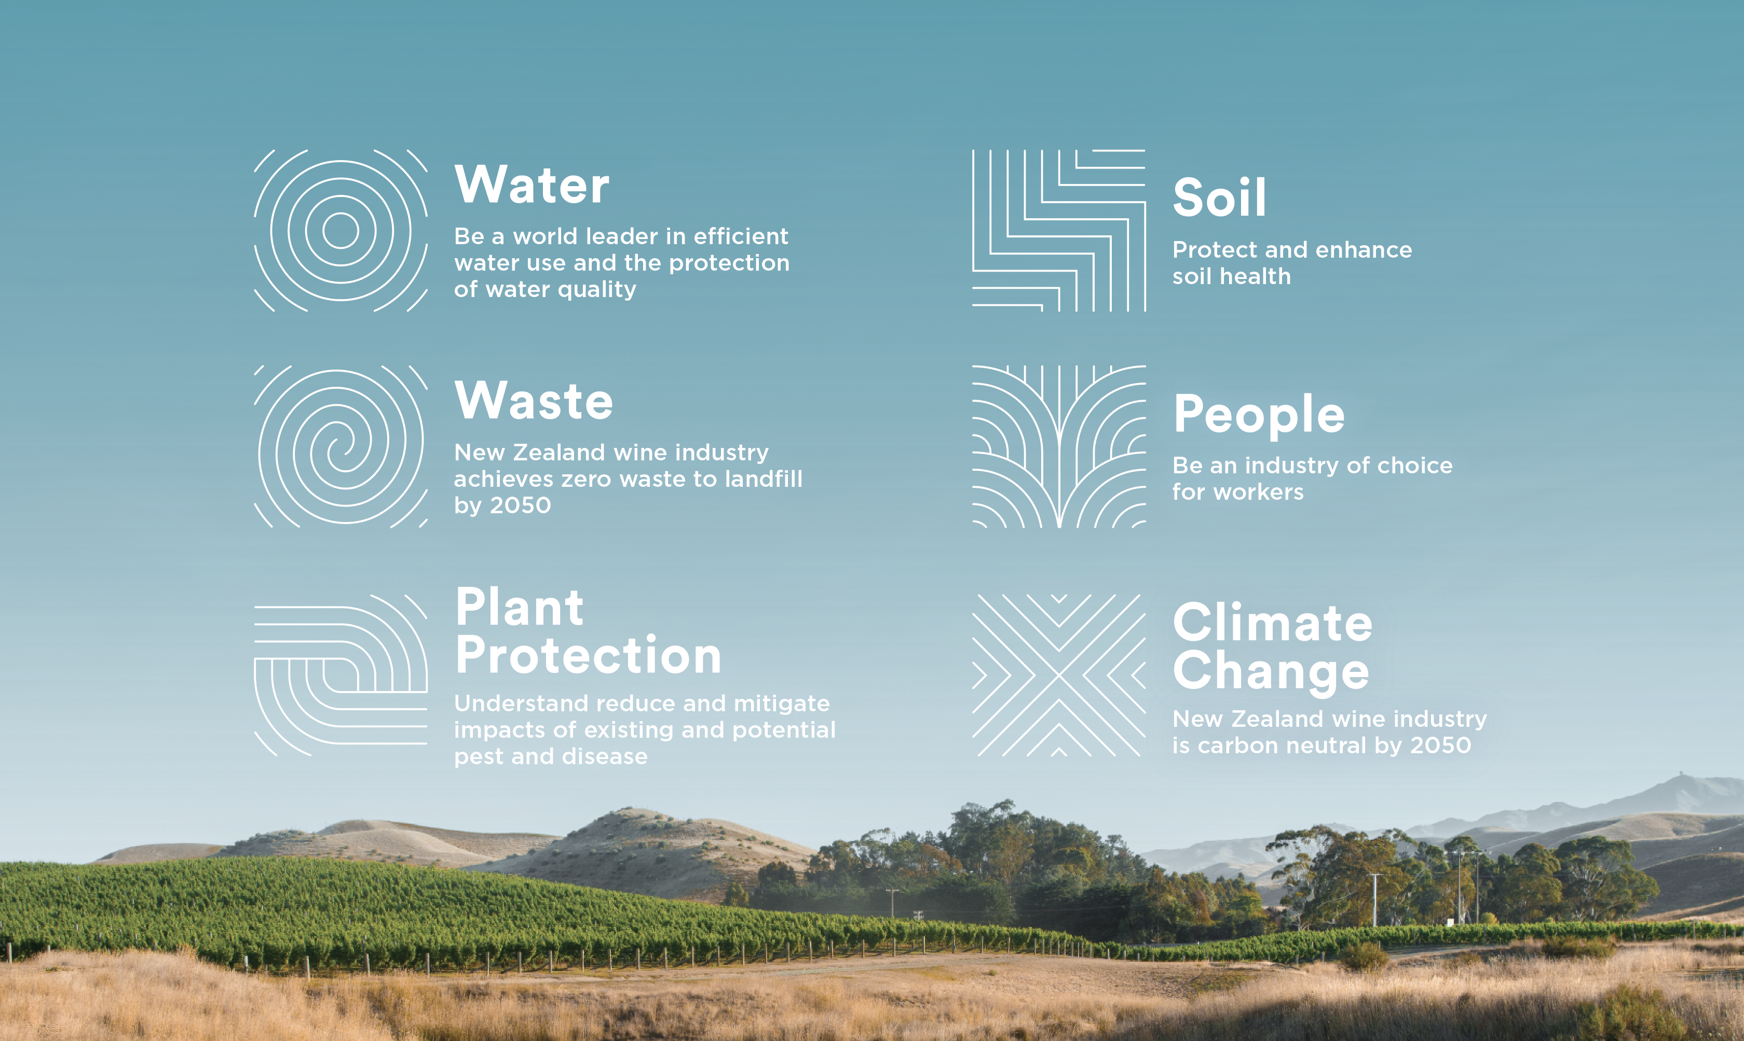
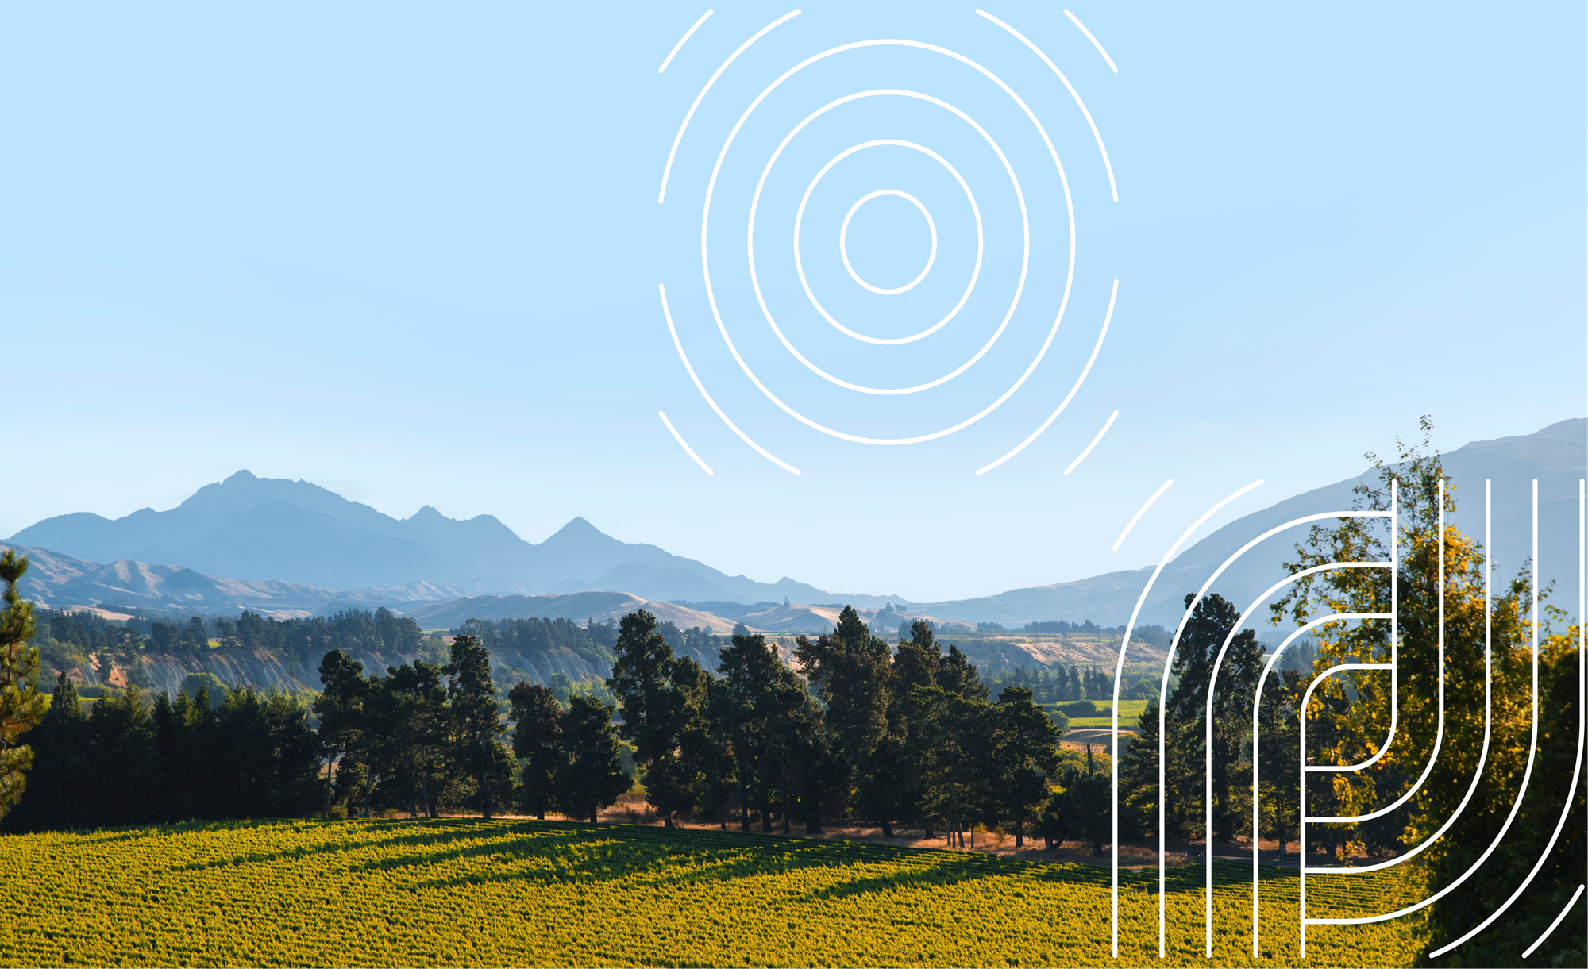
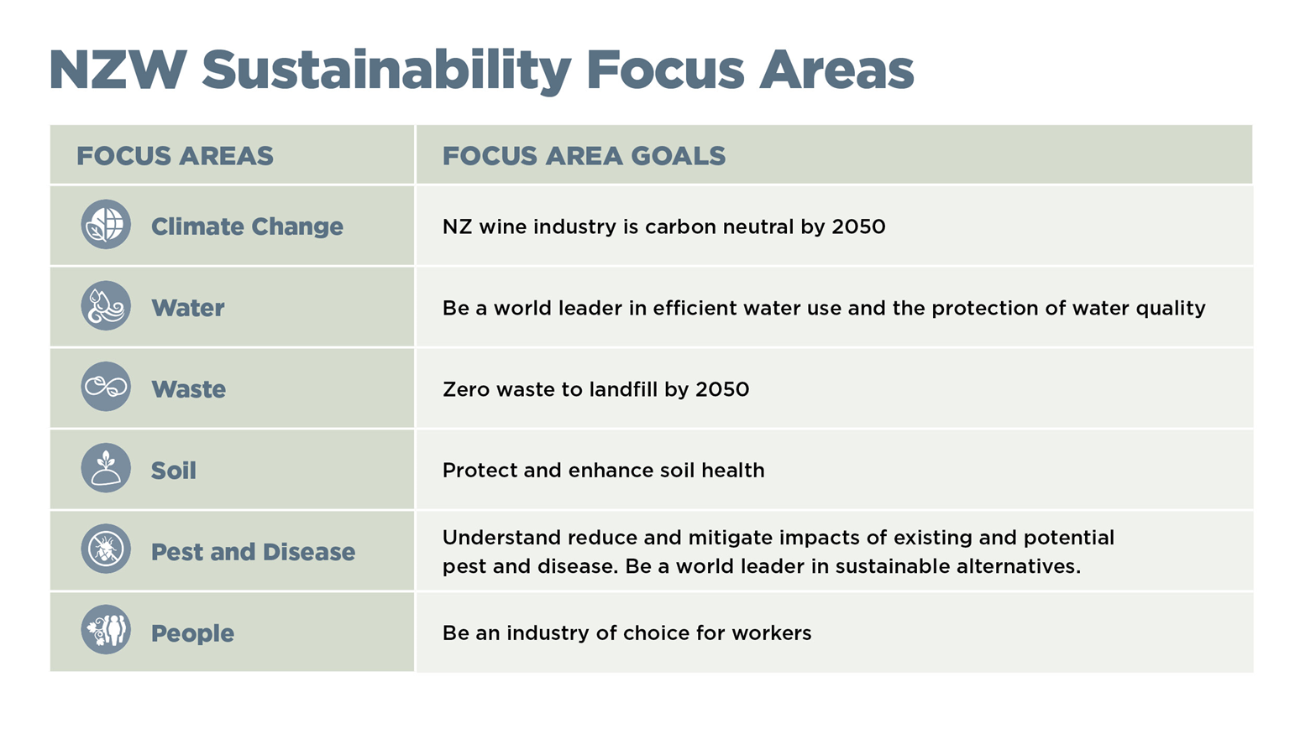

Slide 8
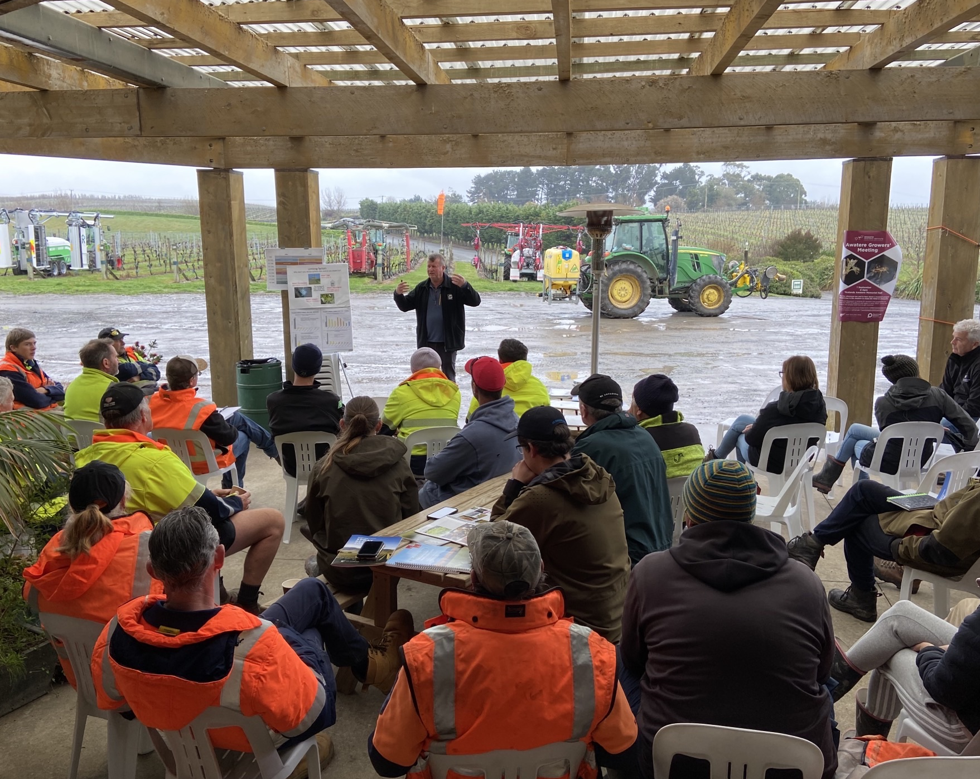
Sustainable Winegrowing NZ
A world leading industry assurance programme
Sustainability needs proof points and requires measurement to be robust
We know our numbers - we implement best practice and continuous improvement
Helps to protect and enhance reputation

Slide 9






Sustainable Winegrowing NZ
Example vineyard questionnaire requirements
Water
Irrigation & frost protection
Regulatory requirements
Water optimisation & efficiency
Soil
Soil makeup and health
Under-vine & inter-row management
Nutritional/biological inputs
Pest & Disease
Monitoring procedures
Spray management & certifications
Biosecurity
Audit Verification
Waste
Waste management
Waste reduction initiatives
Vineyard posts & grape marc
Climate Change
Carbon certification
Energy inputs (diesel, electricity, petrol)
Carbon footprint minimisation
People
Key documents (H&S plan, site map, SOPs)
Employment agreements
Agrichemical & fuel storage
Notes:
Example SWNZ questionnaire requirements for vineyards – shows the type of information/data required from members for certification

Slide 10
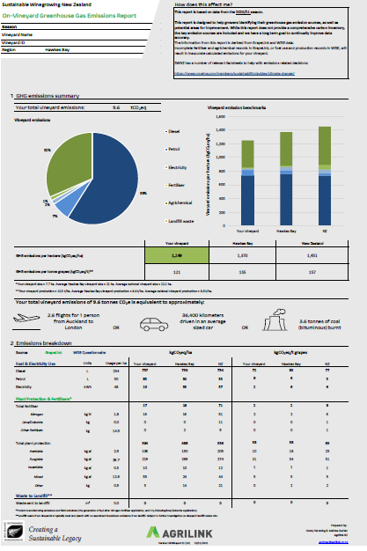
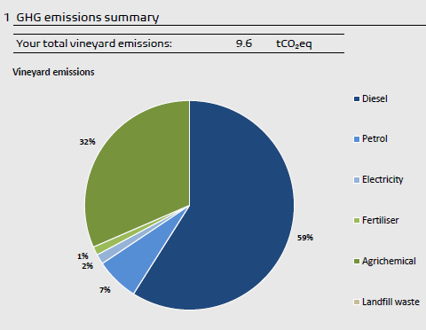
Sustainable Winegrowing NZ
Personalised benchmarking
Notes:
Providing information back to members to help them identify areas for improvement – series of personalised benchmarking reports given to every member each year

Slide 11
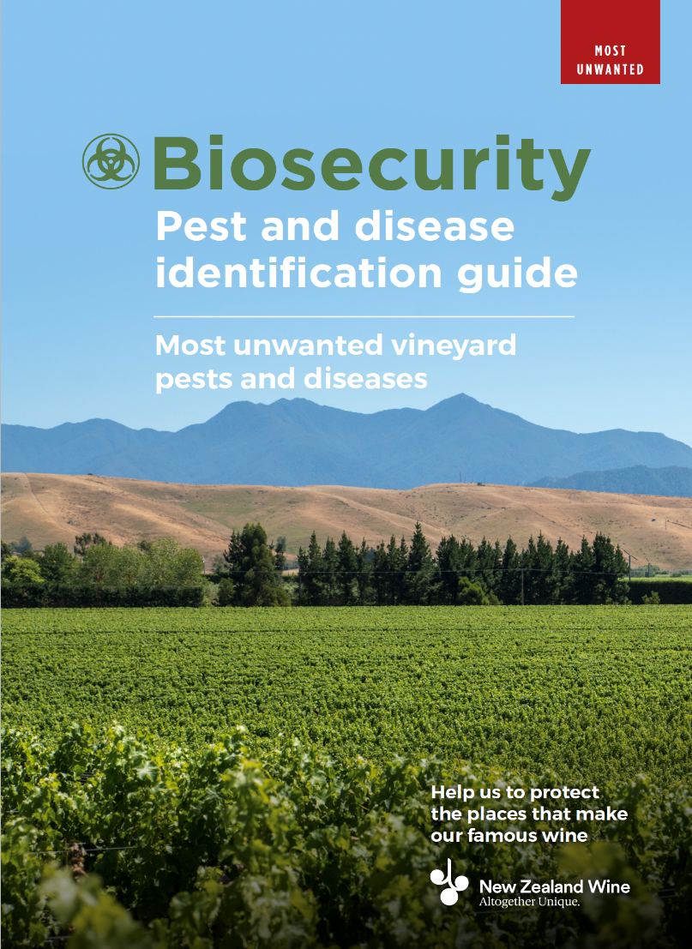
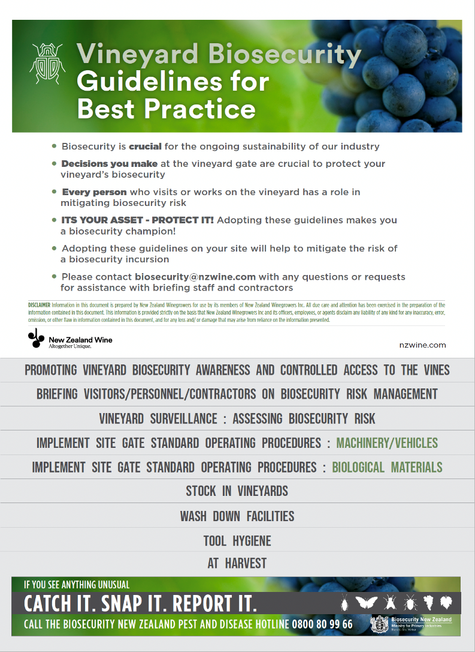

Biosecurity
Awareness & readiness resources
Notes:
Biosecurity resources available for members

Slide 12

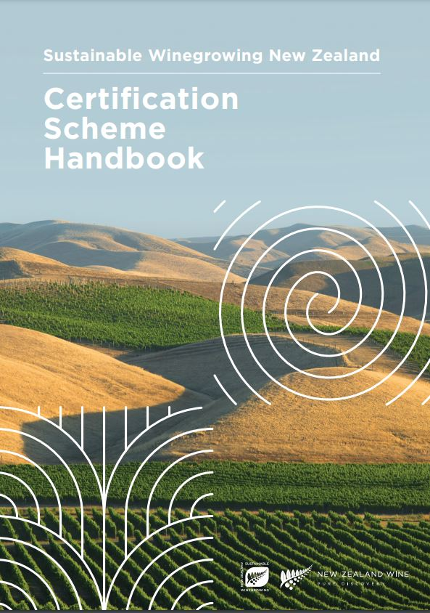
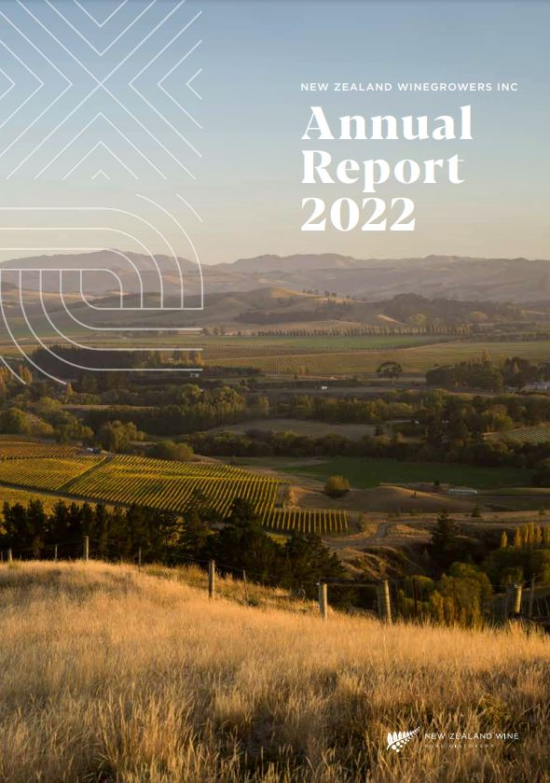
NZW Sustainability Activities
Further information
Notes:
Further information about NZW and SWNZ – available on nzwine.com or by contacting Ed

Slide 13
