Slide 1
Juniper
Worldwide situation with supply and progress on NZ juniper industry
New Zealand Distillers’ Conference
Auckland 9 June 2023
Eve Kawana-Brown
on behalf of Massey University/Juno Gin Collaboration

Slide 2
Who on earth am I…?

Slide 3
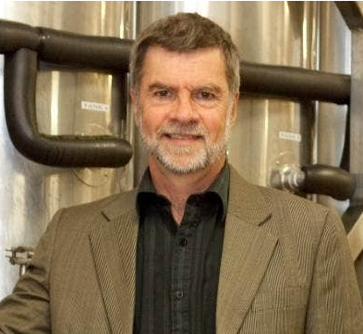
Some of the Team
Eve Kawana-Brown
Richard Archer
Dave and Jo James
David Popovich
Joanne Hort
Svetla Sofkova
Vaughan Symonds

Slide 4
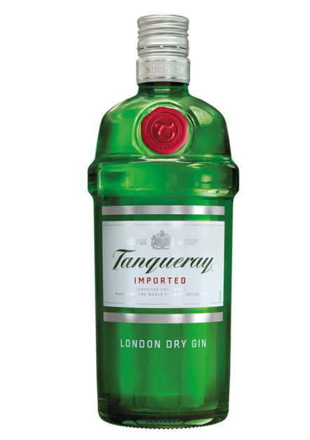
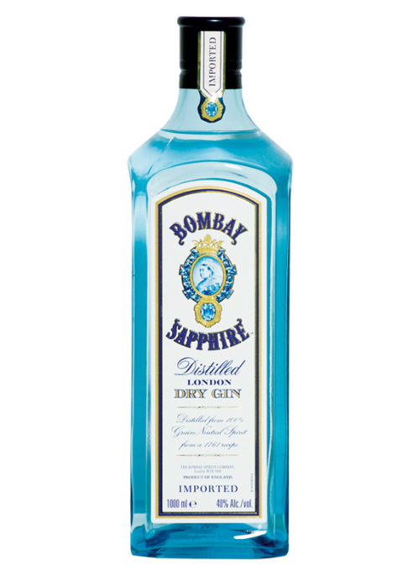
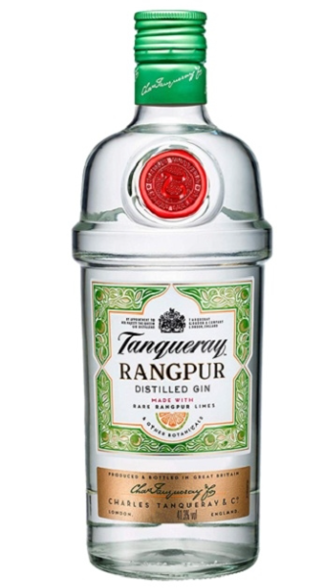
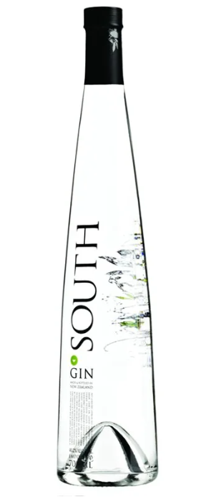
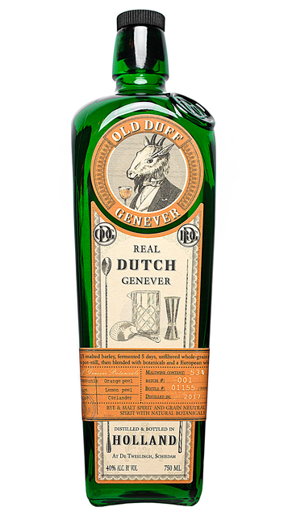
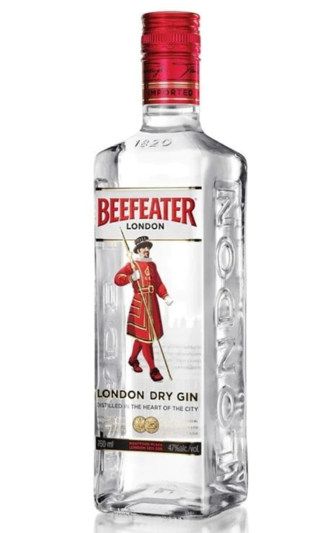
Credentials and Qualification Timeline

Slide 5
The odd cocktail…

Slide 6
“To develop a relationship with businesses, sectors and industry that serves to ensure Massey University and Venture Taranaki expertise are meaningfully utilised in Taranaki to build and underpin sustainable economic growth in the region.” (2013)

Slide 7
Why did we begin working on gin and juniper-related?

Slide 8
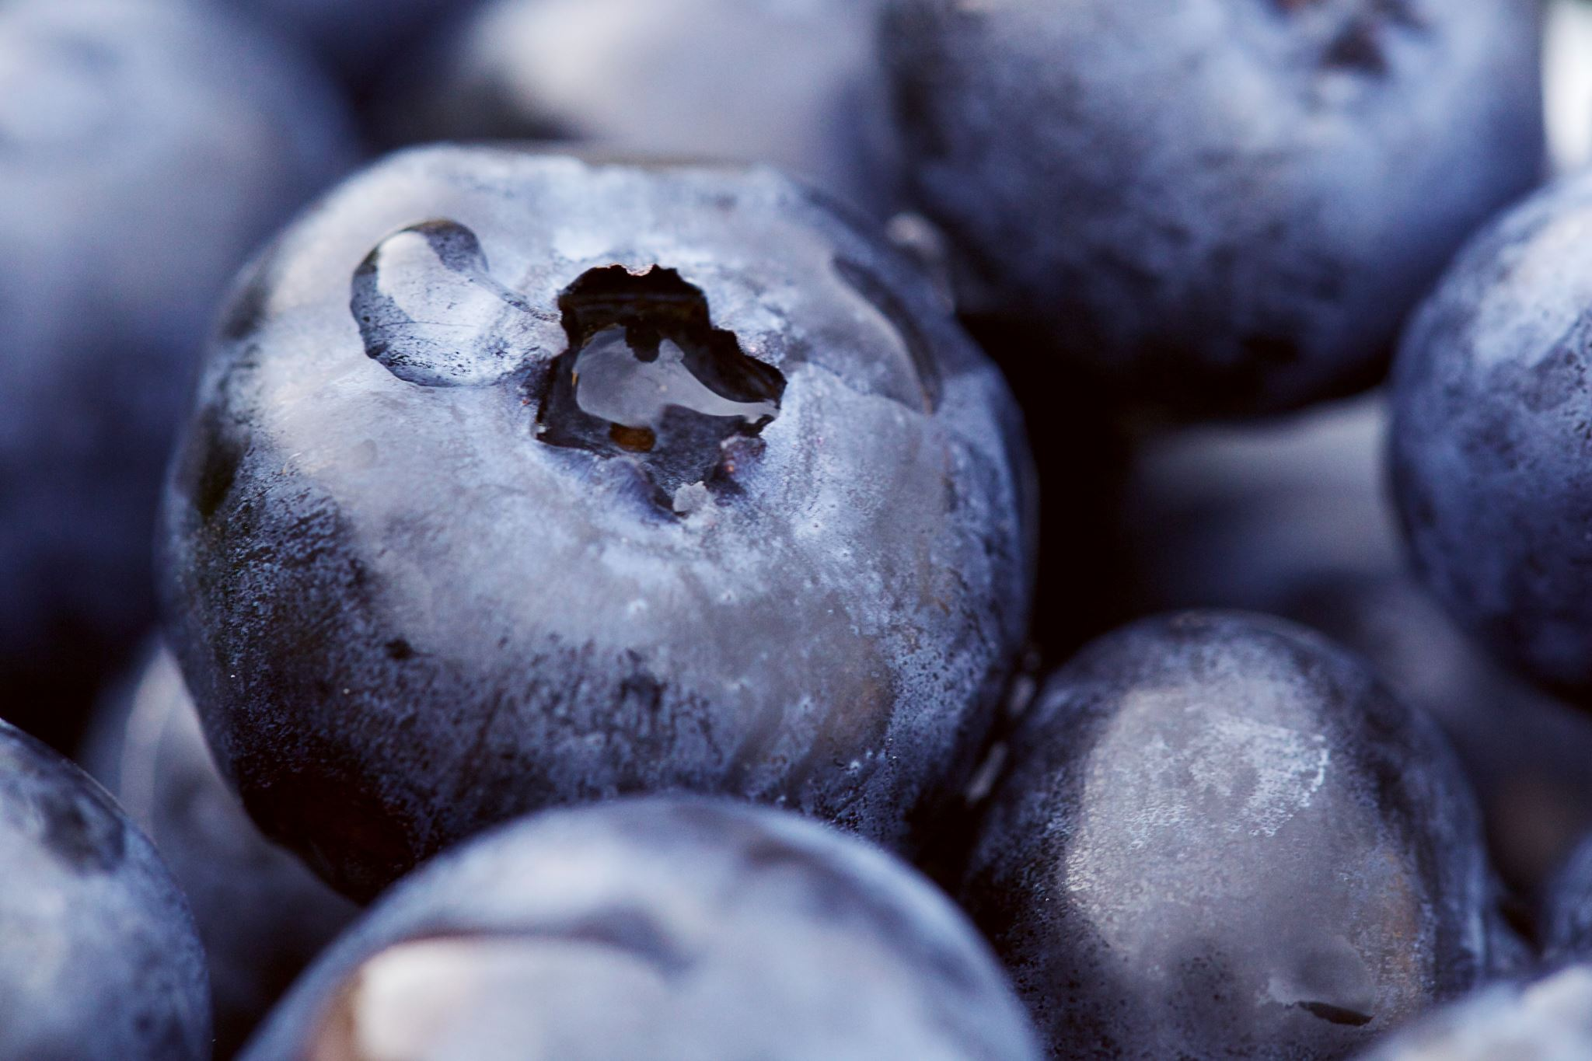
What is Juniper?

Slide 9
Juniperus is a diverse genus of the Cuppressaceae tree family (around 75 species)
Northern group (blue-black cones) and Mediterranean group (reddish cones)
Long-lived – often 100-200 yrs, and some as old as 600 yrs
Northern hemisphere native, junipers survive in range of soils/climates, but watch frost, sunlight, fungal disease (Phytophtora austrocedri)
‘Berries’ are female cones, produced from around Yr 3 and take 3 years to ripen (ripen if male tree nearby, fertile if same species nearby)
Northern Hemisphere trees noted as producing around 0.5 – 1.0 kg berries per tree per season
Juniperus communis are main/only berries recommended for eating/gin (ISO 7377:1984) - 0.5 – 3.0% essential oil content
London Dry Method of distilling gin involves redistillation of alcohol (96% v/v) in the presence of juniper berries and other natural botanical ingredients

Slide 10
The Worldwide Situation with Supply

Slide 11
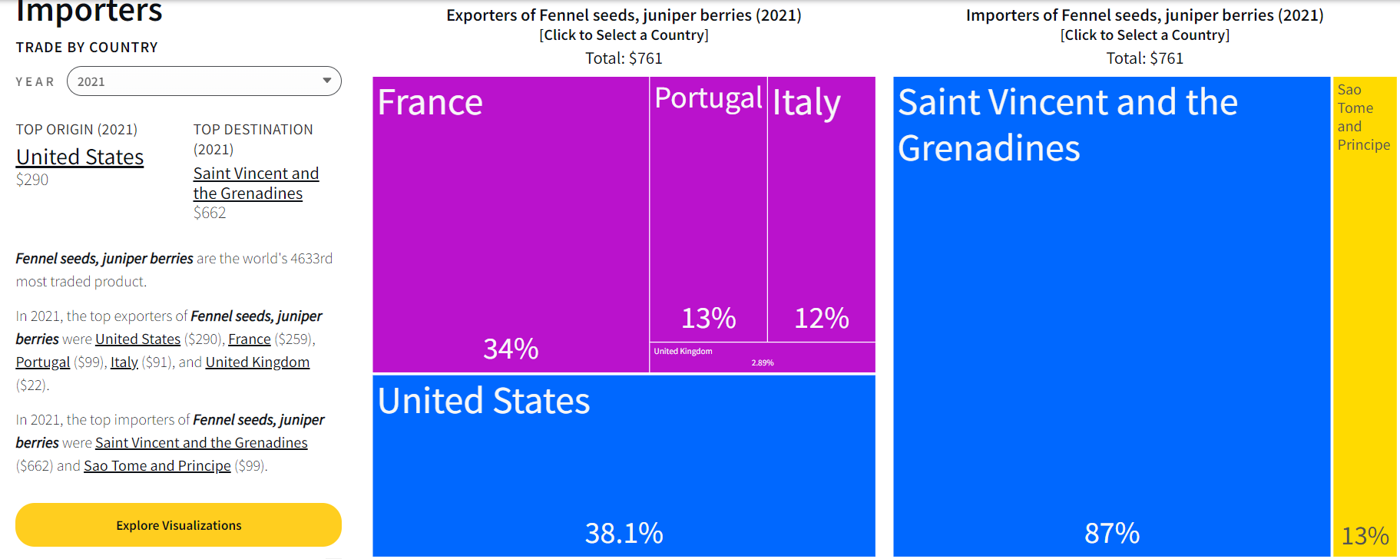
It’s hard to find good information…..
Source: The Observatory of Economic Complexity (www.oec.world)

Slide 12
Chat GPT - 17 May 2023
“As an AI language model, I don't have real-time data access. However, I can provide you with some general information on the global import and export of juniper berries, along with some potential data sources you can explore to obtain the most up-to-date information.”
“I'm sorry, but as an AI language model, I don't have access to real-time data or specific trade information such as the volumes of trade for juniper berries in 2022. My training only goes up until September 2021, and I don't have browsing capabilities to look up the latest trade data.”
“As an AI language model with a knowledge cutoff in September 2021, I don't have access to real-time data or the ability to browse the internet. Therefore, I cannot provide you with the current information on which countries are exporting juniper berries and their respective volumes.”

Slide 13
And then…
To access current data on global import and export statistics for juniper berries, you can refer to the following potential sources:
International Trade Centre
https://www.trademap.org/
United Nations Comtrade Database
https://comtrade.un.org/

Slide 14
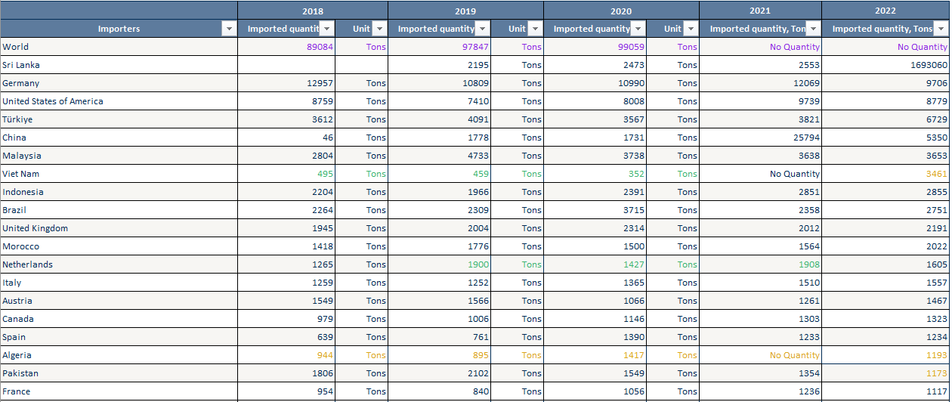
Followed by… An appeal to NZ Trade & Enterprise Resulting in… “Trade Data from 2022 for juniper berries 090961 from ITC” Sources: ITC calculations based on UN COMTRADE and ITC statistics For Product : 090961 Juniper berries and seeds of anise, badian, caraway or fennel, neither crushed nor ground
With thanks and acknowledgement to Ed Parker, Regional Manager, Taranaki
and Lucy Vickers, Research Specialist, NZTE

Slide 15
Export Data 2018-2022
With thanks and acknowledgement to the wizardry of
Qiufen Cui, Business Analyst, Venture Taranaki

Slide 16
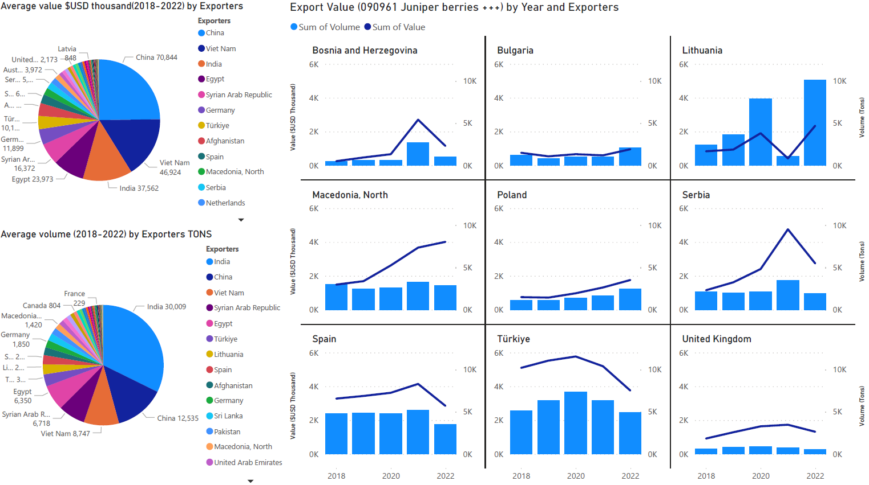

Slide 17
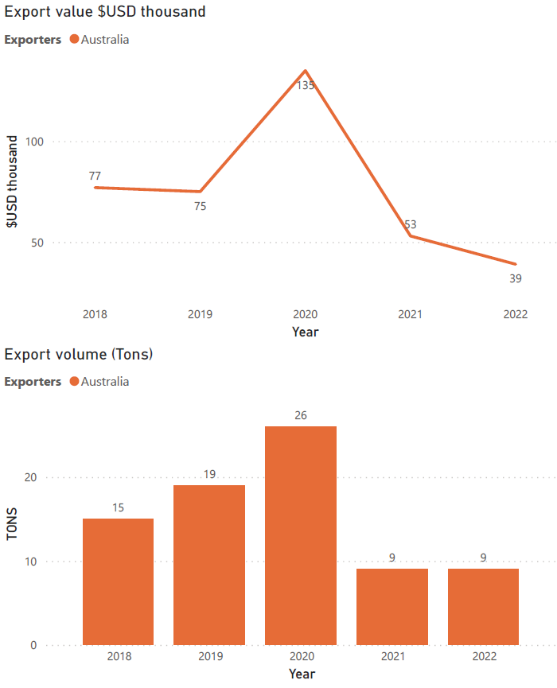
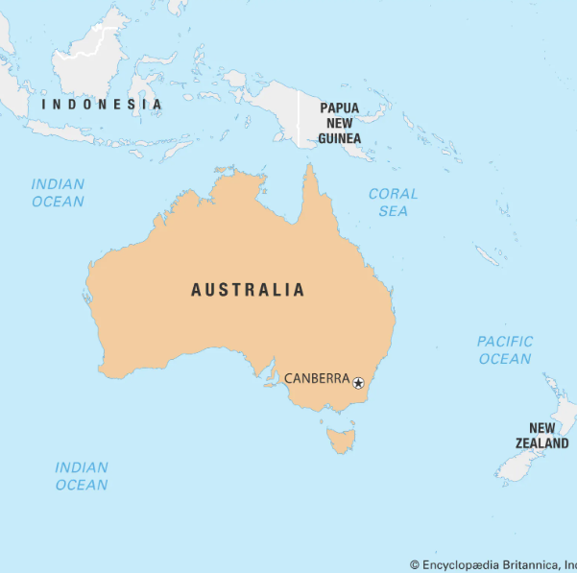

Slide 18
Import Data 2018-2022
With thanks and acknowledgement to Sue James, David James and Qiufen Cui for help with this data

Slide 19
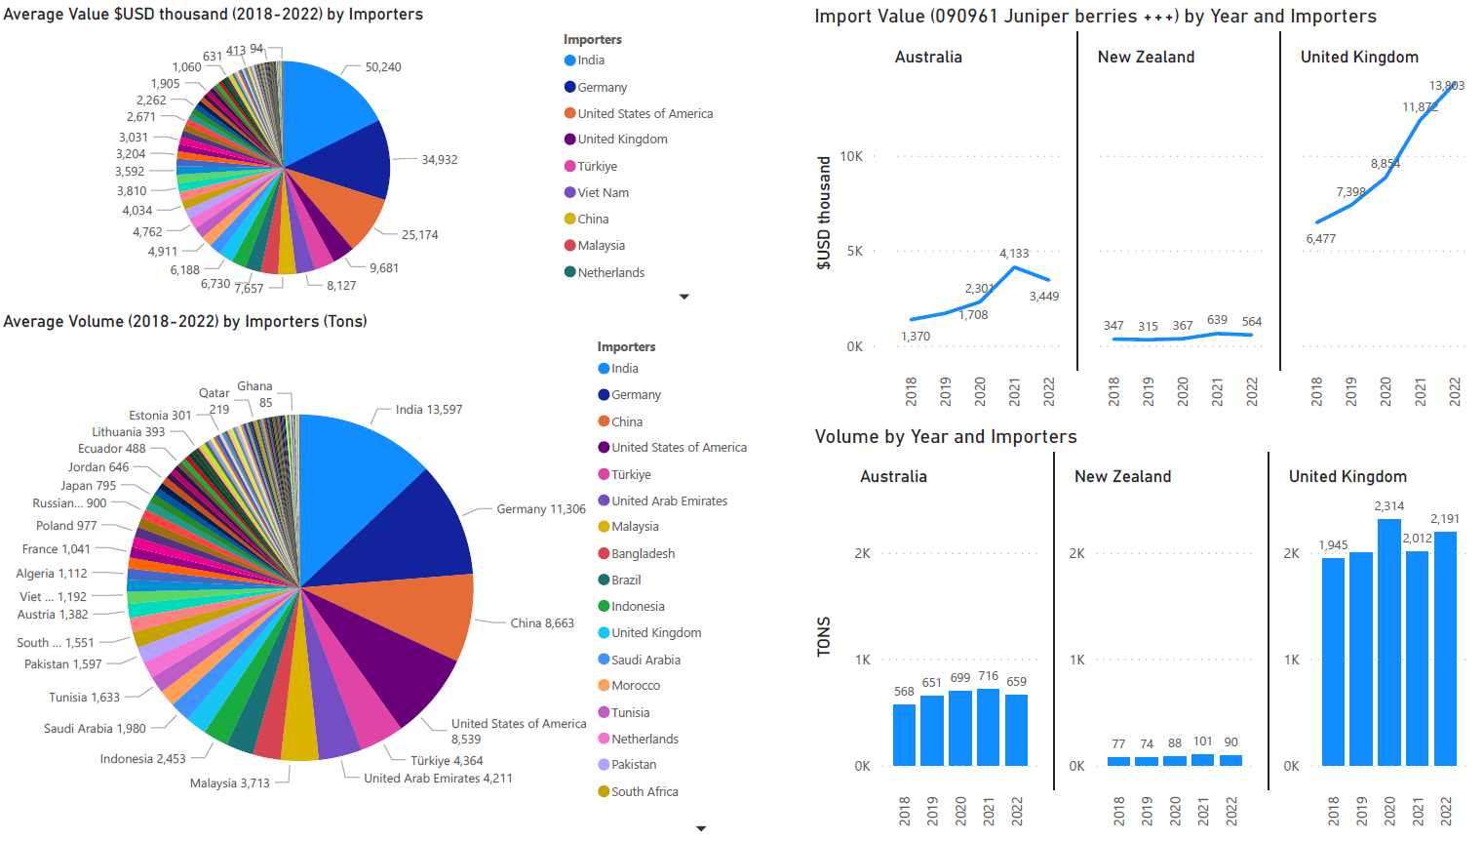

Slide 20
Global Import and Export Total Volumes 2018-2021

Slide 21
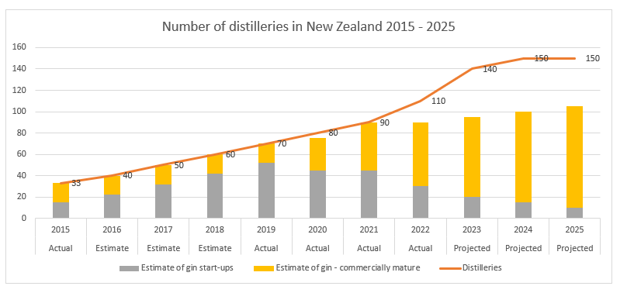
Growth in New Zealand Gin Distilleries

Slide 22
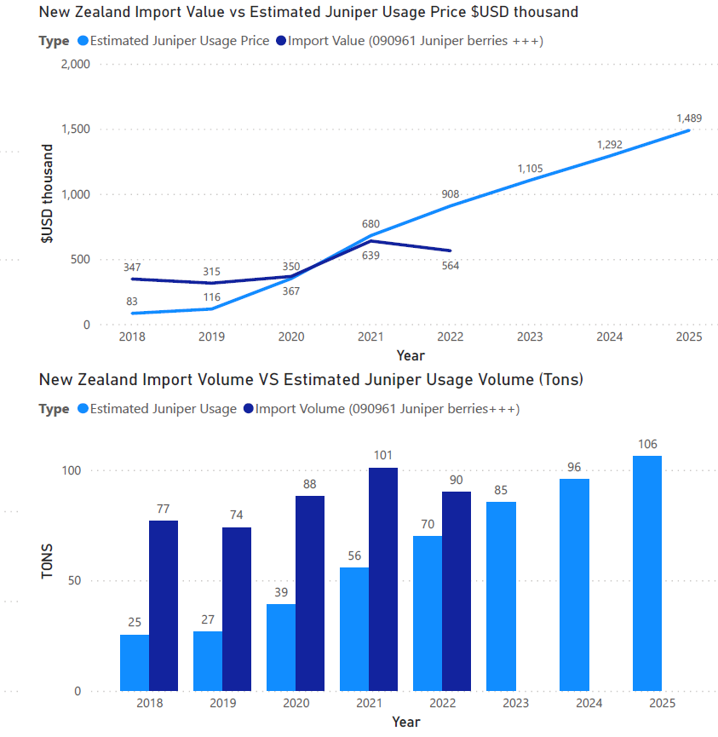
Estimates of NZ Distillery Juniper Usage & Category Import Data
Assumptions:
Price point $6/kg 2015, rising to projected $25.80/kg 2025
Start-up Distilleries average use is 120kg p.a.
Commercially mature Distilleries use $1,000kg p.a.
NZ tonnes have been converted to USA tons and $NZ have been converted to $USA to allow for comparisons between NZ usage data and import data

Slide 23
Progress on New Zealand Juniper Industry

Slide 25
Why New Zealand Juniper?
Begins with Begin Distilling / Juno Gin
Local Supply Chain
Provenance
Point of Difference
Transparency and Traceability
Sustainability
Fostering additional opportunity for Taranaki / NZ
Cost
Accessibility / Supply Chain Threats & Bottlenecks
Quality
Summer 2017 - 2018

Slide 26
Collaboration partners and Funders
Enterprise and Business Development (Venture Taranaki partnership)
School of Agriculture and Environment
School of Food and Advanced Technology
Food Experience and Sensory Testing (FEAST) Laboratory
School of Natural Sciences
Plant Growth Unit

Slide 27
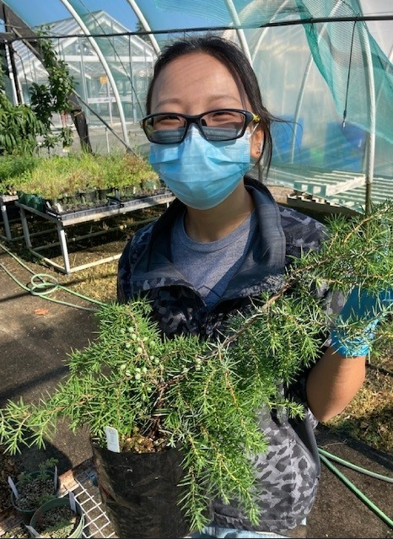
Significant Student Contributions
Talon Sneddon
Ben Ruston
Shikaele Harris & Sophie Lim
Su Liu

Slide 28
Mid 2018 – Apr 2020 ‘Juniper Genetics Study’
MPI-approved biosecurity treatments for seeds – requires chemicals not approved for use in USA/Germany
Plant Import Health Standards require plants to be quarantined as highest level 6+ months, but with a 3-year waitlist for the only accredited facility in NZ
No tissue culture imports permitted
Hunt proper started February 2019
By April 2020 - 142 observations by 32 observers, with 19 acting as identifiers, noting 11 species
By May 2023 - 211 observations by 79 observers, with 29 acting as identifiers, noting 9 species
Contacted 30+ clubs and societies and 40+ nurseries
And golf courses…
https://inaturalist.nz/projects/the-great-new-zealand-juniper-hunt

Slide 29
The Great New Zealand Juniper Hunt
2019 until now….
We have worked with 129 specimens
from 52 tree owners/identifiers

Slide 30
Confused landscape…

Slide 31
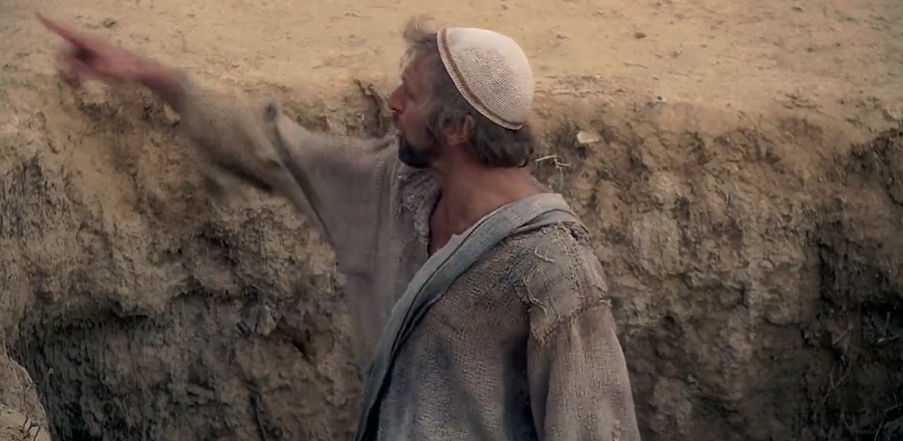
https://www.playphrase.me/#/search; https://getyarn.io/yarn-clip/c453b093-088d-4897-926e-a5f57b1602a5
Monty Python’s Life of Brian 1979 – ‘Alright I am the Messiah’

Slide 32
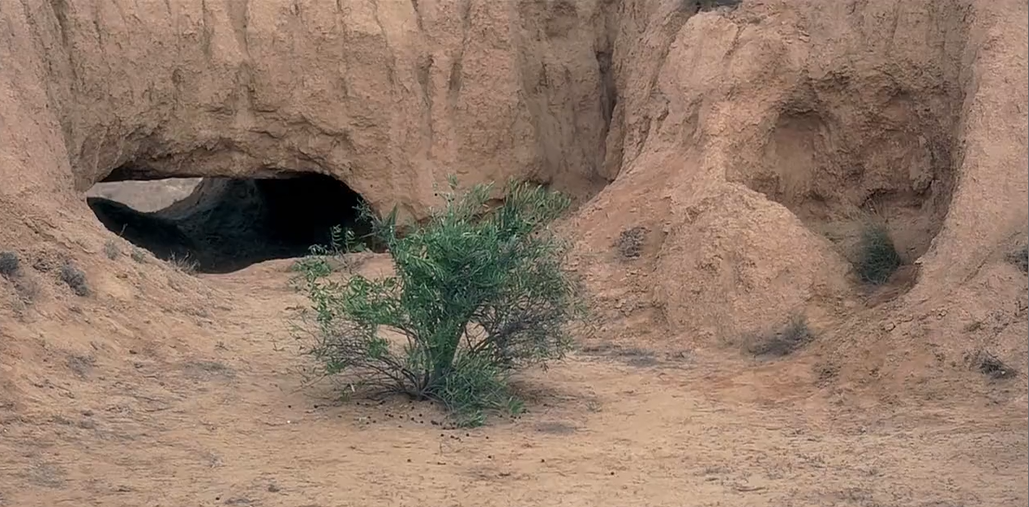
“What about those juniper bushes over there?”

Slide 33
Juniperus communis morphology (‘Spirited Away’, Joanna Wane, North & South, April 2020)

Slide 34
The Great New Zealand Juniper Find to date
20-25 owners of Juniperus communis
Approx 40 adult Juniperus communis confirmed so far
+ More bred-on from those

Slide 35
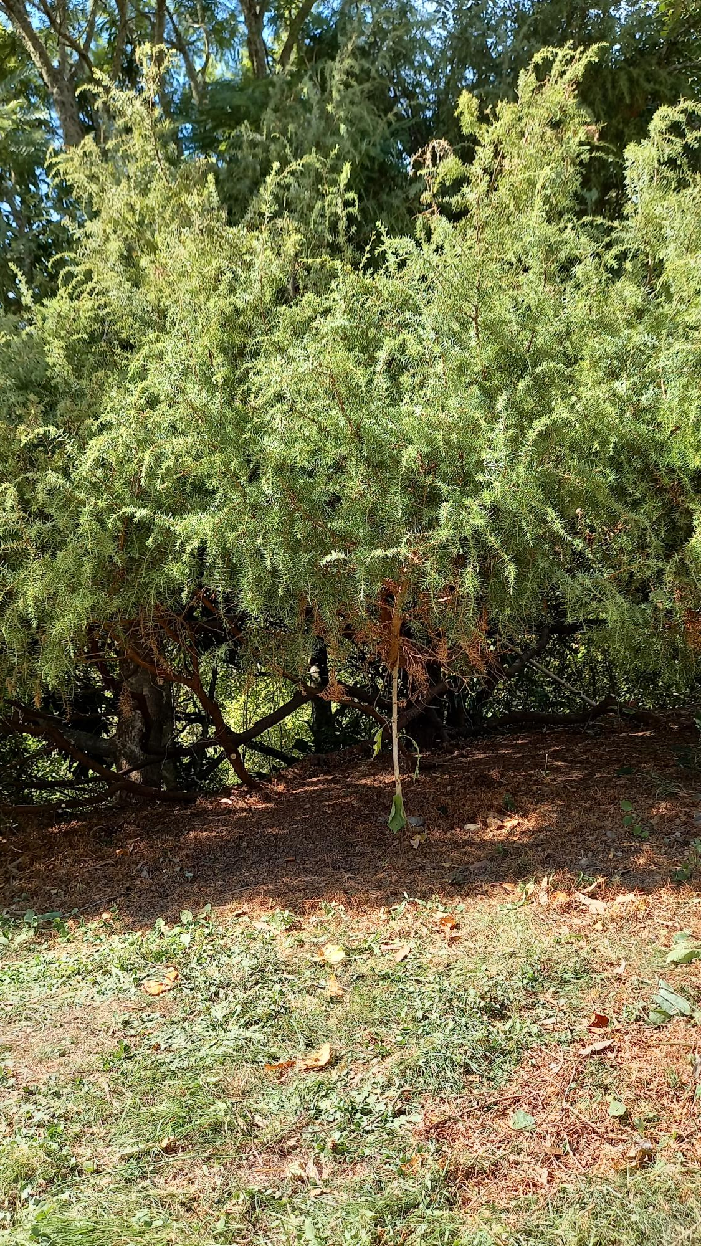
What we were looking for…

Slide 36
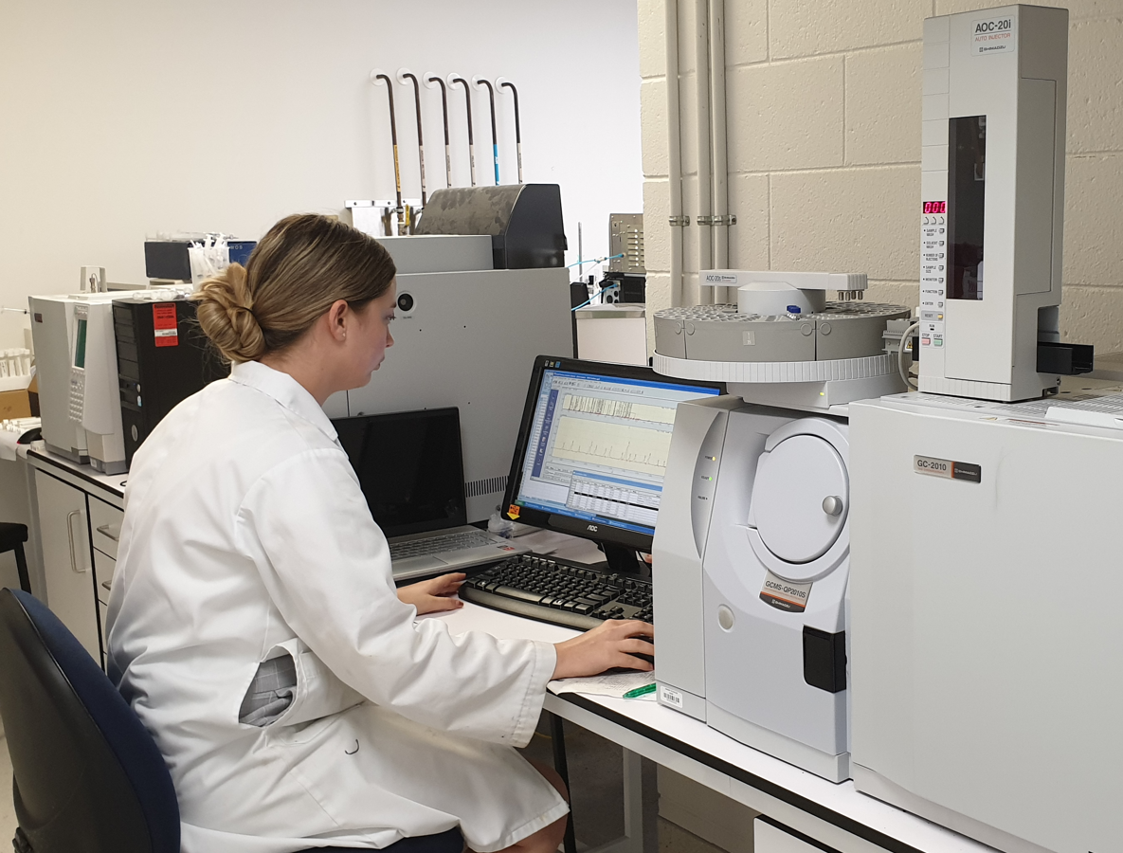
Juniper Genetics Study Findings
Trees and tree owners
Plant ID, collection & storage protocols
What is not a Juniperus communis
Microsatellite DNA markers analysed, selected and trialled, with genetic testing of 24 samples showing promising level of heterozygosity
Berry volatiles testing
Propagation experiments (experimenting with variables that impact rooting and growth success – cutting, timing, plant material, media, hormones, greenhouse conditions)

Slide 37
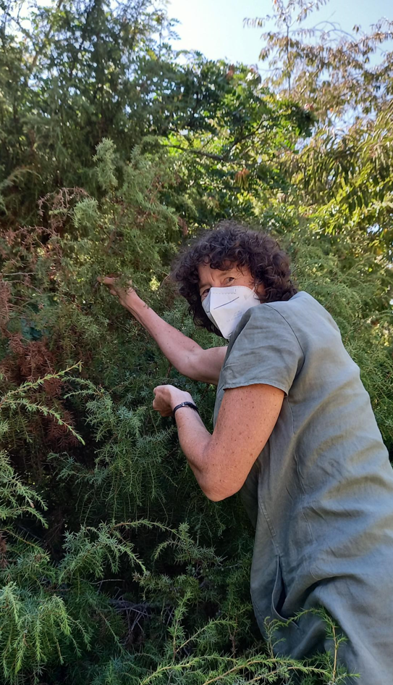
2021 – 2022 ‘Advancing a Juniper Berry Industry for New Zealand’
To focus on:
MORE juniper hunting (females with berries!!!)
Sensory testing of NZ juniper berry gins
Clonal propagation experimentation
Micropropagation experimentation
Refining molecular marker system for establishing genetic diversity

Slide 38
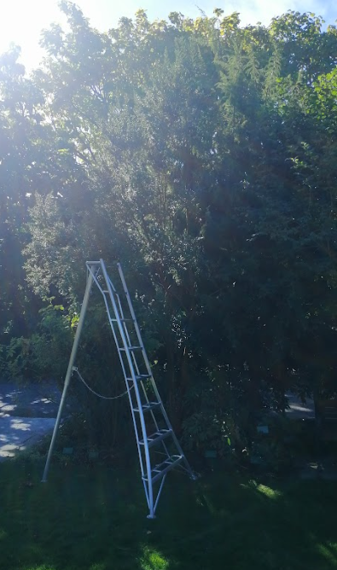
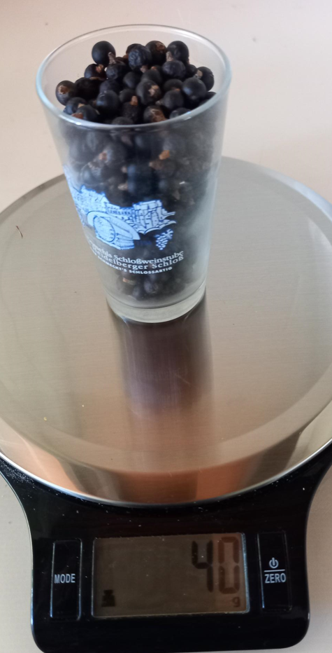
Juniper Berry Hunt
Totals collected Summer-Autumn 2022
235.81g from tree #1 (dried weight)
86.32g from tree #2 (dried weight)
Tree #1
Tree #2

Slide 39
Can consumers (n=51) perceive differences in aroma profiles?
Sensory Testing
Prepared ‘model gins’ using 300g, 150g, 100g, and 50g berries
75gm gins made for actual testing – NI, SI, Macedonian
Aroma testing only (13 aromas)
NZ juniper gins ‘less intense’
No preference, as such
NI gin more ‘grassy’ and ‘spicy’
SI gin more ‘piney’ and ‘woody’
Both less ‘citrus’ and ‘floral’ than Macedonian
Other differences observed, but not statistically significant
Chief finding – taste testing of gins will be key to further understandings

Slide 40
Juniper Genetics
Developed and deployed a range of molecular genetic markers on all source plants identified as J. communis, as well as a small collection of other Juniperus species, with a goal of better understanding the genetic diversity in NZ junipers.
Full genotyping of 46 samples, representing 40 J. communis and 6 ‘other juniper’ was successful.
Found that there is considerable genetic variation within NZ stockholdings, and three primary genetic groupings were identified.
Compares with similar patterns found in native J. communis conducted in Europe (Lithuania, Belgium, France and Germany).
Three clusters of genetically identical specimens were observed, indicative of genetic cloning.
Progression of a juniper cropping system will need to remain informed about the genetic composition of individuals so that vulnerable monocultures are avoided.

Slide 41
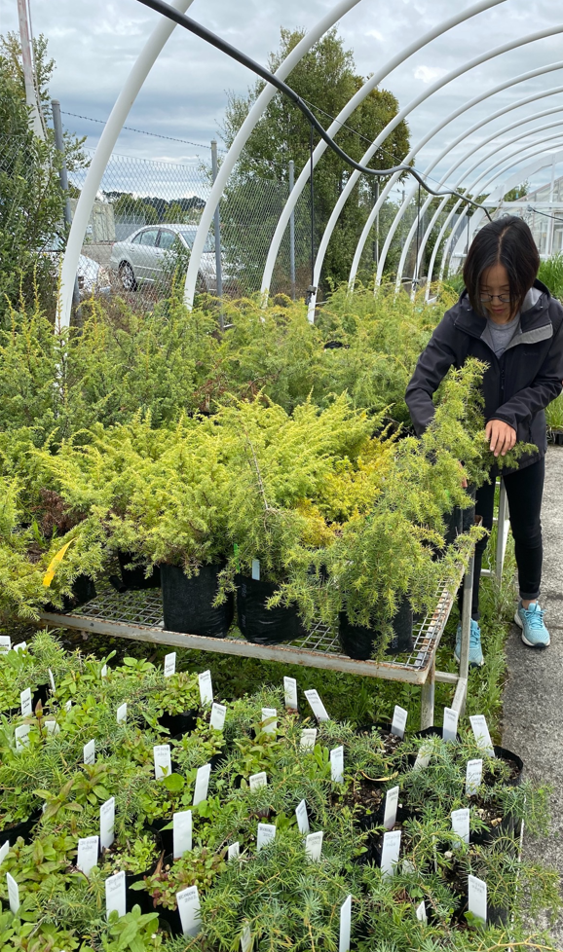
Clonal Propagation Work
Three experiments: Oct 2020 – Mar 2021, Sep 2021 – Dec 2021, and Jun 2022-Oct 2022
Multiple replications of cuttings from different sample trees, subjected to various auxins and rooting/growing media
The first and second experiments saw highest rooting First experiment = 67.86% rooting rate Second experiment = 79.17%
Rooting media and hormone type were observed to impact rooting success. Plant sex also was found to impact rooting, with female cuttings proving less difficult to root

Slide 42
Depending on how a plant is propagated, it can take 2-4 years if propagated from a cutting to reach a level of maturity sufficient for berry production.
17 x 4-5 yr olds in first on-farm trial.
Now 845 young trees in total (plantlets from early cutting stage to 5 yrs), from 8 different tree owners.
72+ enquiries from people wanting to grow or trial grow (Houhora to Tuataupere, Taranaki and Karamea to Cape Runaway, Wairarapa and Akaroa).
In planning stages re ‘where to from here’.

Slide 43
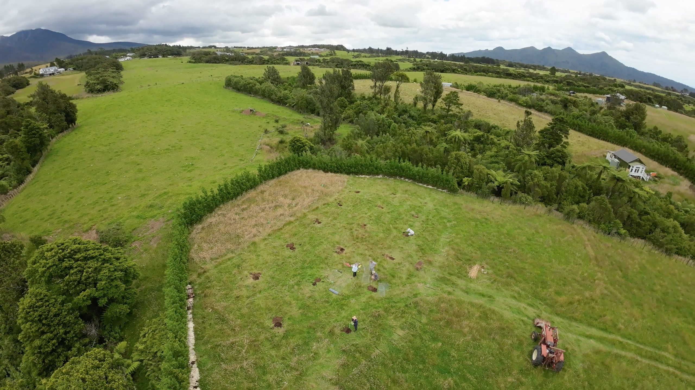

Slide 44
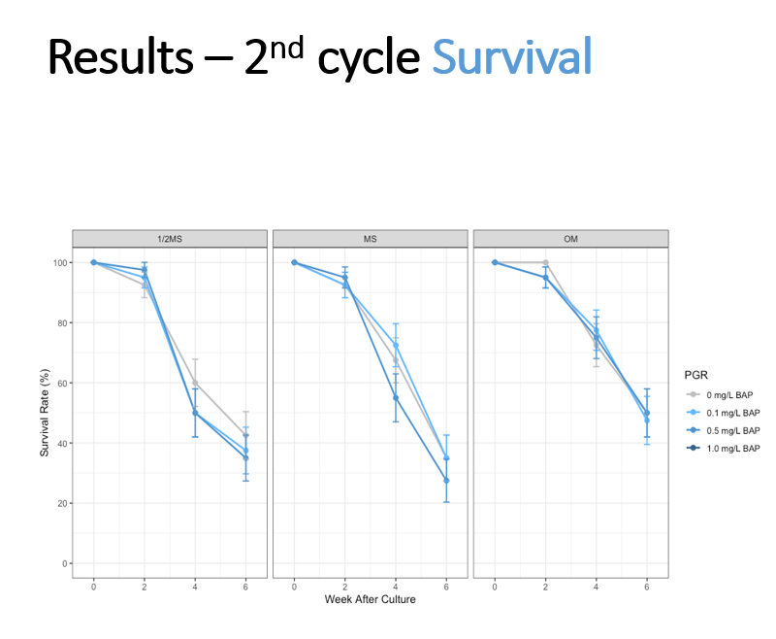
Micropropagation Cloning Experiment
756 shoot tips and 326 nodal segments were cultured on 12 different media for multiplication

Slide 45
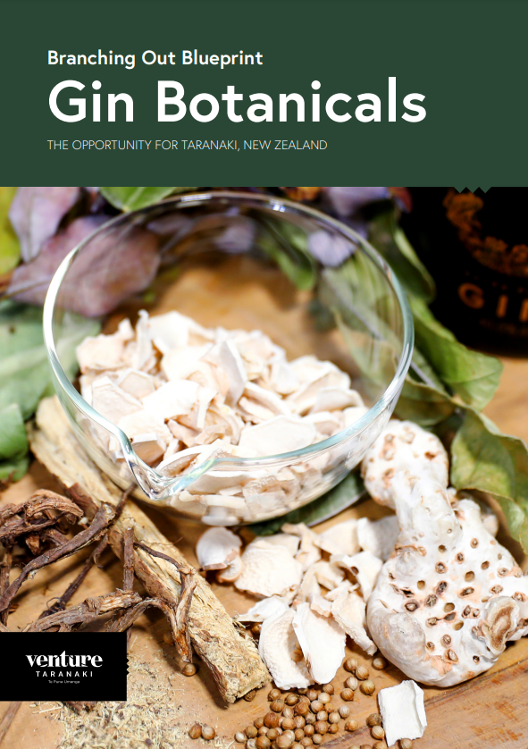
2021 – 2022 Taranaki Branching Out Project
Gin Botanicals “Venture Blueprint”
Seeking to identify innovative, commercially viable food and fibre value chain opportunities for Taranaki.
Blueprints aim to build investor confidence and to provide informative and inspirational ‘roadmaps’ to kick-start complementary land-based activities and associated value chain enterprises in Taranaki.
https://www.venture.org.nz/assets/Uploads/Gin-Blueprint-Final.pdf

Slide 46
What did the Venture Blueprint tell us about Juniper (and Angelica, Orris and Liquorice)?
That they could be grown in Taranaki/NZ
Financials are a bit of a ‘thumb suck’, as yield data is scarce and some ‘unknowns’ in terms of commercial production
$22,000 per tonne (now more like $24,000) sounds attractive, but unknowns around set-up and planting costs, yields and yield timeframes
Good demand in adjacent industries
“Finger-print compounds” could offer “terroir” potential
Carbon sequestration potential (J. thurifera research finding that organic matter stability x lifespan could lead to sequestration of highly stable carbon over a long period
With thanks and acknowledgement to:
Alton Gondipon (Massey Agribusiness graduate) – background research
Michelle Bauer - “Branching Out” Project Manager, Blueprints ‘Driver’
Venture Taranaki Marketing & Comms Team

Slide 47
A “Branching Out” side benefit….
Scion researchers attend ‘Branching Out’ Phase 1 dinner event May 2022.
Indicate they can help with ‘Alternative Biomass Refineries (Plant Valorisation) Project’ by analysing principal components of berries, stems and leaves

Slide 49
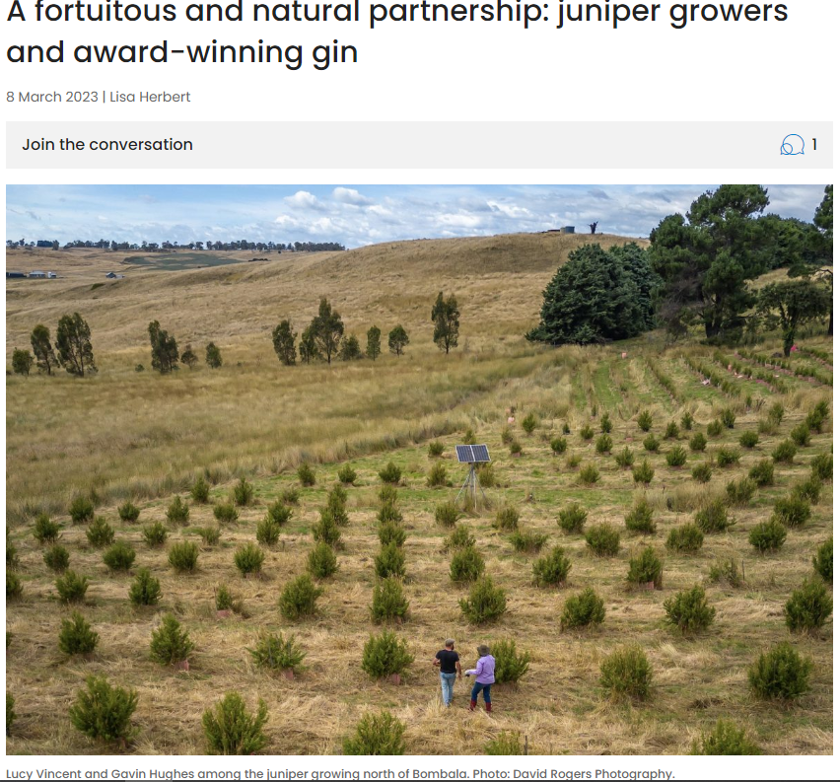
Meanwhile, in Australia…
https://aboutregional.com.au/a-fortuitous-and-natural-partnership-juniper-growers-and-award-winning-gin/

Slide 50
Where to from here?
We’ll be figuring that out soon….. Over a drink or two ☺
E.Kawana-Brown@massey.ac.nz
021 881 245

